Slide 1
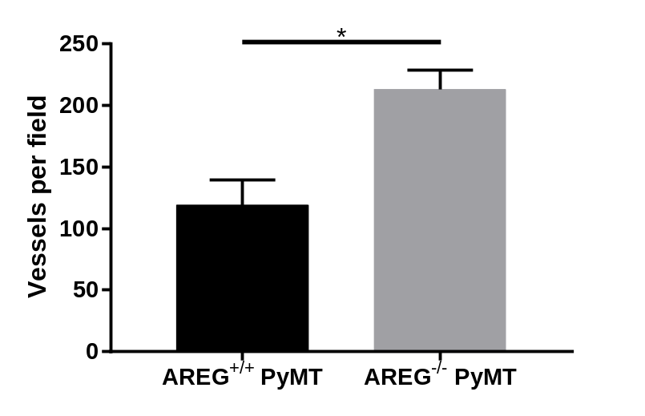
Supplementary figure 5
A
B
CD31
AREG^{+/+} PyMT
AREG^{-/-} PyMT

