Slide 1
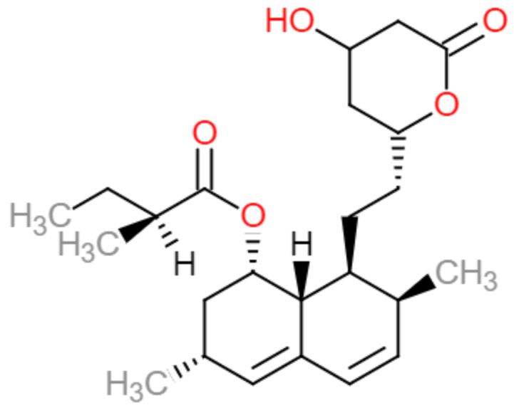

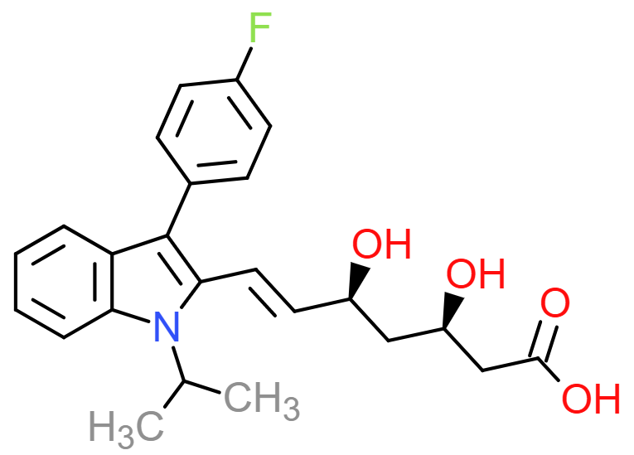
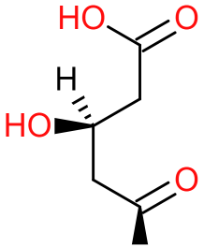
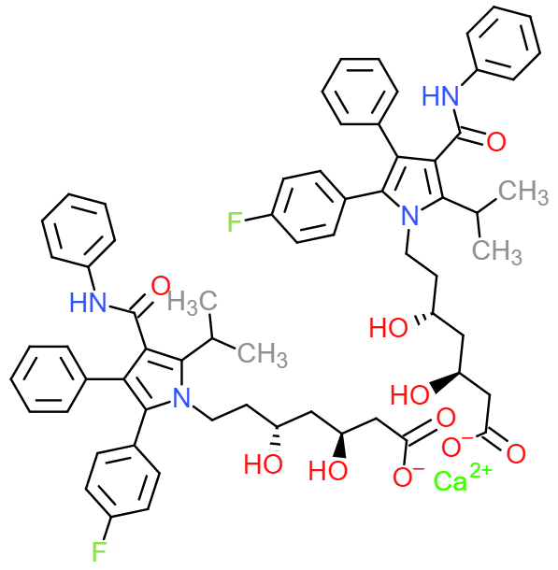
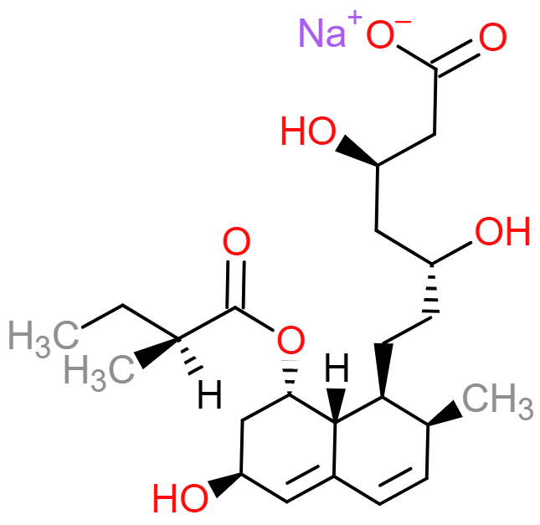
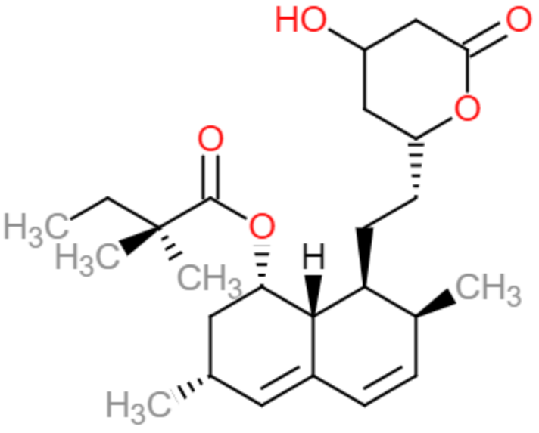
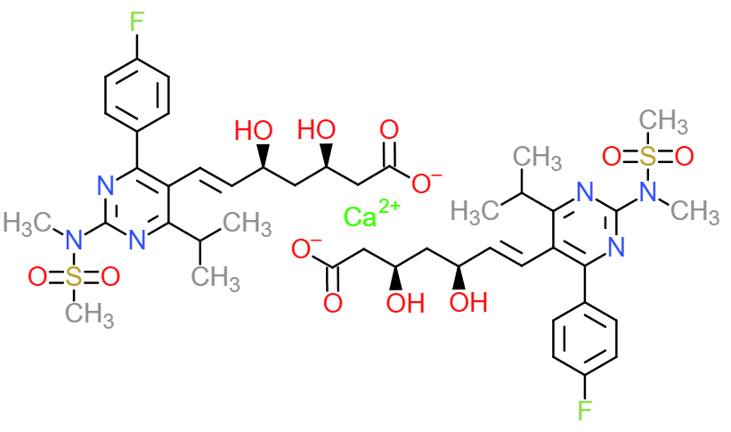
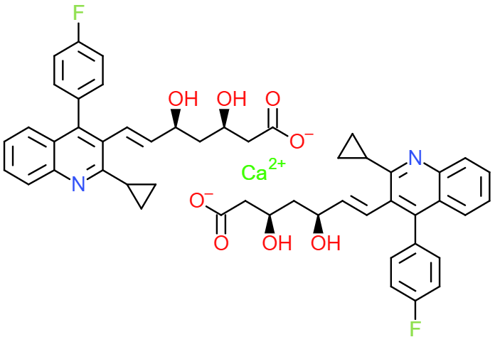
Lovastatin (1987)
Compactin
Fluvastatin (1993)
S-CoA
HMG-CoA
Simvastatin (1991)
Pravastatin (1991)
Atorvastatin (1996)
Rosuvastatin (2003)
Pitavastatin (2009)
Additional File 1.pptx: Chemical structures of HMG-CoA, compactin, and FDA-approved statins. The chemical structures of HMG-CoA, compactin, the first derived statin, and the seven FDA-approved statin drugs. Dates in parentheses indicate the initial approval date by the FDA, as according to their website²⁰¹. Drug structures were drawn using ChemDoodle Sketcher²⁰².

