Slide 1
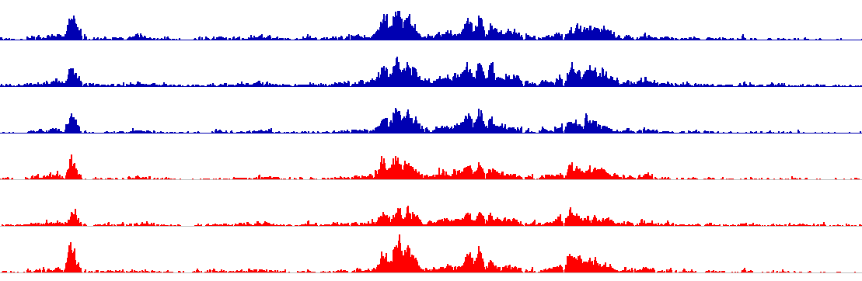
Figure S1. Example of a super-enhancer shared by BRCA1^{+/+} and BRCA1^{mut/+} HMECs
Chr. 9
132,230,000
132,240,000
132,250,000
132,260,000
132,270,000
SE
25
0
25
BRCA1^{+/+}
0
25
H3K27ac
0
25
0
25
BRCA1^{mut/+}
0
25
0
LINC00963

Slide 2
Figure S2. Quantification of H3K27ac in BRCA1^{185delAG/+} MCF10A cells
2.0
n.s.
1.5
H3K27ac/H3
1.0
0.5
0.0
WT1
WT2
Het1
Het2

Slide 3

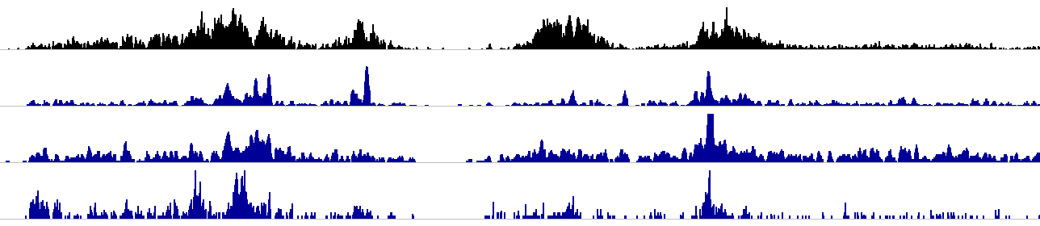
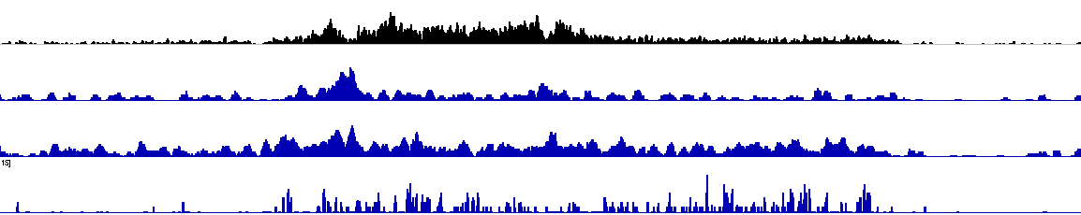
Figure S3. BRCA1 and CTCF ChIP-seq tracks
A
SE
CTCF
75
Left
Right
HMEC
0
H3K27ac
25
HMEC
0
50
HeLa
0
BRCA1
30
HepG2
0
20
MCF10A
0
SOD2
primer
WTAP
5kb
B
SE
H3K27ac
25
HMEC
0
30
HeLa
0
BRCA1
30
HepG2
0
15
MCF10A
1
primer
TNFAIP3
5kb

Slide 4
Figure S4. BRD4 level is not affected in BRCA1^{185delAG/+} MCF10A clones
A
B
n.s.
WT1
WT2
Het1
Het2
2.5
2.0
130 kD
BRD4
1.5
BRD4/α-Tubulin
1.0
55 kD
α-Tubulin
0.5
0.0
WT1
WT2
Het1
Het2

Slide 5
Figure S5. Lower BRD4-H3K27ac co-occupancy in BRCA1^{185delAG/+} MCF10A clones
A
SOD2 SE
B
TNFAIP3 SE
0.4
*
0.15
*
BRCA1^{+/+}
BRCA1^{+/+}
0.3
BRCA1^{185delAG/+}
0.10
BRCA1^{185delAG/+}
Relative ChIP-re-ChIP signal
Relative ChIP-re-ChIP signal
0.2
*
*
0.1
0.05
0.0
WT1
Het1
WT1
Het1
WT1
Het1
0.0
WT1
Het1
WT1
Het1
WT1
Het1
WT2
Het2
WT2
Het2
WT2
Het2
WT2
Het2
WT2
Het2
WT2
Het2
ChIP:
re-ChIP:
BRD4
IgG
BRD4
BRD4
BRD4
H3K27ac
ChIP:
re-ChIP:
BRD4
IgG
BRD4
BRD4
BRD4
H3K27ac

Slide 6
Figure S6. CTCF level is not affected in BRCA1^{185delAG/+} MCF10A clones
A
B
n.s.
WT1
WT2
Het1
Het2
2.0
1.5
130 kD
CTCF
CTCF/α-Tubulin
1.0
55 kD
α-Tubulin
0.5
0.0
WT1
WT2
Het1
Het2

Slide 7
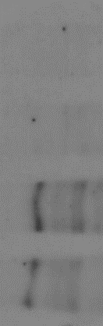
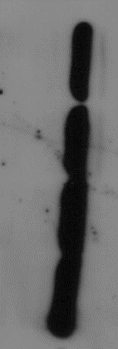
Figure S7. Lower WT BRCA1 expression in BRCA1^{185delAG/+} MCF10A clones
WT1
WT2
Het1
Het2
250 kD
BRCA1
55 kD
α-Tubulin

