Slide 1
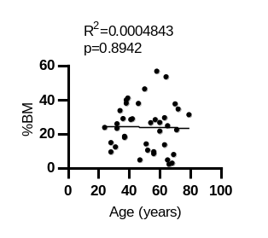
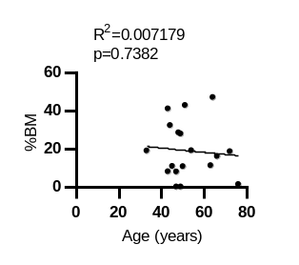
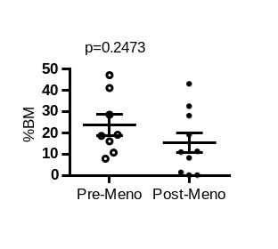
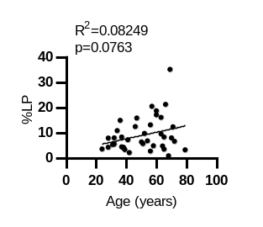
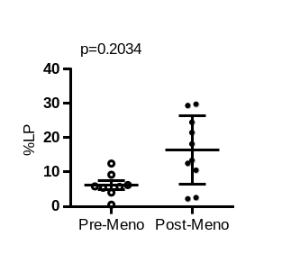
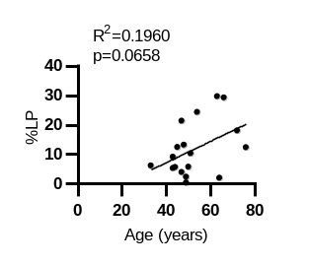
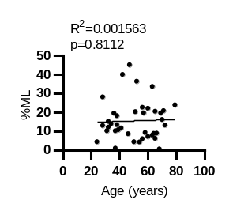
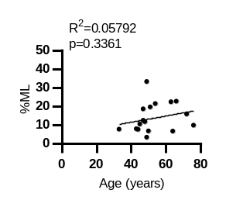
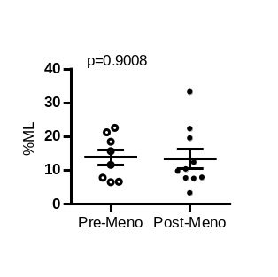
Supplementary Figure 2: Frequency of epithelial cell populations in the mammary gland from women with varied age
CHTN
UT Control
A
B
C
D
E
F
G
H
I
Supplementary Figure 2: Frequency of epithelial cell populations in the mammary gland from women with varied age.
Linear regression analysis showing changes in proportions of BM cells (A & B), LP cells (D & E), and ML cells (G & H) as a function of age for CHTN (n= 39 individuals) and local (UT Control) (n=18) patient samples. Panels C, F, and I show the distribution of the proportions of these three cell types in pre- (n=8) and post-menopausal (n=10) local patient samples with P values from unpaired t-tests. Each dot represents one patient.

