Slide 1
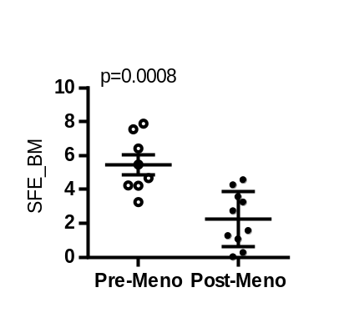
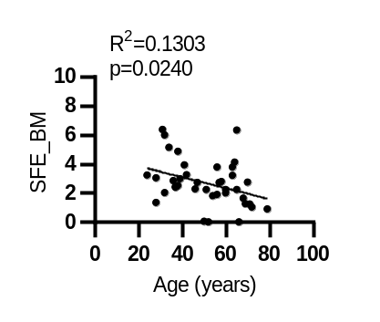
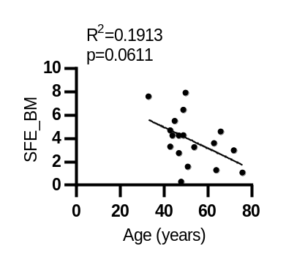
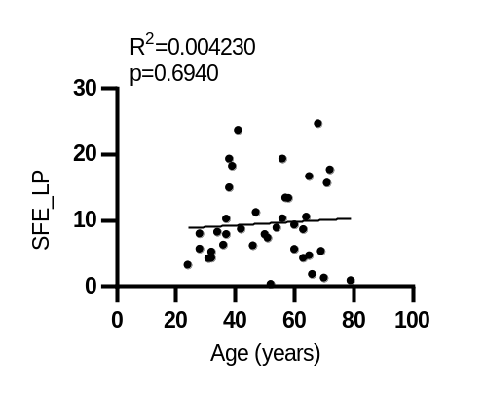
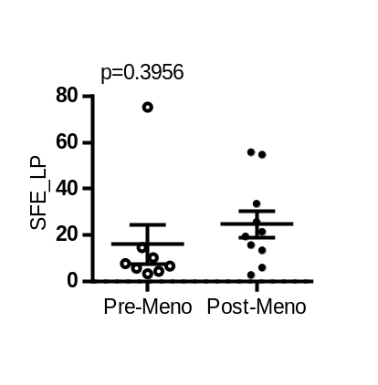
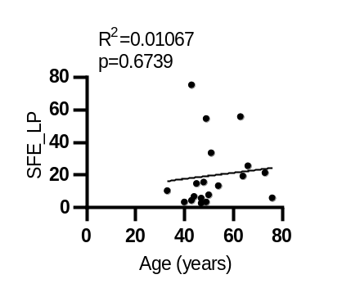
Supplementary Figure 3: SFE of BM and LP cells from women with varied age
CHTN
UT Control
A
B
C
D
E
F
Supplementary Figure 3: SFE of BM and LP cells from women with varied age.
Linear regression showing the SFE of BM cells in CHTN and local samples (A & B) from FACS sorting of epithelial populations as a function of age for CHTN (n= 39 individuals) and local samples (n=18). SFE values of pre vs post-menopausal derived tissue are also shown (n= 8, 10) and differences calculated with unpaired t-test (C). LP SFEs are shown as a function of age (D & E) for both data sets (n=39,18) and as a function of menopausal status (F).

