Slide 1
Full uncropped Gels and Blots images

Slide 2
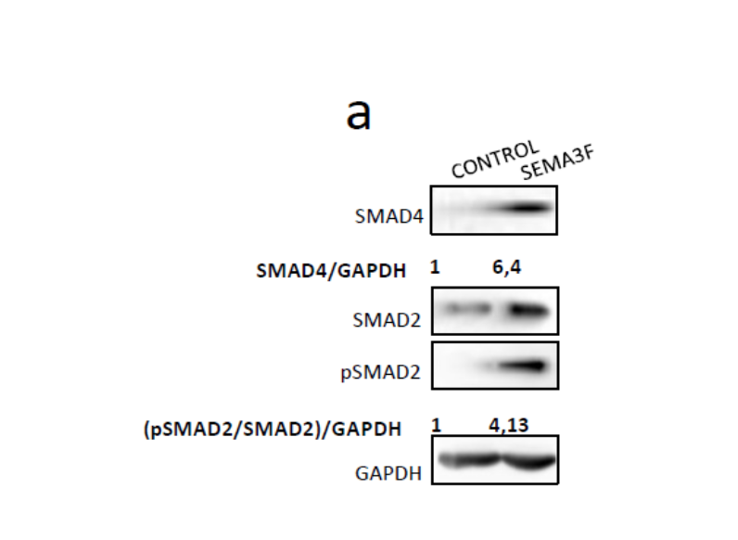
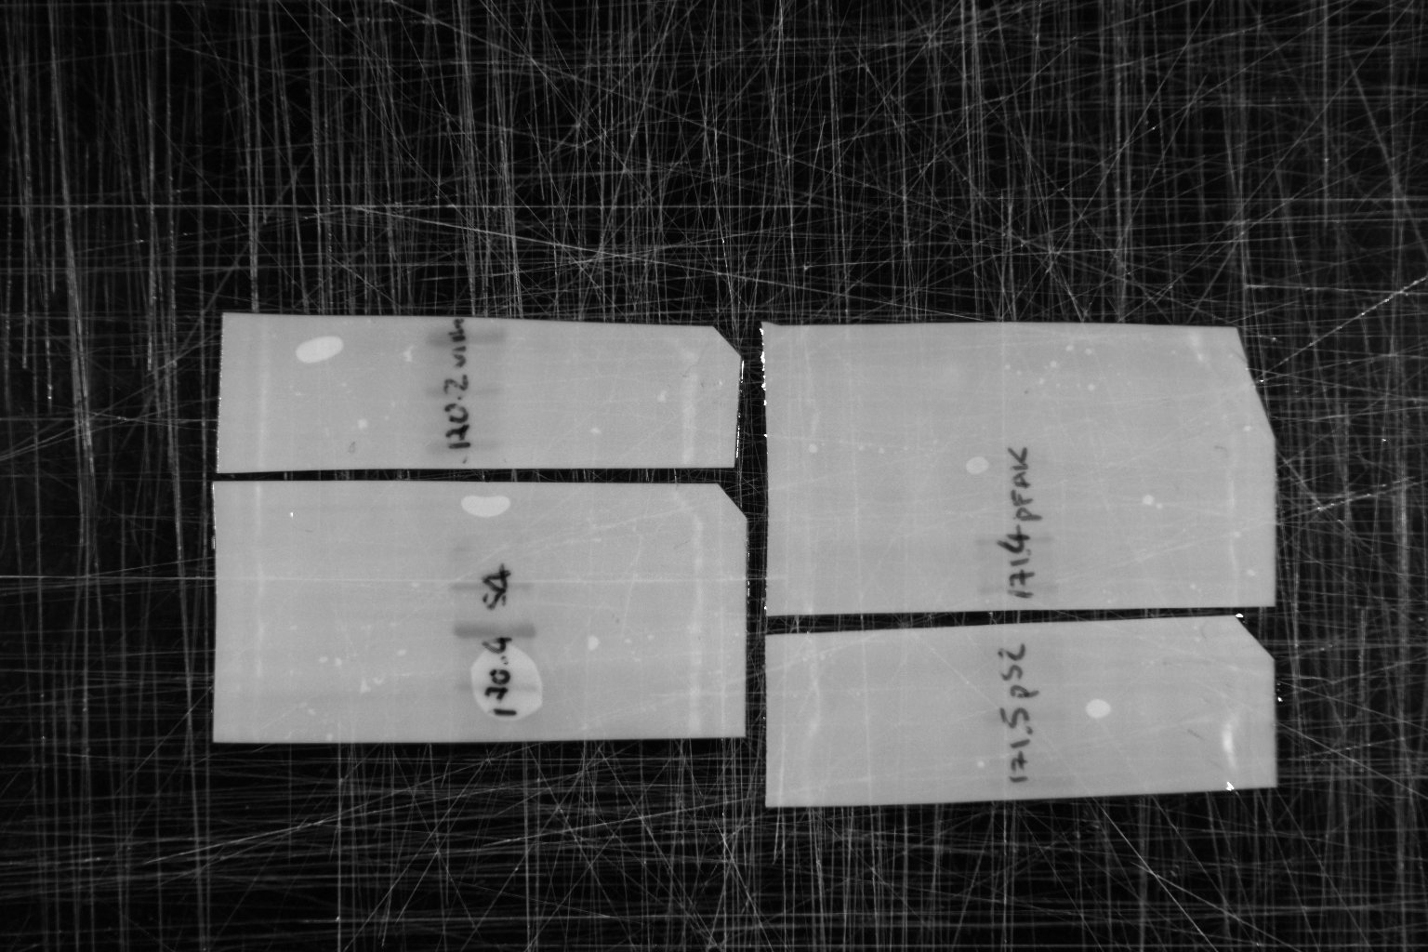
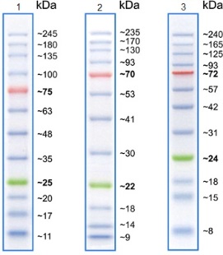
Figure 6A
SMAD4
CONTROL
SEMA3F
SMAD4
70 kDa
75
75
63
63

Slide 3
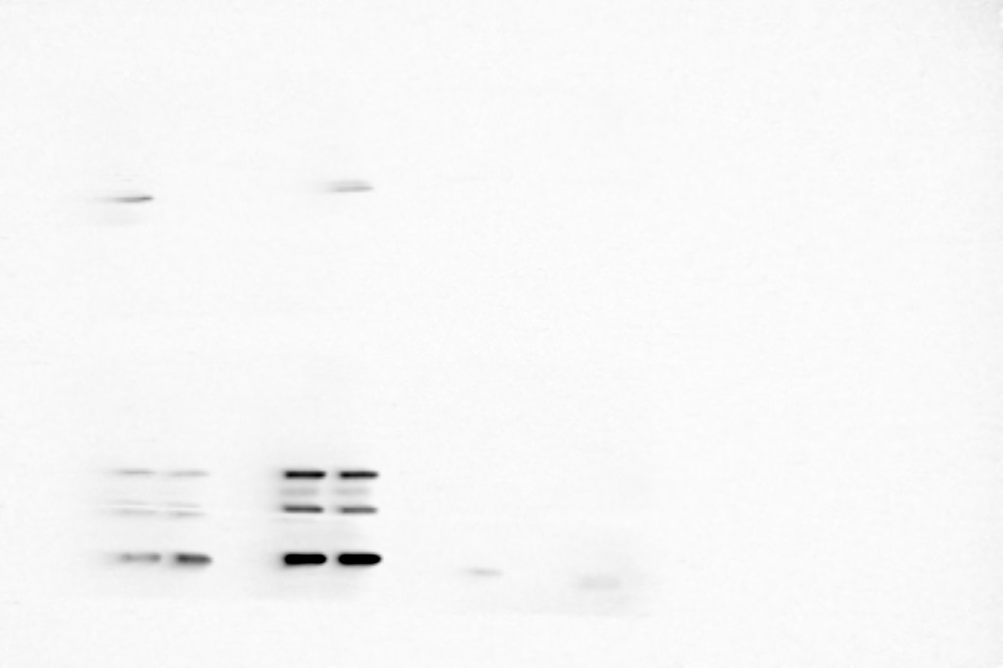
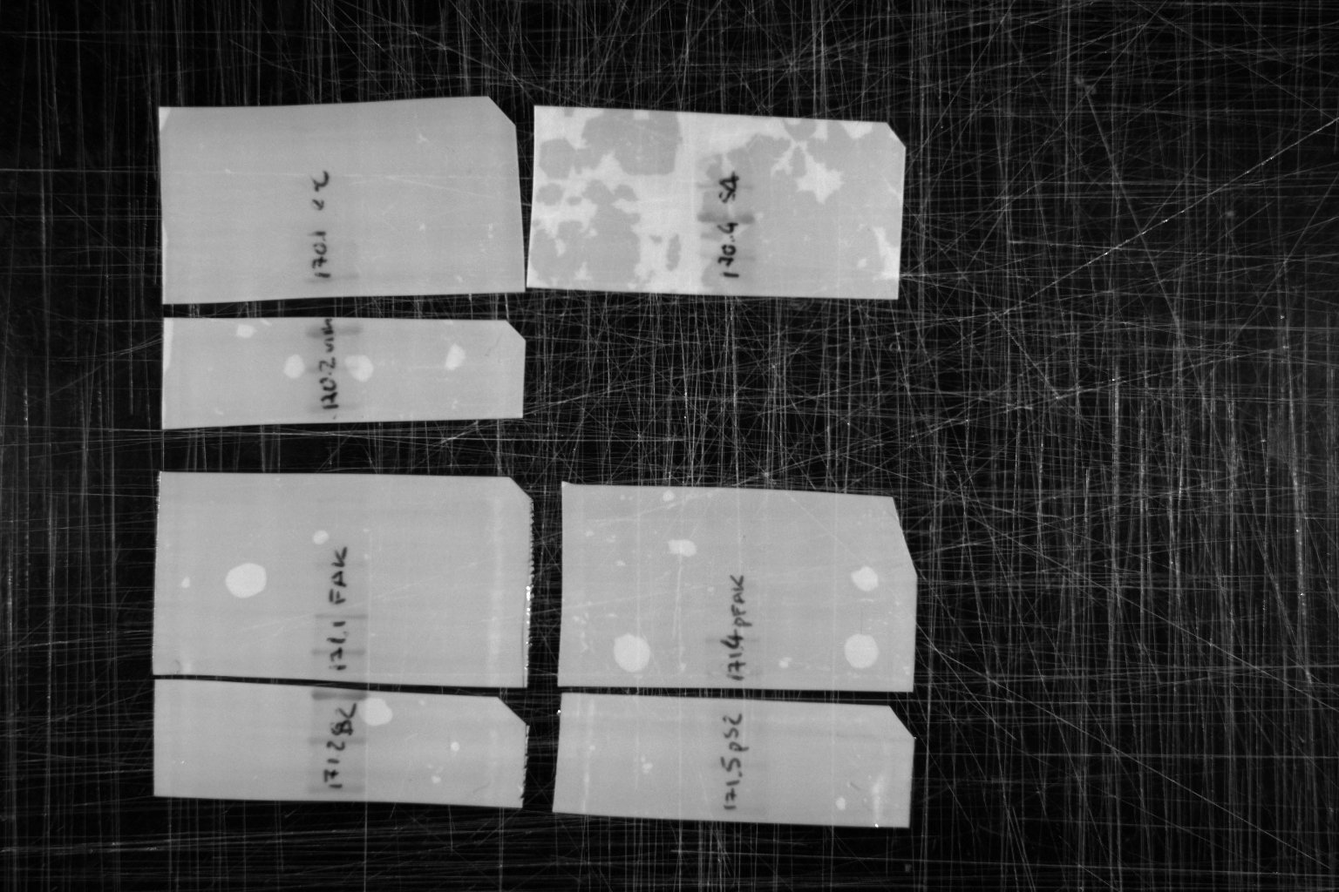
Figure 6A
SMAD/pSMAD2
CONTROL
CONTROL
SEMA3F
SEMA3F
CONTROL
SEMA3F
SEMA3F
CONTROL
135
75
75
100
135
SMAD2
60 kDa
63
pSMAD2
60 kDa
100
63
75
75
63
63

Slide 4
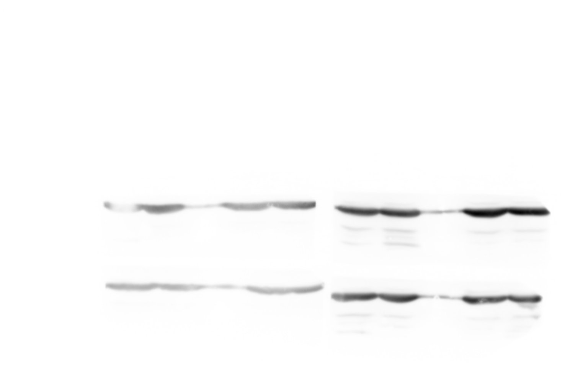
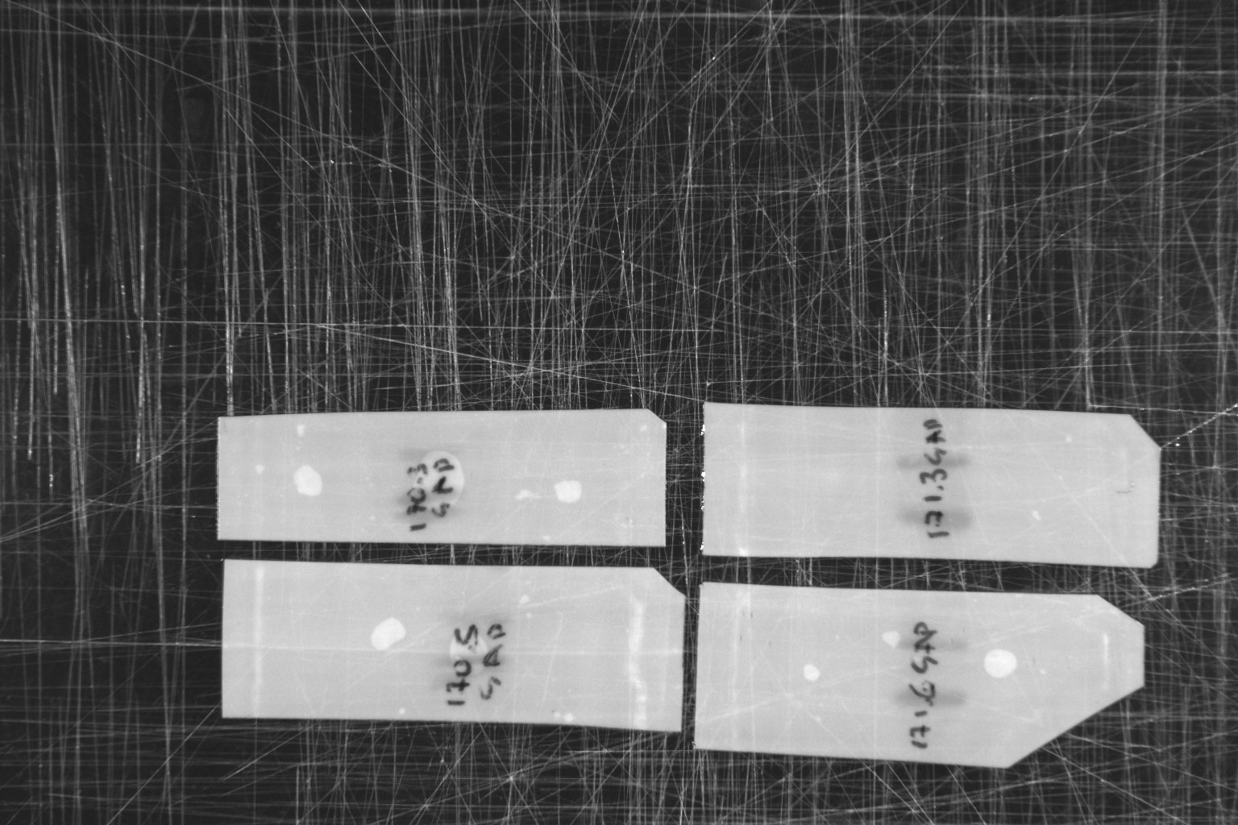
Figure 6A
GAPDH
CONTROL
SEMA3F
CONTROL
GAPDH
37 kDa
(of SMAD2)
CONTROL
SEMA3F
SEMA3F
CONTROL
GAPDH
37 kDa
(of pSMAD2)
SEMA3F
GAPDH
37 kDa
(of SMAD4

Slide 5
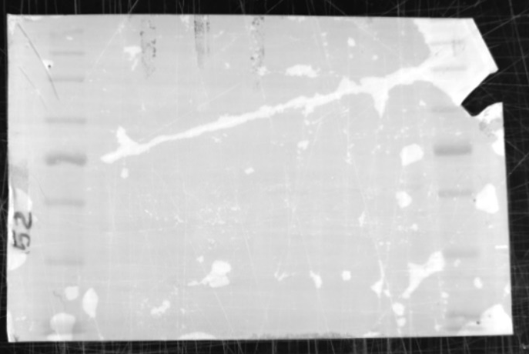
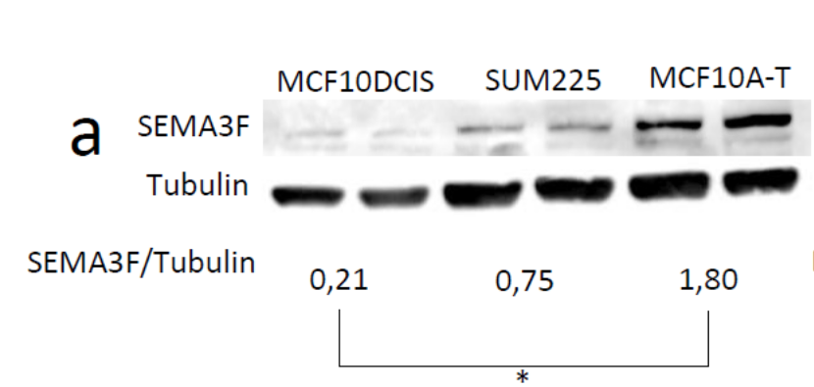
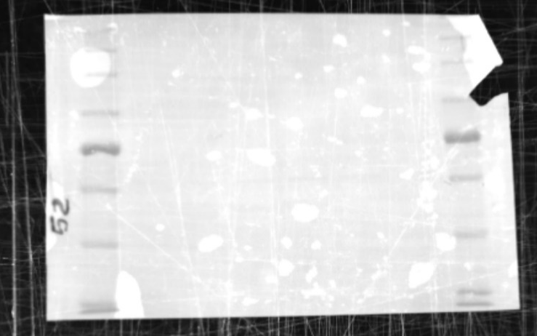
Supplementary Figure 2a
SEMA3F
Antibody used:
https://www.rndsystems.com/products/human-mouse-semaphorin-3f-antibody_af3237
MCF10DCIS
MCF10A-T
SUM225
100
SEMA3F 97 kDa
75
100
MCF10DCIS
MCF10A-T
SUM225
75
Tubulin 52kDa

Slide 6
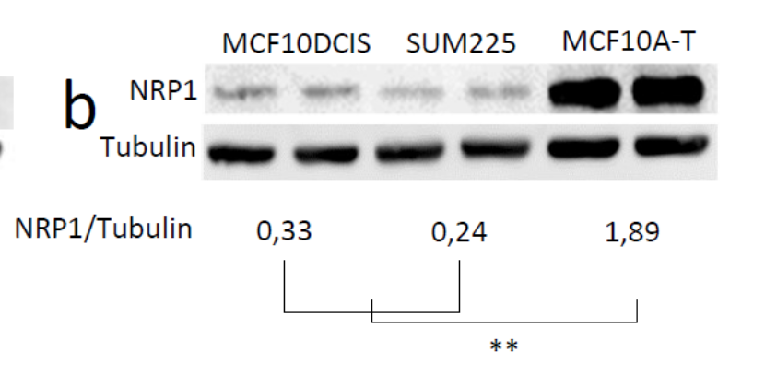
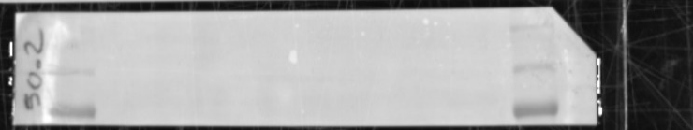
Supplementary Figure 2b
NRP1
MCF10DCIS
MCF10A-T
135
SUM225
100
NRP1 120 kDa
75
Tubulin 52kDa

Slide 7
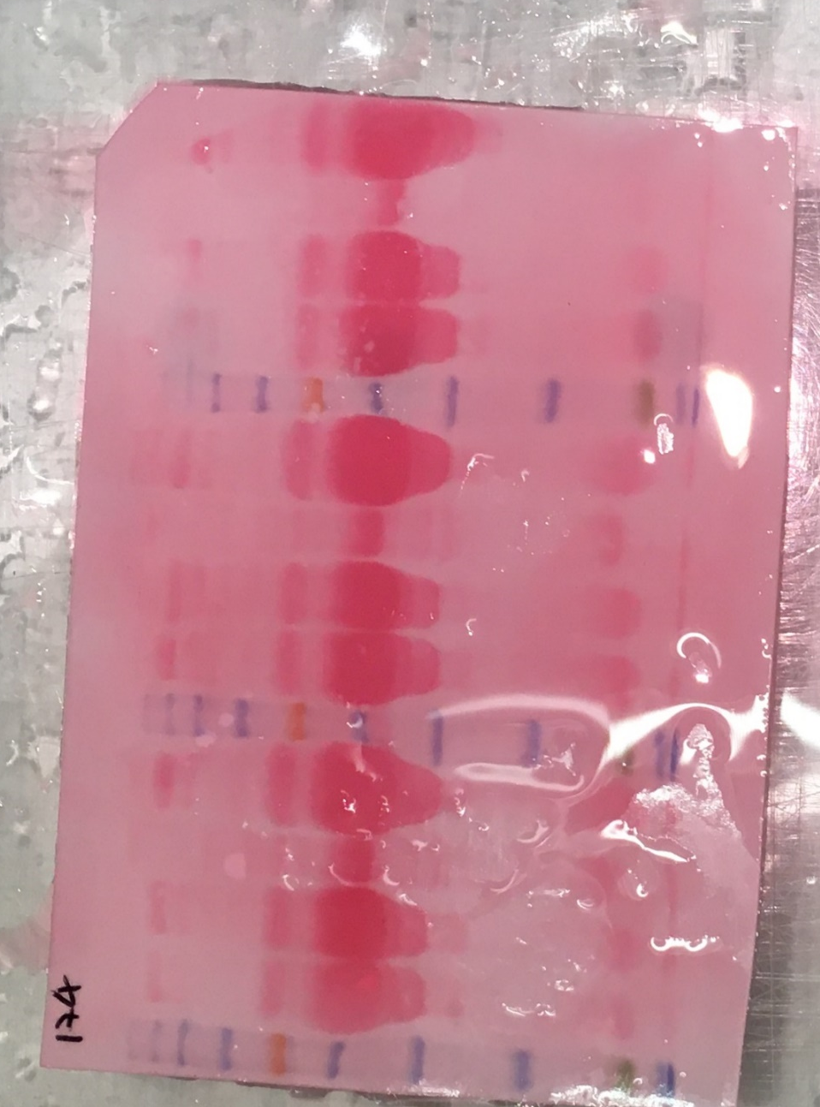
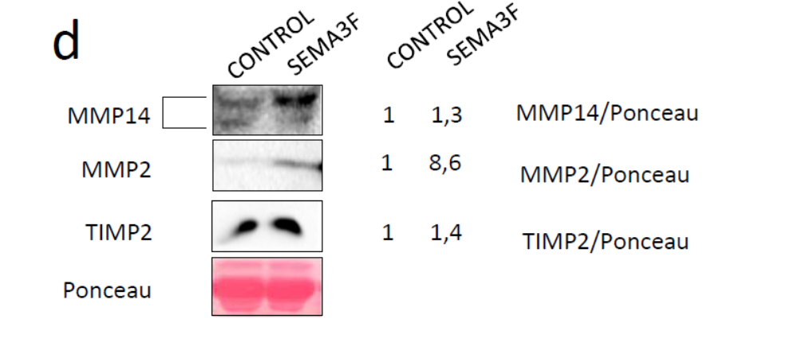
Supplementary Figure 3d
MMP14, MMP2, AND TIMP2
SEMA3F
SEMA3F
SEMA3F
CONTROL
CONTROL
CONTROL
135
100
75
63
48
35
25
MMP9
MMP14
MMP2
 | Gel nº 174
 | 10%
 |  | 1 | MMP9 | MW: 96 |  |  | 1 | MMP14 | MW: 50 - 62 |  | 3 | MMP2 | MW: 77

Slide 8
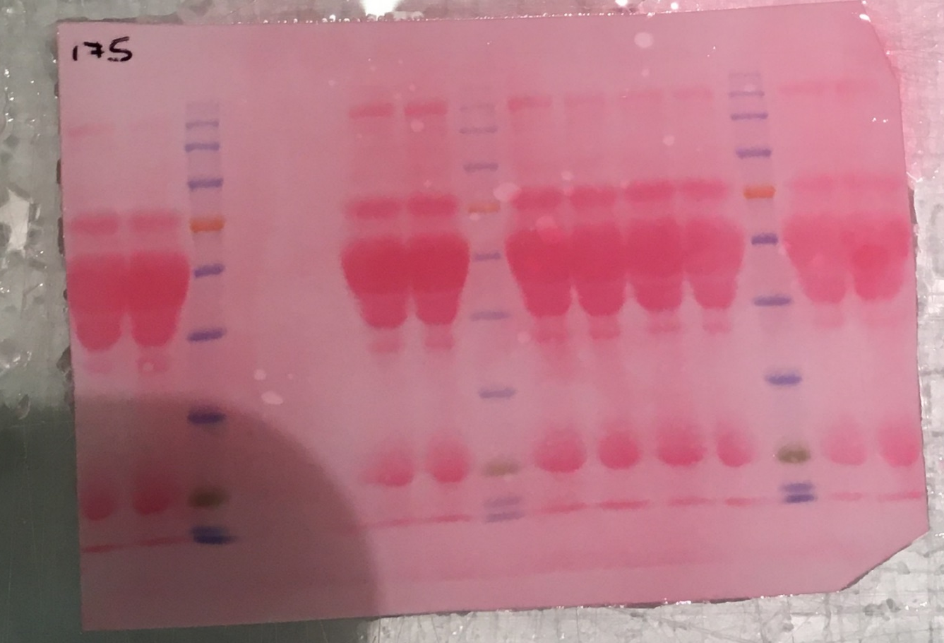
Supplementary Figure 3d
MMP14, MMP2, AND TIMP2
SEMA3F
SEMA3F
CONTROL
CONTROL
135
100
75
63
48
35
25
TIMP2
 | Gel nº 175
 |  | 2 | TIMP2 | MW: 22
 | 10%

Slide 9
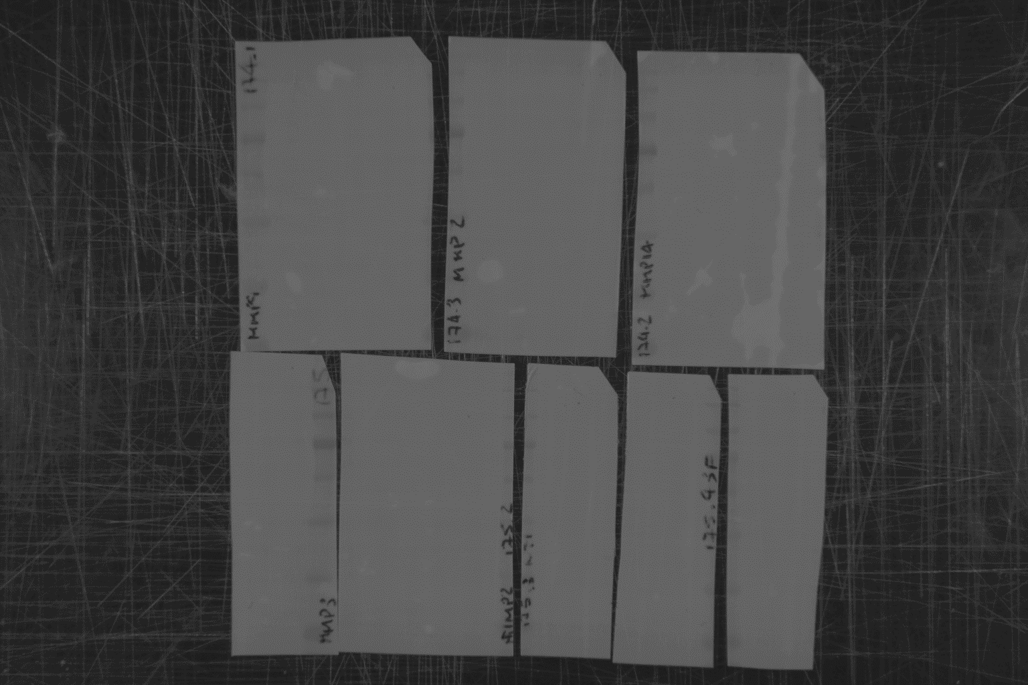
Supplementary Figure 3d
MMP14, MMP2, AND TIMP2
CONTROL
SEMA3F
CONTROL
SEMA3F
CONTROL
SEMA3F
CONTROL
SEMA3F

Slide 10
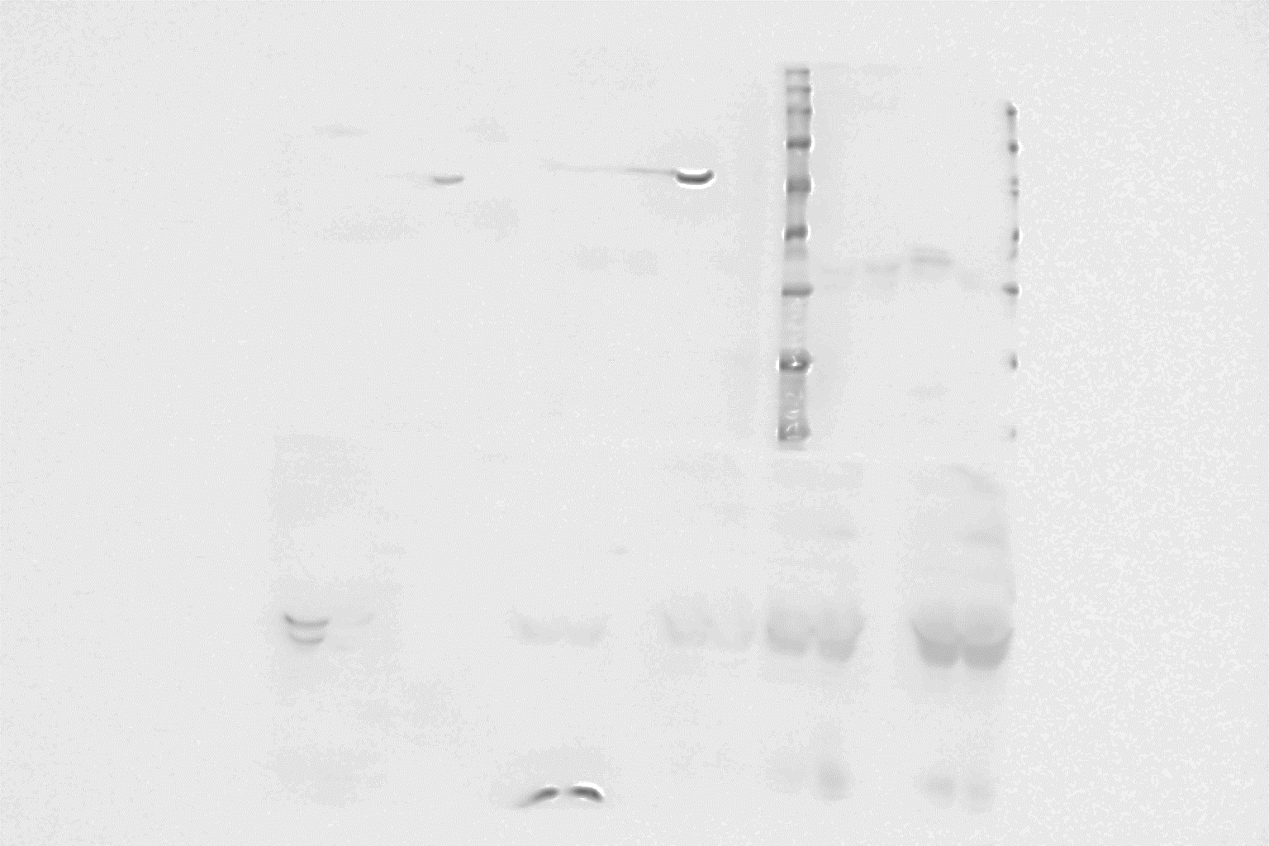
Supplementary Figure 3d
MMP14, MMP2, AND TIMP2
100
75
MMP9
96 kDa
MMP2
77kDa
63
48
MMP14
50-62 kDa
35
25
SEMA3F
CONTROL

Slide 11
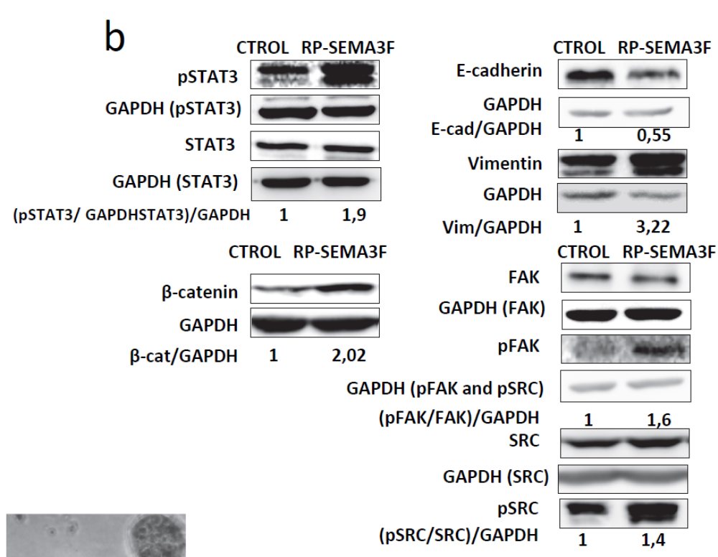
Supplementary Figure 4b

Slide 12
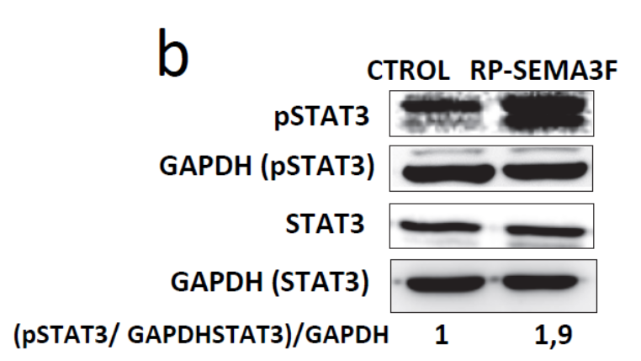
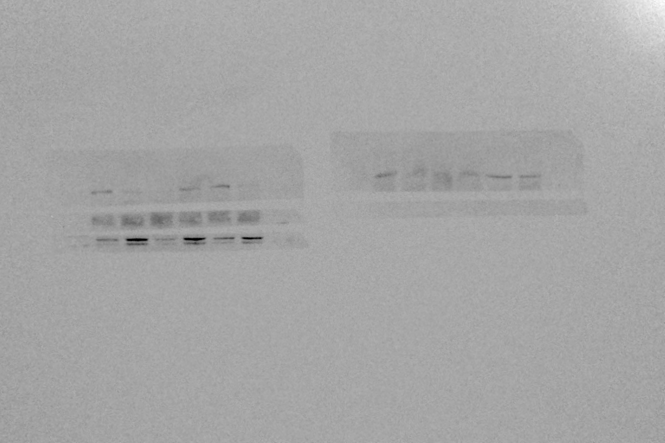
Supplementary Figure 4b
pSTAT3 and GAPDH (Membrane 101)
RP-SEMA3F
CTROL
75 kDa
pSTAT3
79-86kDa
RP-SEMA3F
CTROL
GAPDH
37 kDa

Slide 13
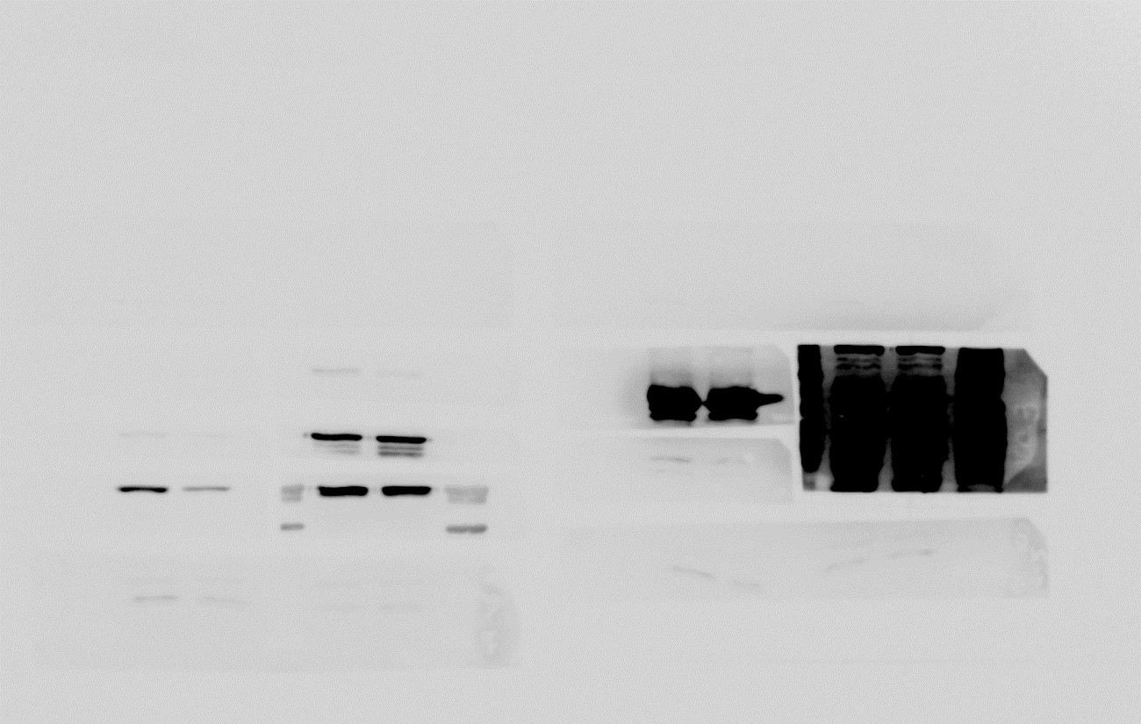
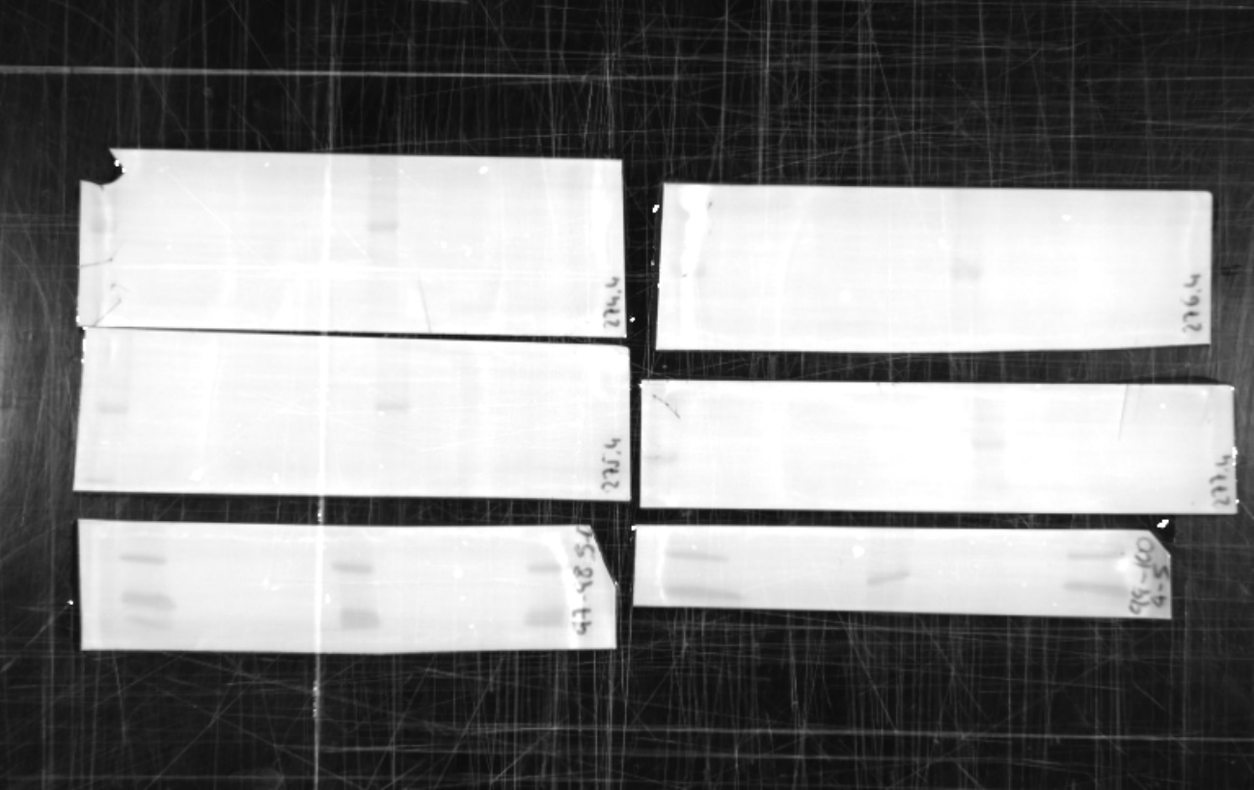
Supplementary Figure 4b
STAT3 (Membrane 98)
RP-SEMA3F
CTROL
RP-SEMA3F
STAT3
79-86kDa
CTROL

Slide 14
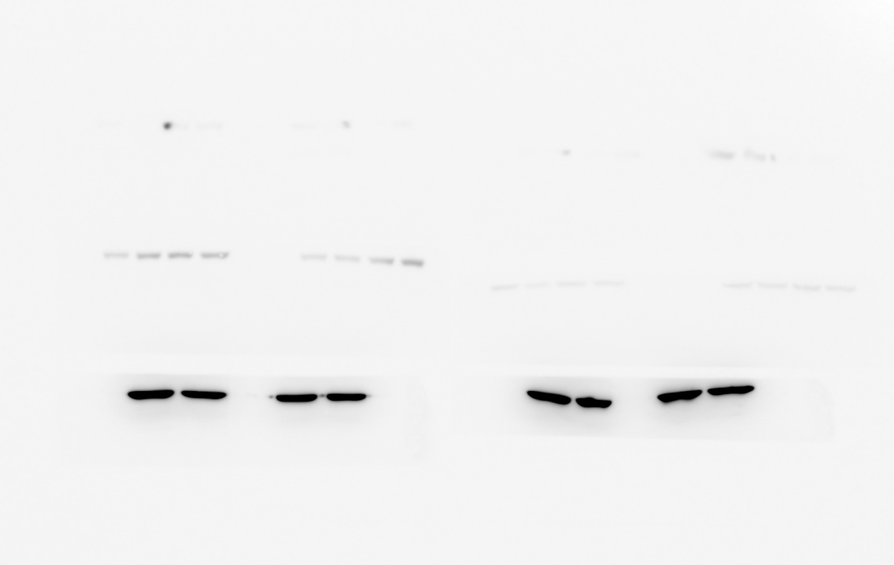
Supplementary Figure 4b
GAPDH STAT3 (Membrane 98)
CTROL
RP-SEMA3F
GAPDH
37 kDa

Slide 15
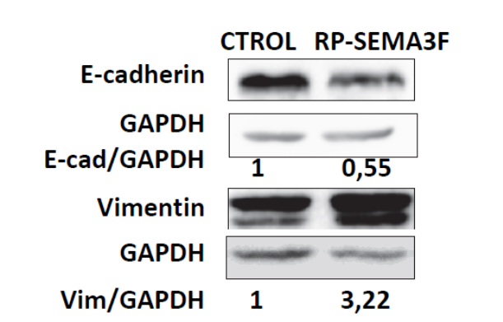
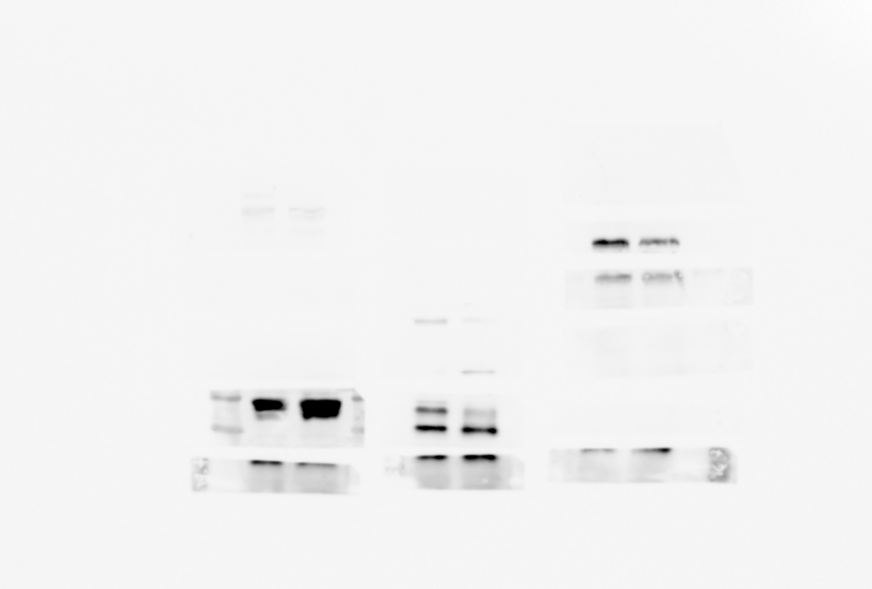
 | Membrane 96
Supplementary Figure 4b
E-cadherin (Membrane 96)
RP-SEMA3F
CTROL
RP-SEMA3F
CTROL
e-cadherin
135 kDa

Slide 16
 | Membrane 96
Supplementary Figure 4b
GAPDH for E-cadherin (Membrane 96)
GAPDH
37 kDa

Slide 17
Supplementary Figure 4b
Vimentin (Membrane 66)
RP-SEMA3F
RP-SEMA3F
CTROL
CTROL
Vimentin
57 kDa

Slide 18
Supplementary Figure 4b
GAPDH for Vimentin (Membrane 66)
RP-SEMA3F
CTROL
GAPDH
37 kDa

Slide 19
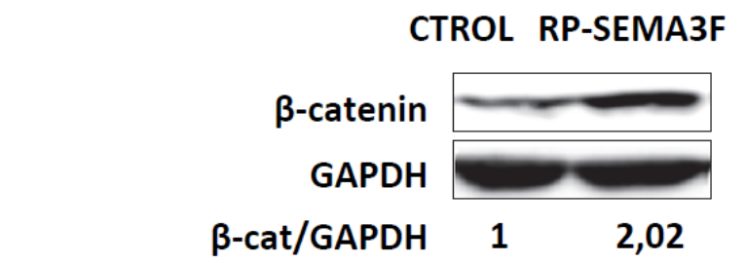
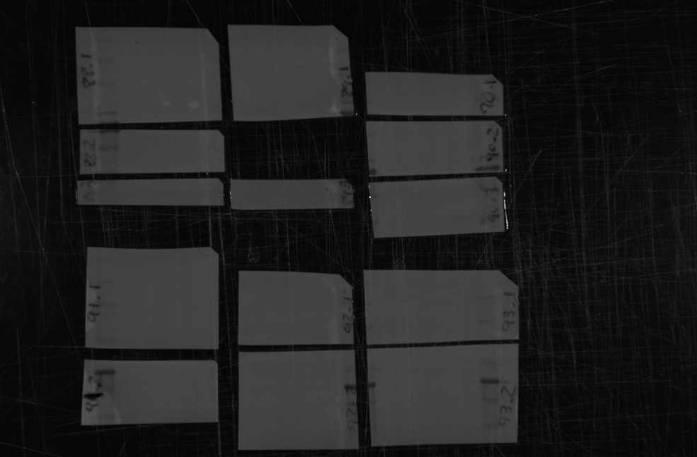
Supplementary Figure 4b
Beta catenin (Membrane 90)
RP-SEMA3F
RP-SEMA3F
CTROL
CTROL
β-catenin
92 kDa
RP-SEMA3F
CTROL
RP-SEMA3F
CTROL
GAPDH
37 kDa

Slide 20
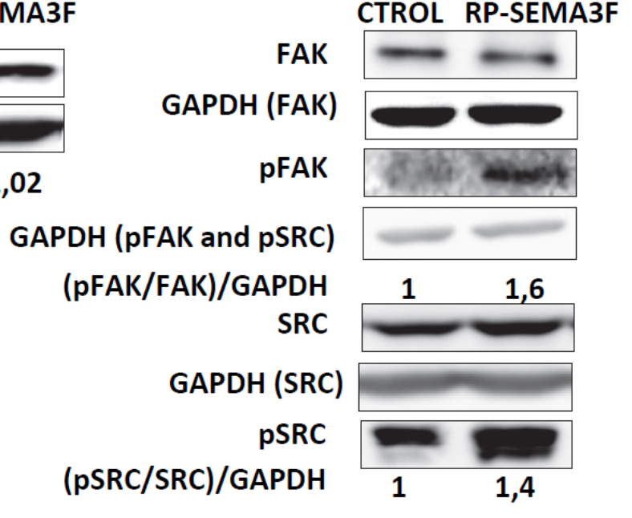

Supplementary Figure 4b
FAK and GAPDH for FAK (Membrane 95)
RP-SEMA3F
CTROL
FAK
125 kDa
RP-SEMA3F
RP-SEMA3F
CTROL
CTROL
GAPDH
37 kDa
GAPDH
37 kDa

Slide 21
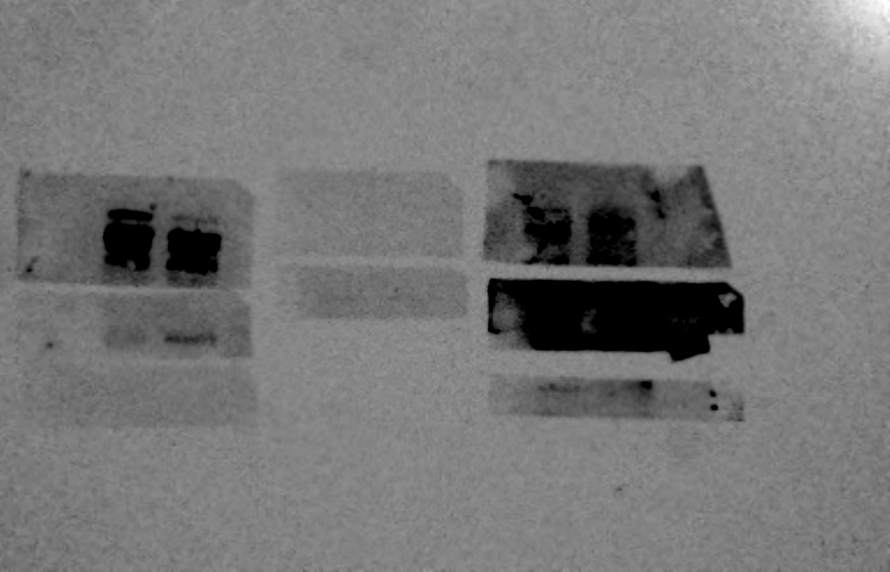
Supplementary Figure 4b
pFAK and pSRC (Membrane 94)
RP-SEMA3F
CTROL
RP-SEMA3F
CTROL
pFAK
125 kDa
pFAK
125 kDa
RP-SEMA3F
RP-SEMA3F
CTROL
CTROL
pSRC
60 kDa
pSRC
60 kDa

Slide 22
Supplementary Figure 4b
GAPDH for pFAK and pSRC (Membrane 94)
RP-SEMA3F
CTROL
GAPDH
37 kDa
RP-SEMA3F
CTROL
GAPDH
37 kDa

Slide 23
Supplementary Figure 4b
SRC AND GAPDH FOR SRC (Membrane 94)
RP-SEMA3F
RP-SEMA3F
CTROL
CTROL
RP-SEMA3F
RP-SEMA3F
CTROL
CTROL
Src
60 kDa
RP-SEMA3F
CTROL
RP-SEMA3F
CTROL
GAPDH
37 kDa

Slide 24
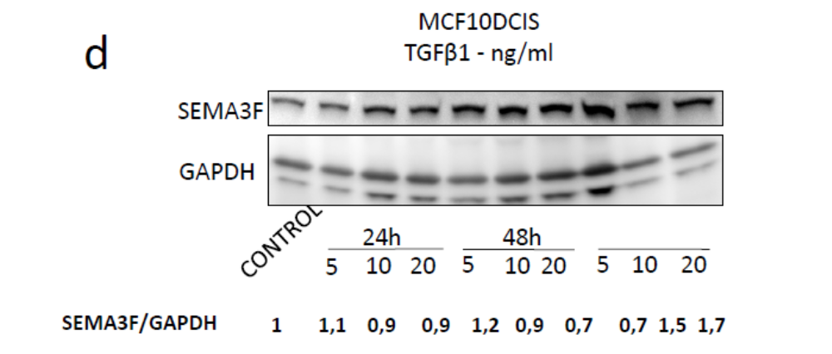
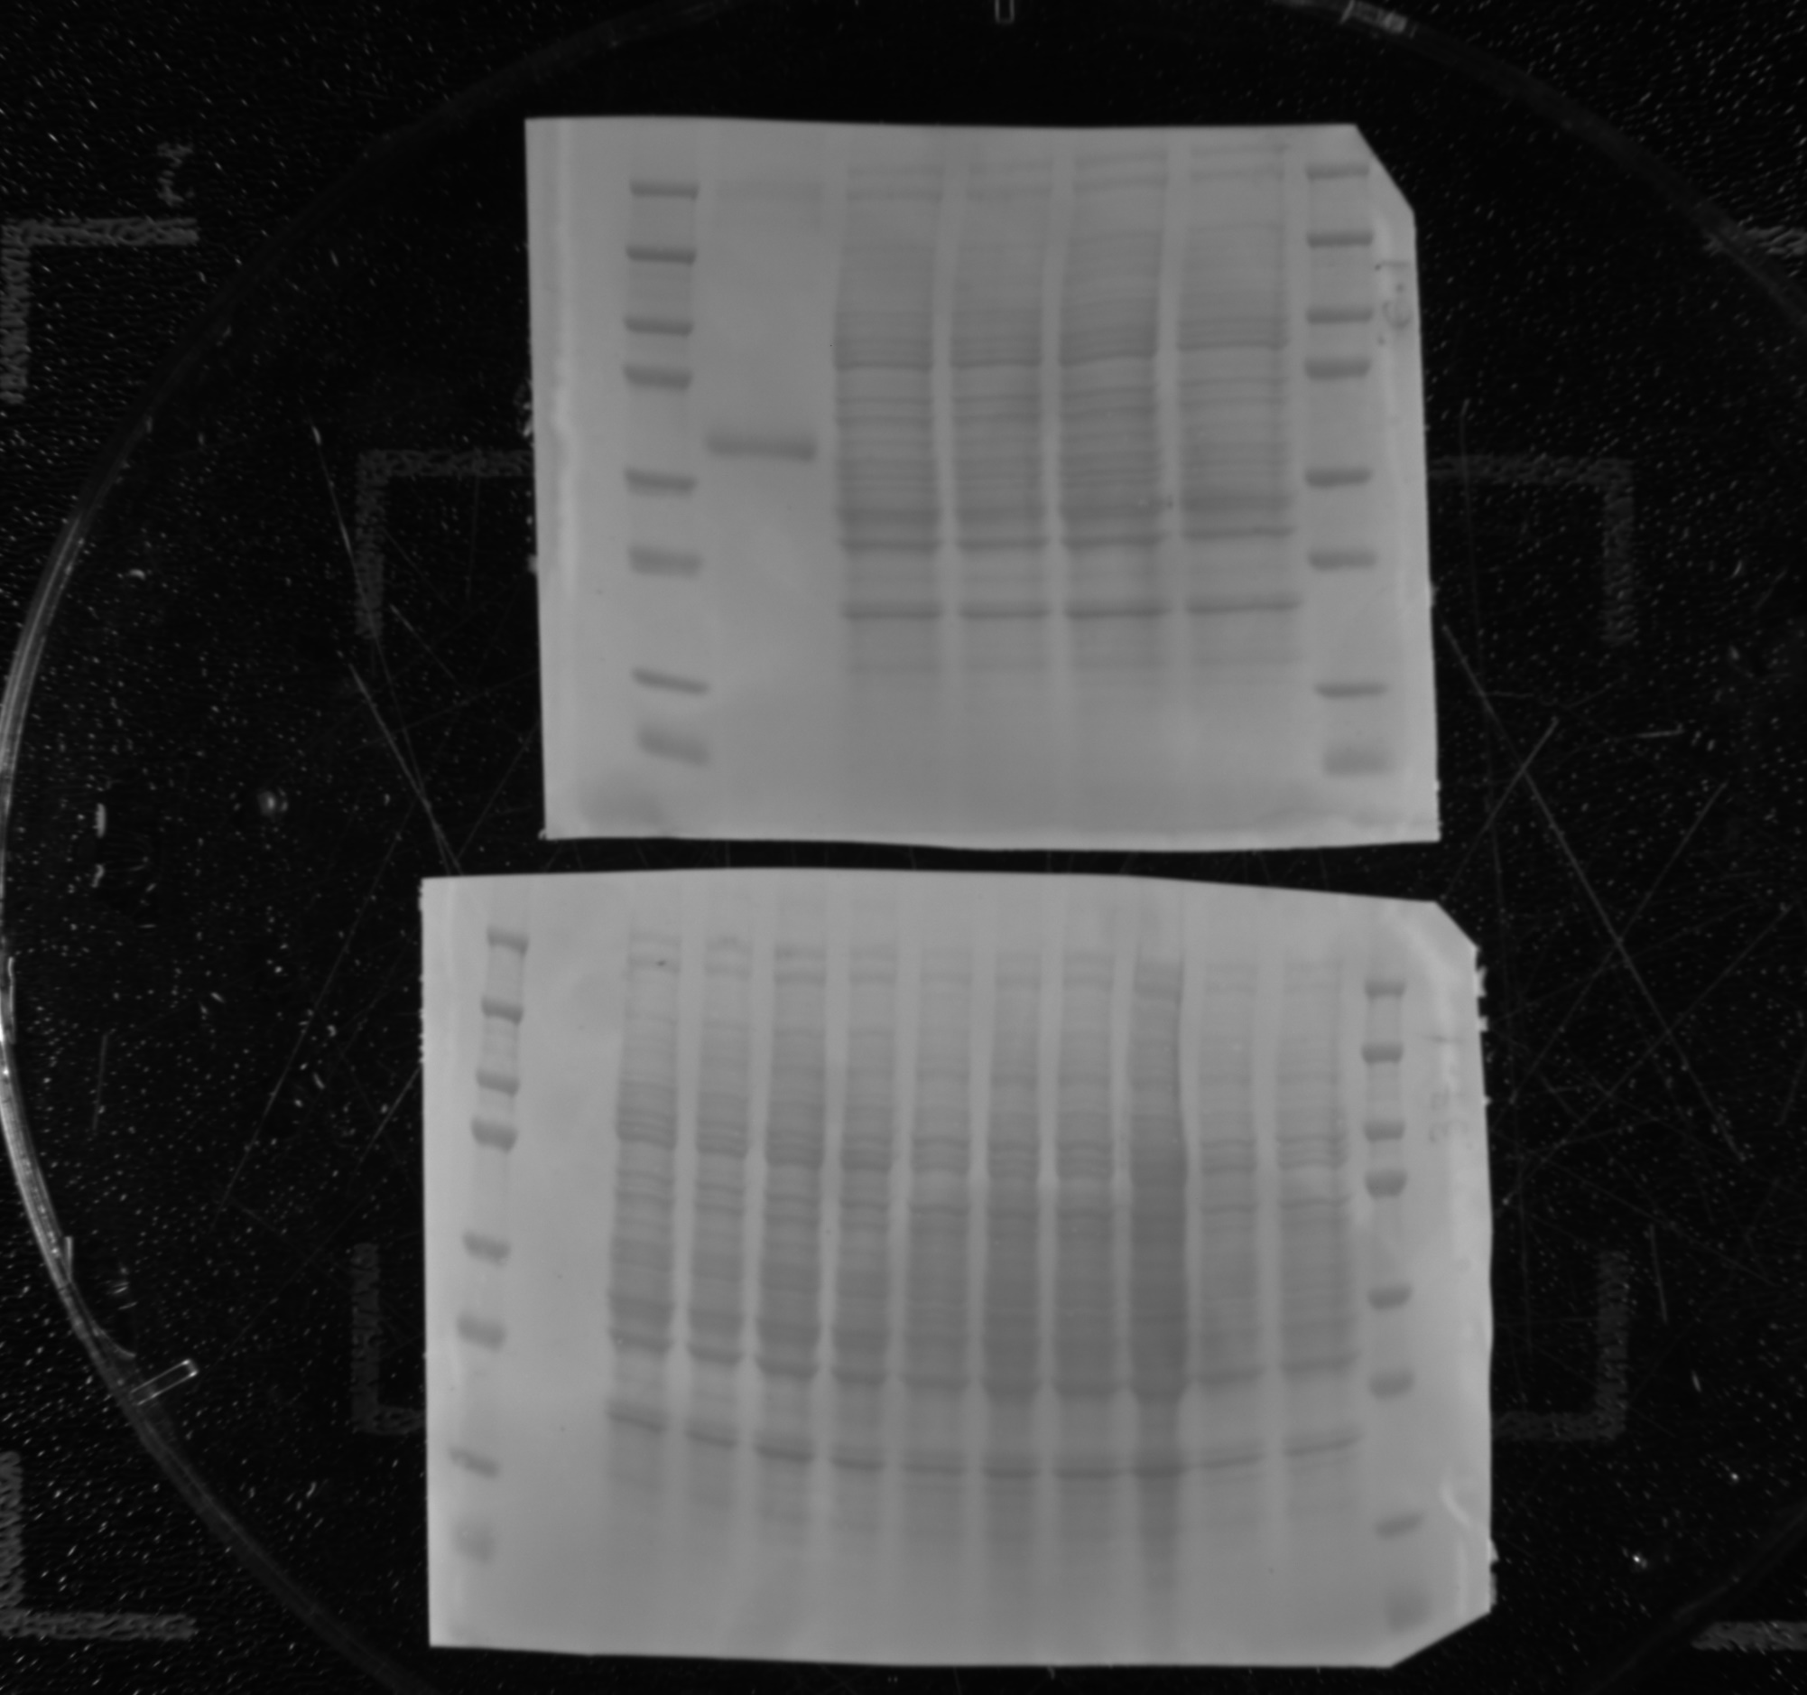
Supplementary Figure 4d
SRC AND GAPDH FOR SRC (Membrane 94)
Antibody used:
https://datasheets.scbt.com/sc-68795.pdf
A Upper part
B Bottom part

Slide 25
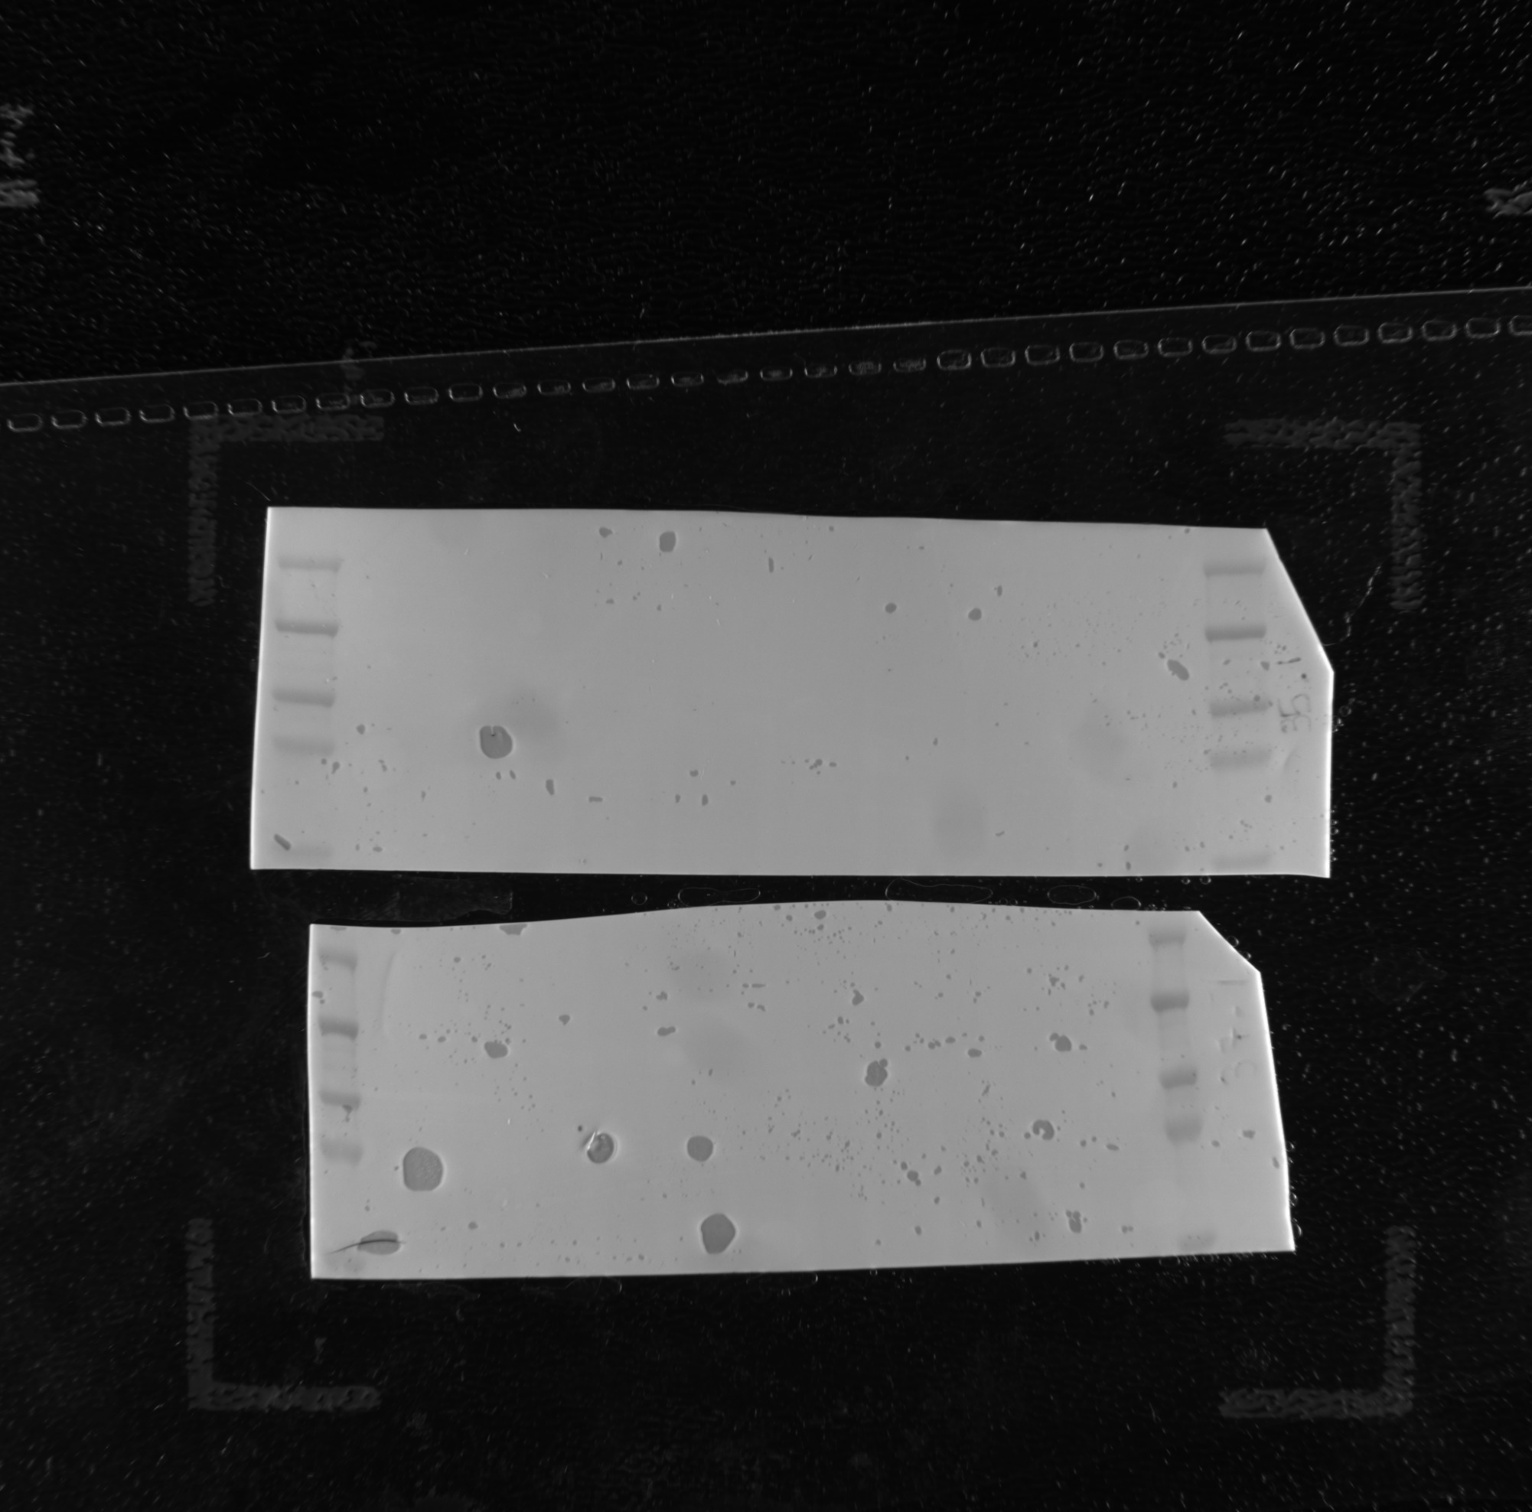
Supplementary Figure 4d
SEMA3F and GAPDH
Antibody used:
https://datasheets.scbt.com/sc-68795.pdf
CONTROL
48h
72h
24h
5
10
20
10
5
20
5
20
10
SEMA3F
88 kDa
A Upper part
CONTROL
48h
72h
24h
5
10
20
10
5
20
5
20
10
GAPDH
37 kDa
B Bottom part

Slide 26
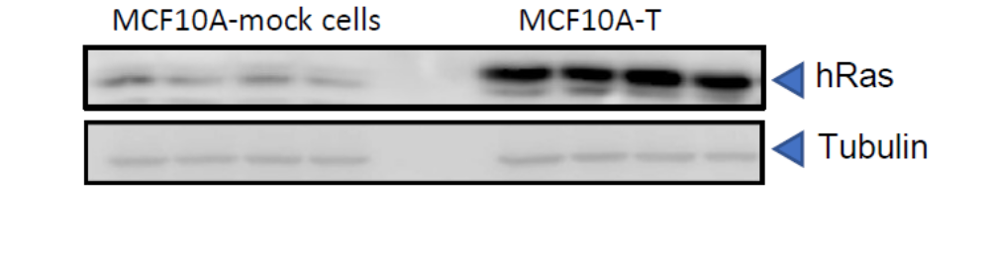
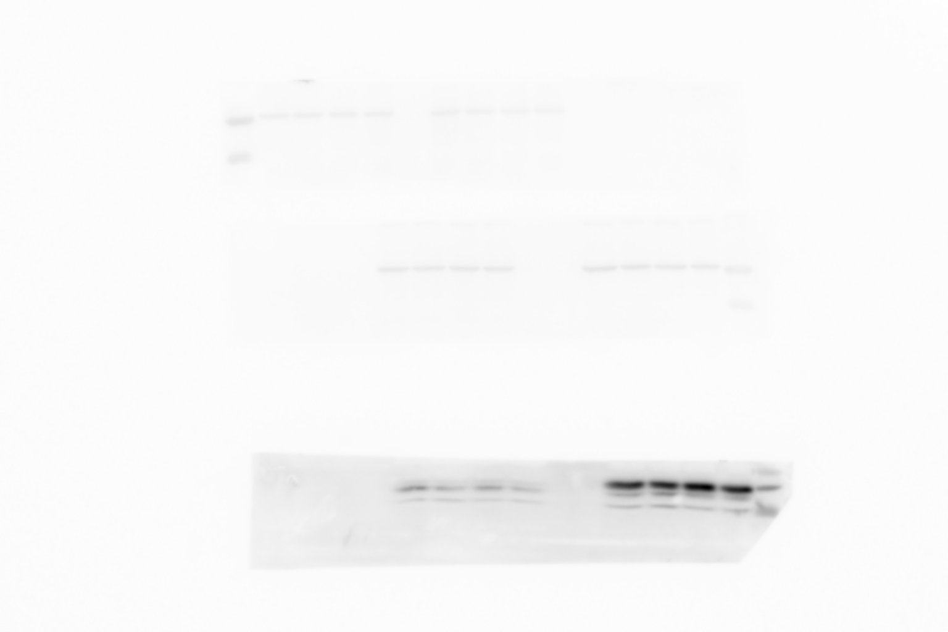

Supplementary Figure 5 B
MCF10A-T
Less exposition
More exposition
MCF10A-mock cells
MCF10A-T
Tubulin
52KDa
48KDa band from Molecular weight marker
hRas
21 KDa
20 KDa
band from Molecular weight marker

