Slide 1
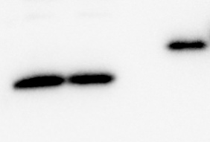
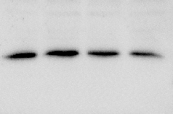


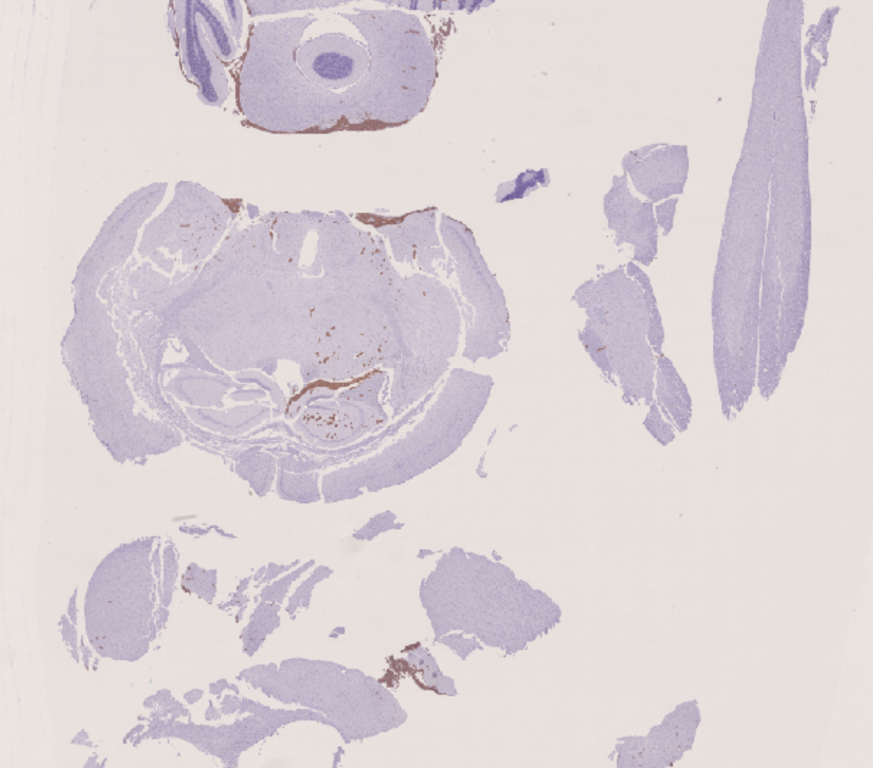
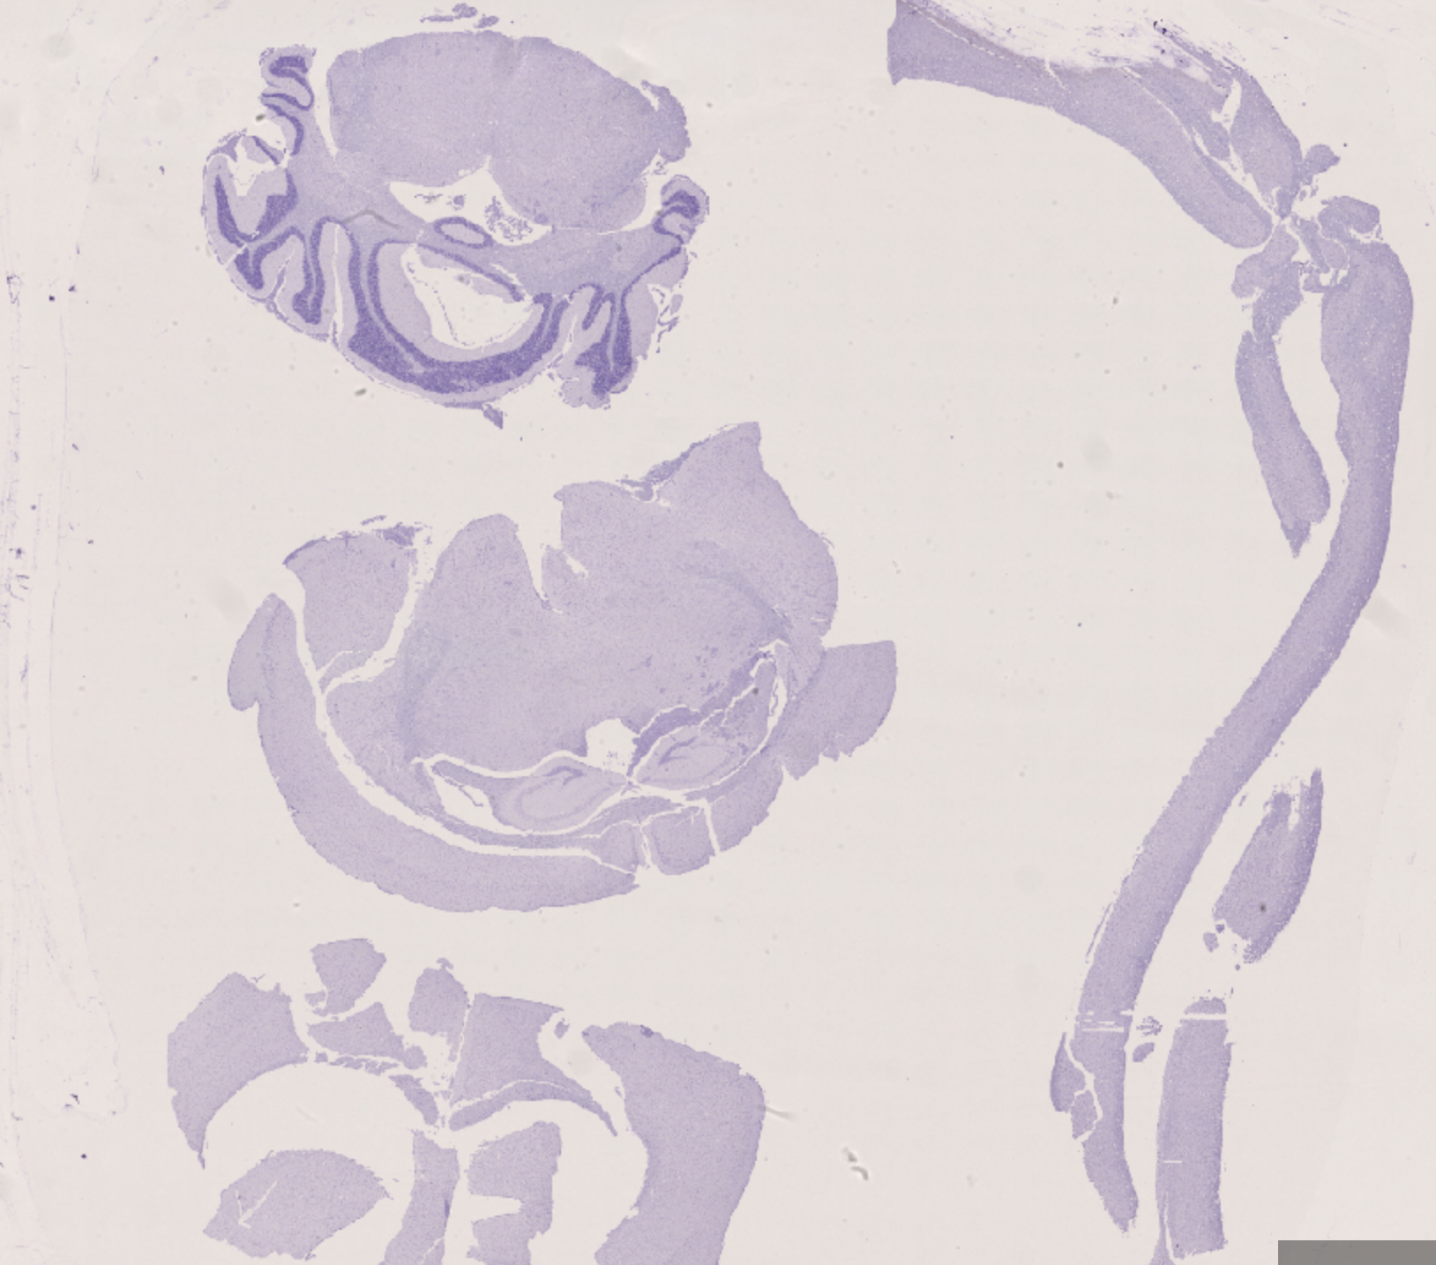
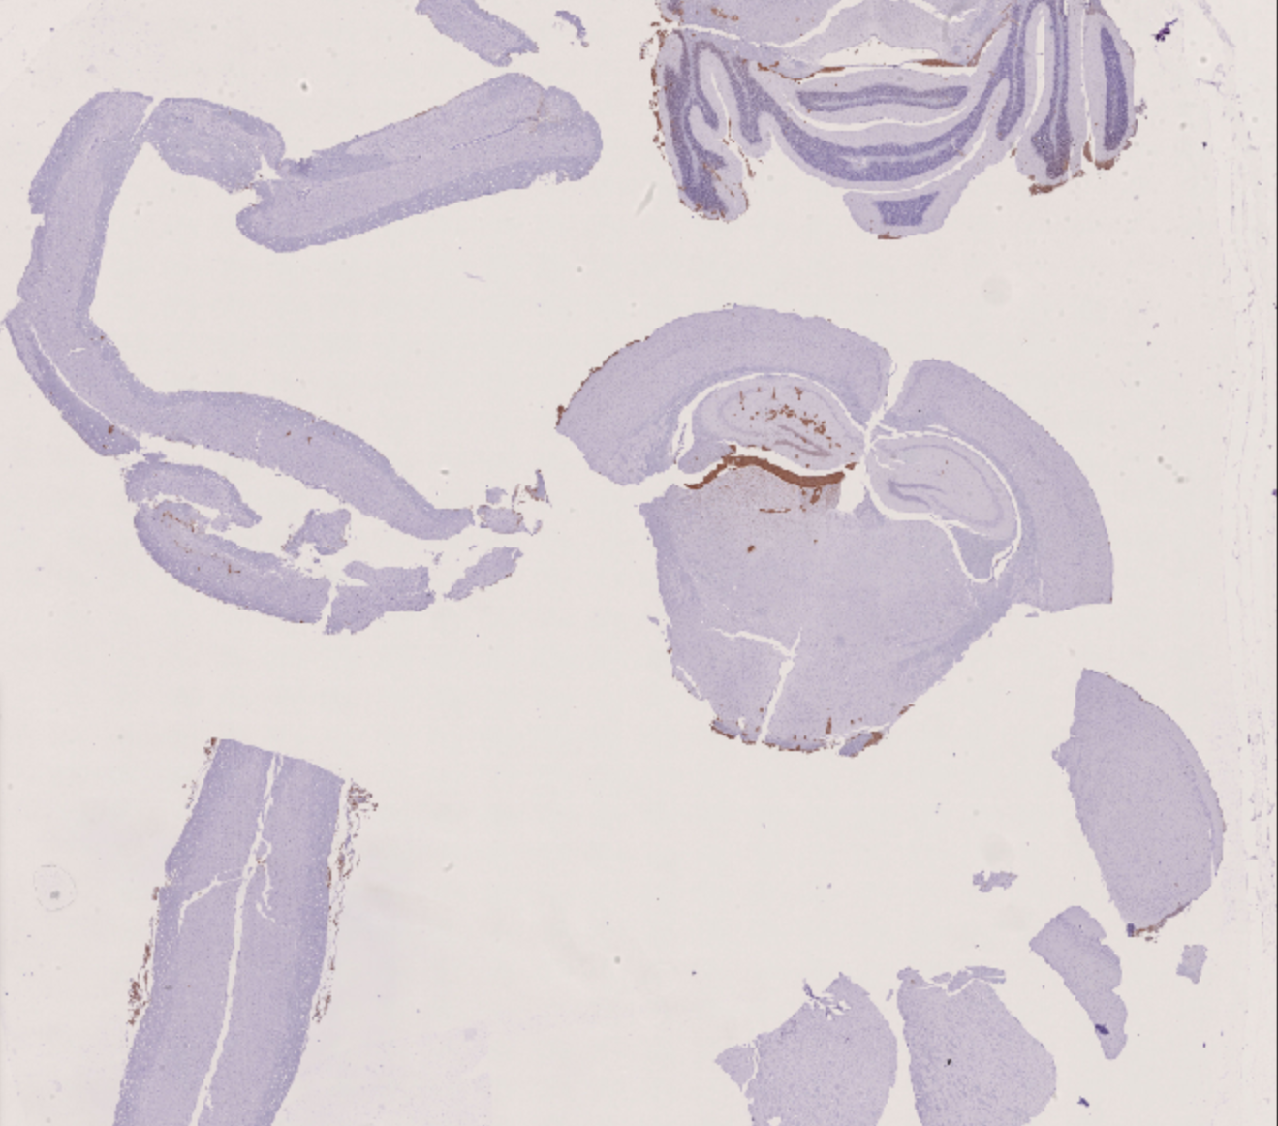
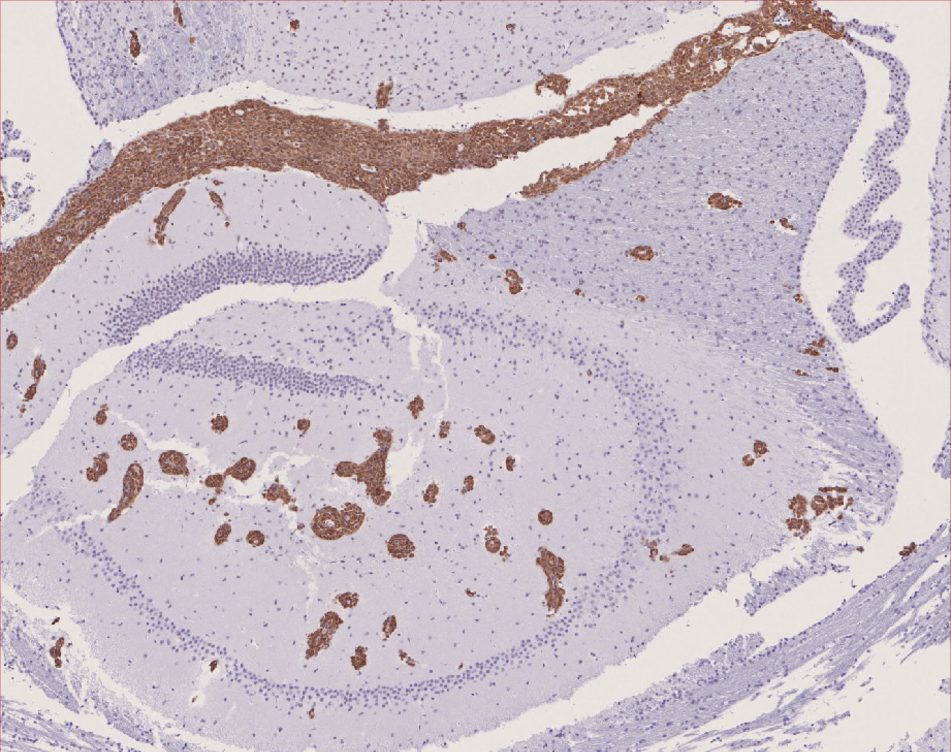
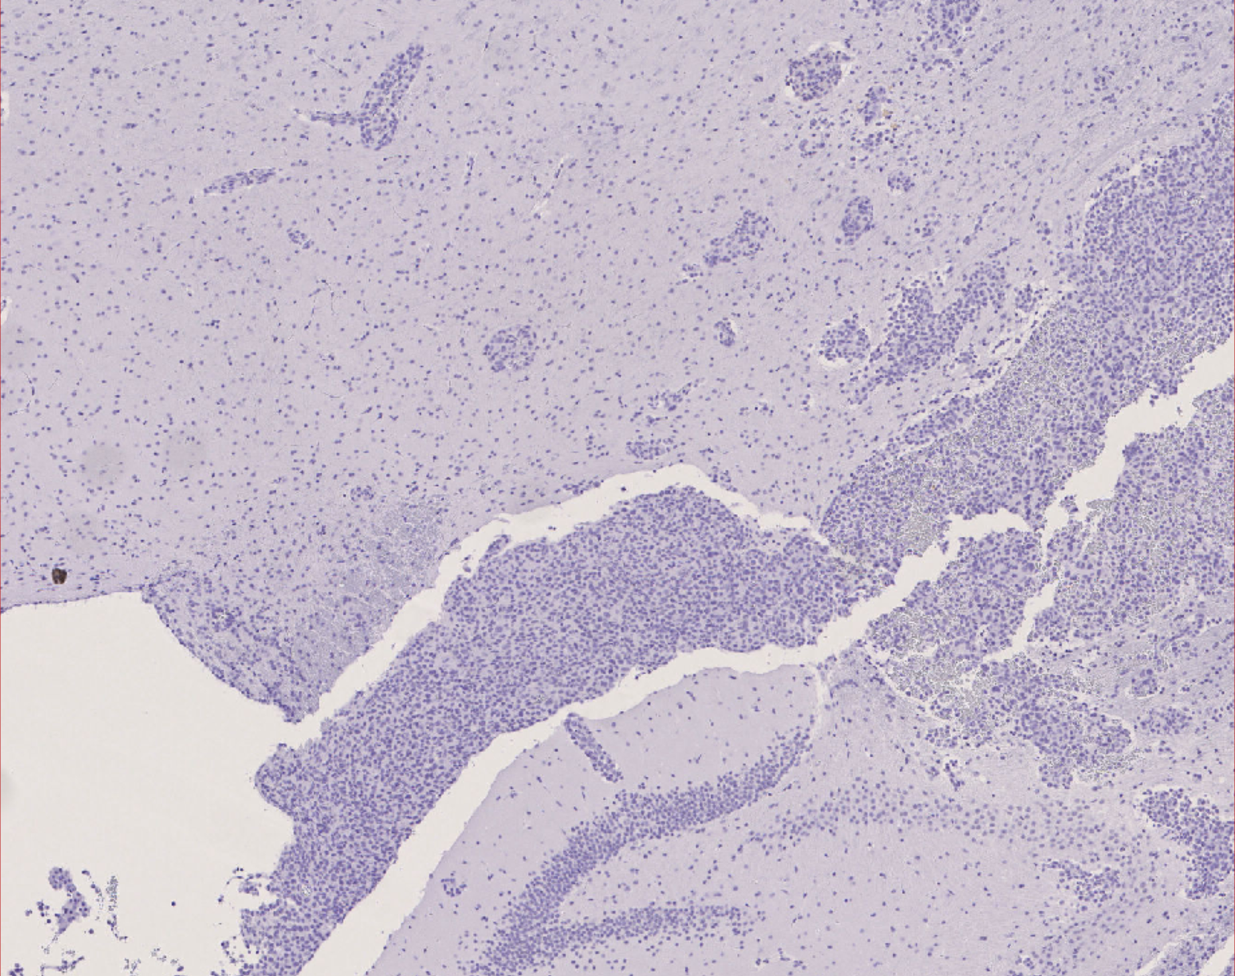
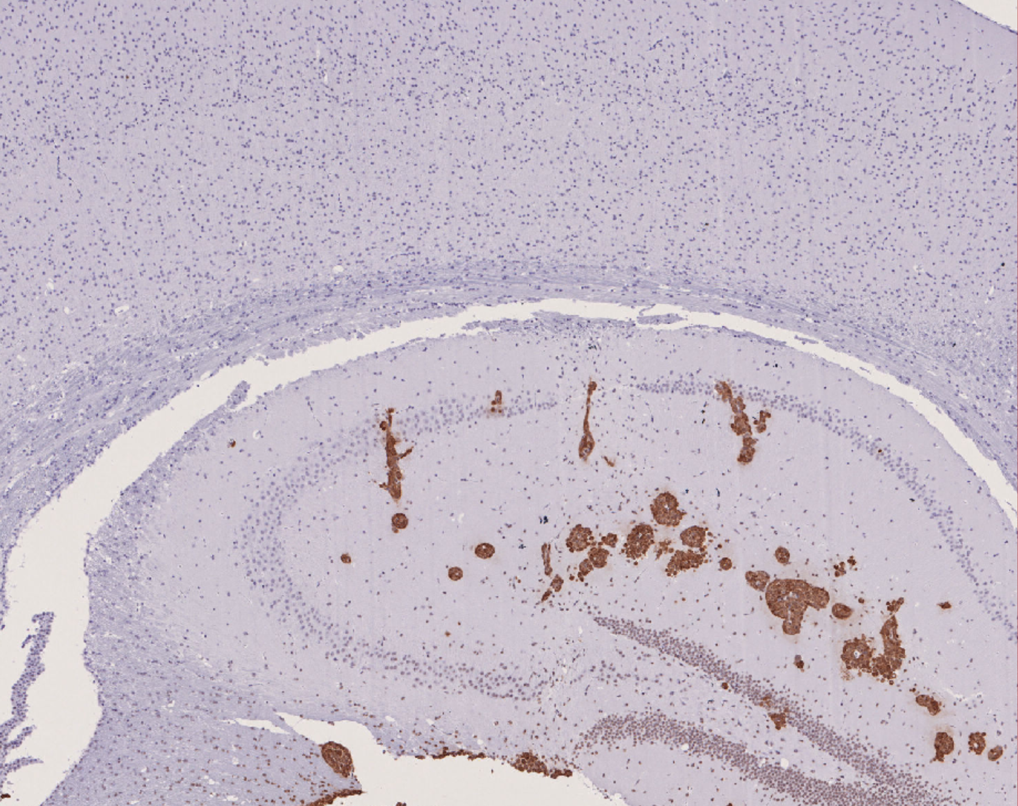
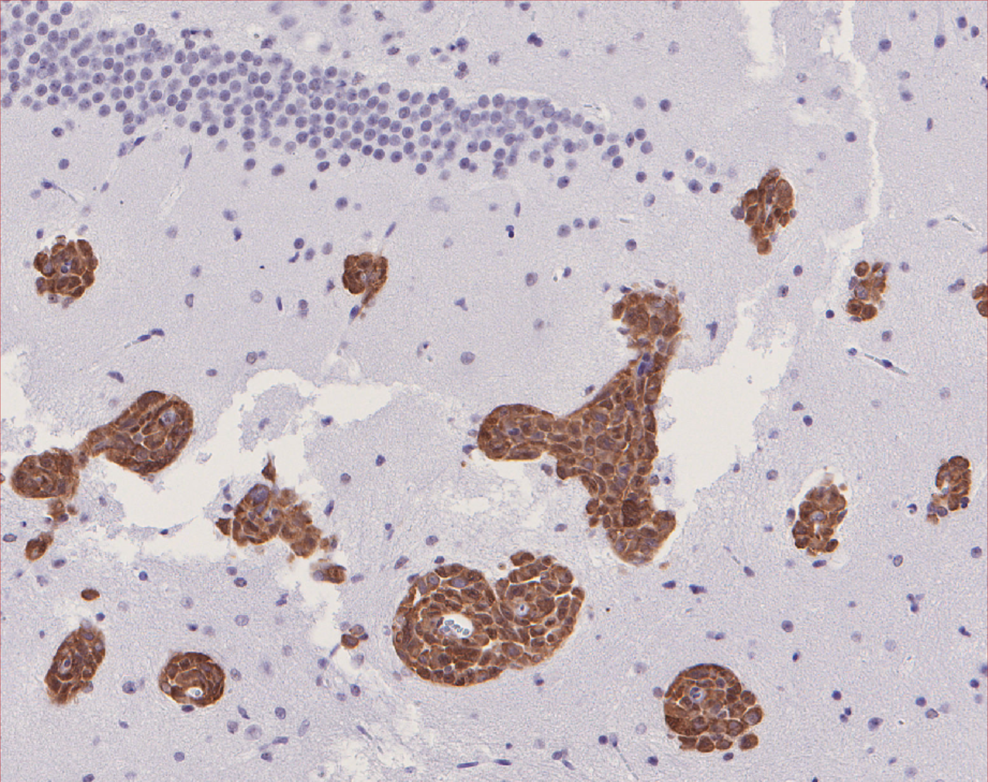
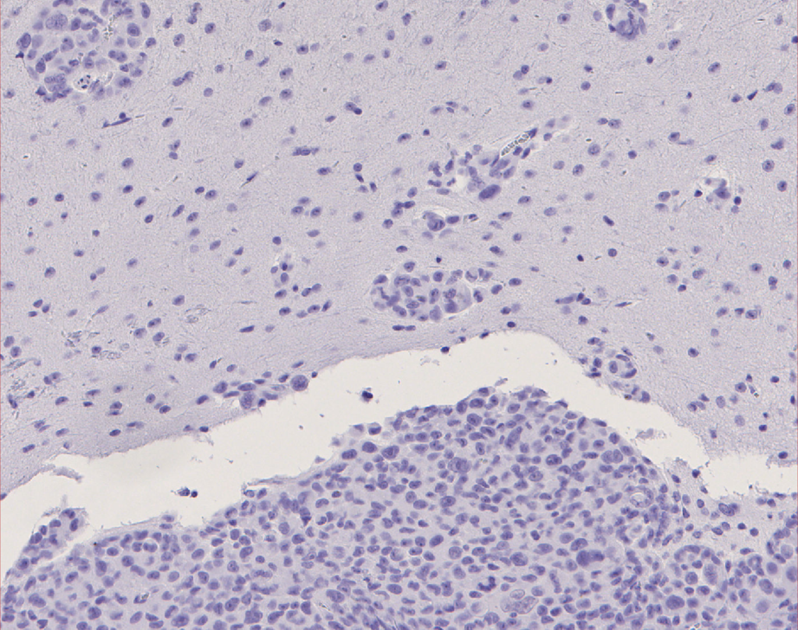
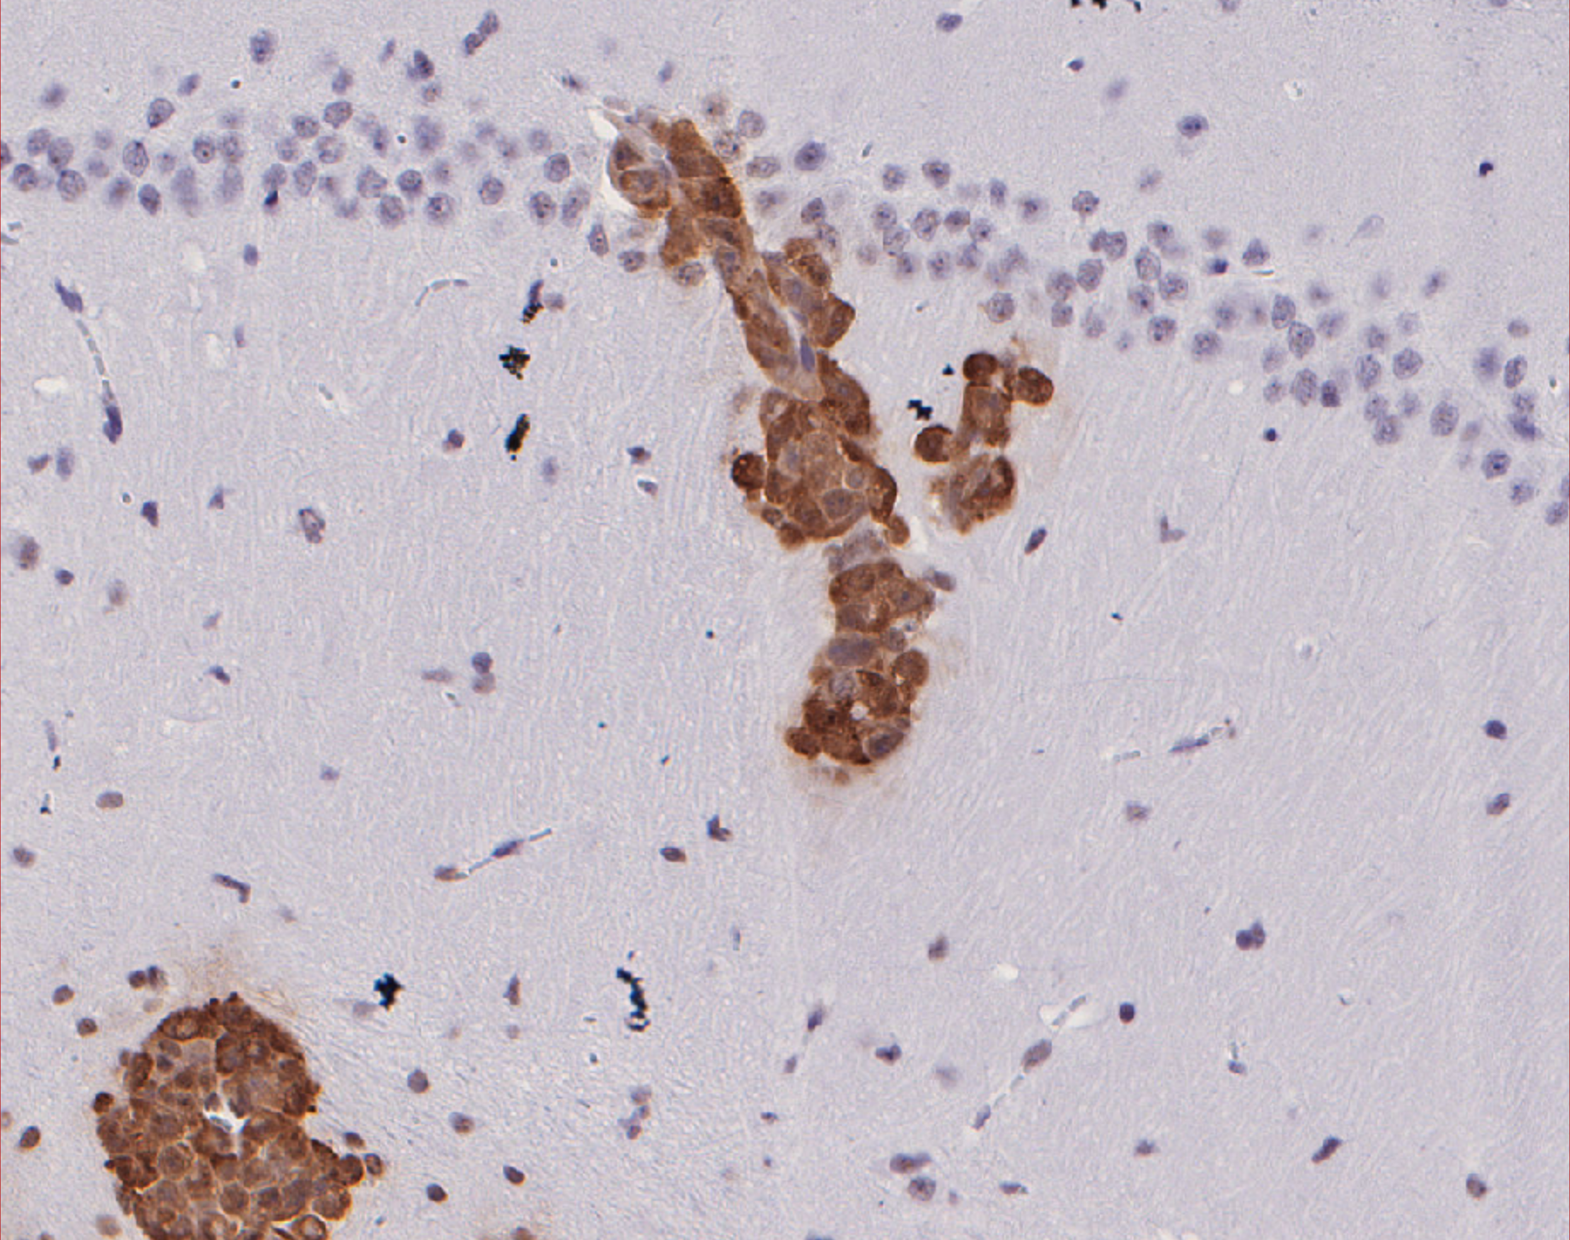
A
MDA-MB-231
B
MDA-MB-231
CIRBP^{CRISPR}
CIRBP^{CRISPR}
AAVS1 ^{CTRL}
AAVS1 ^{CTRL}
Parental
+ VC
+ WT
Parental
+ VC
+ WT
kDa
kDa
25
CIRBP-FLAG
20
CIRBP
15
RBM3
50
⍺-Tubulin
50
⍺-Tubulin
C
Scale bar: 2mm
Scale bar: 250 um
Scale bar: 50 um
Parental
+ VC
+ WT
CIRBP^{CRISPR}
MDA-MB-231

