Slide 1
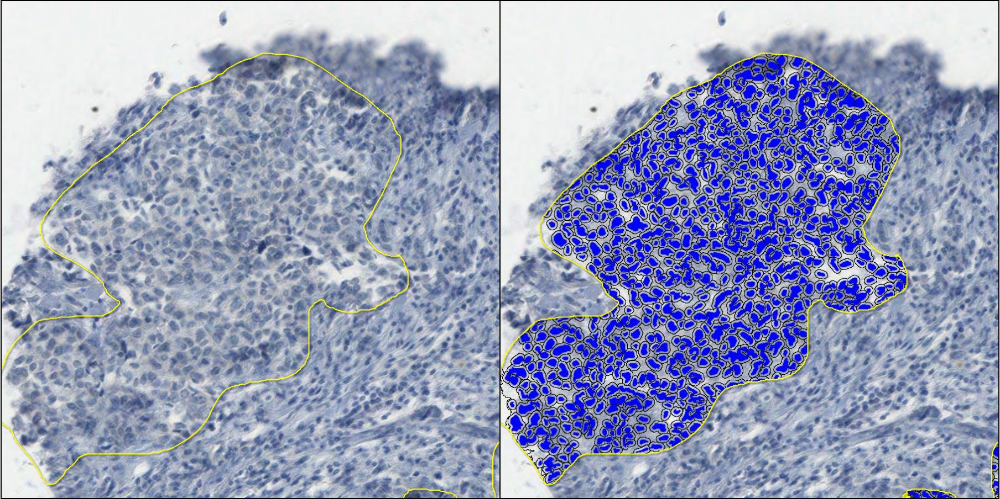
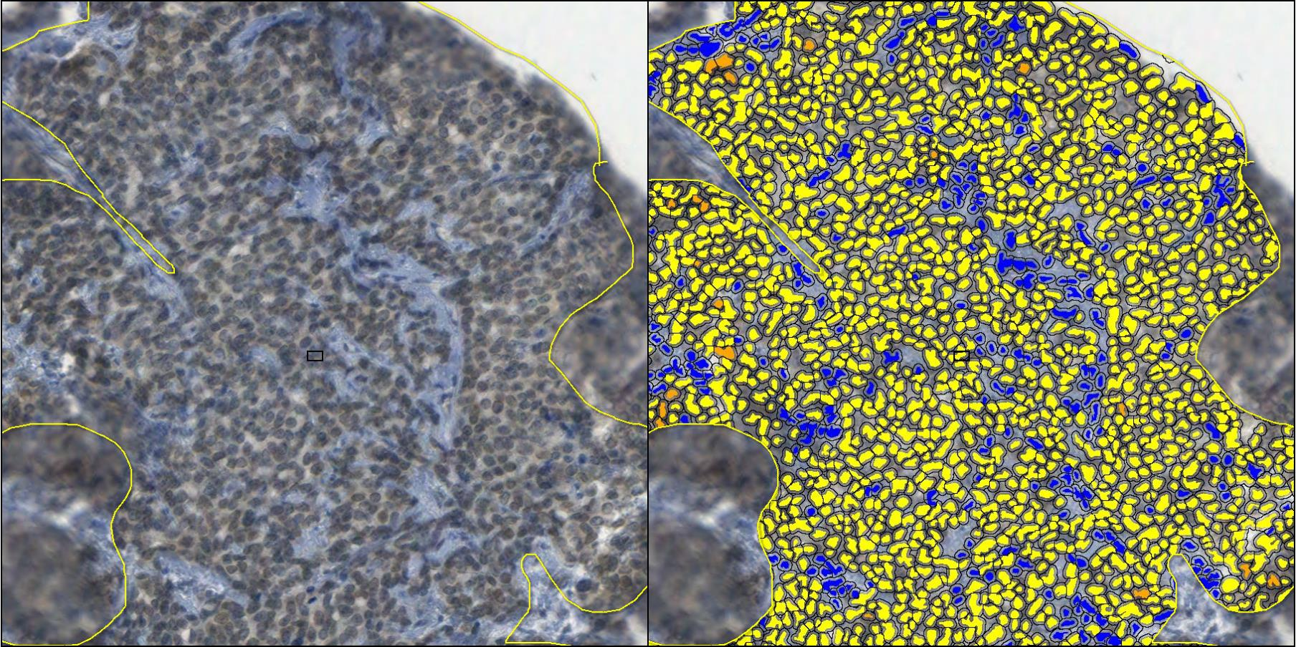
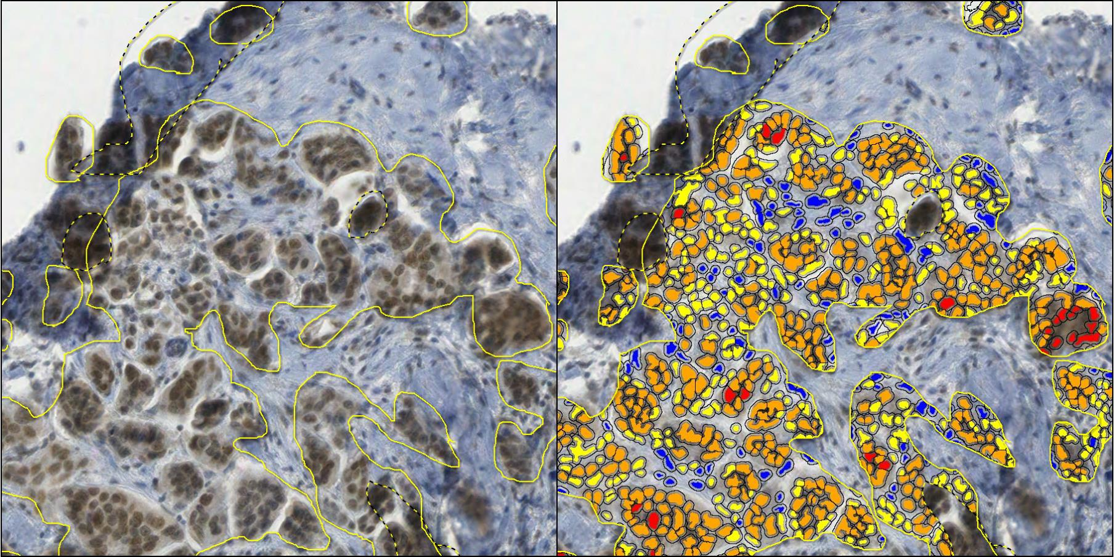
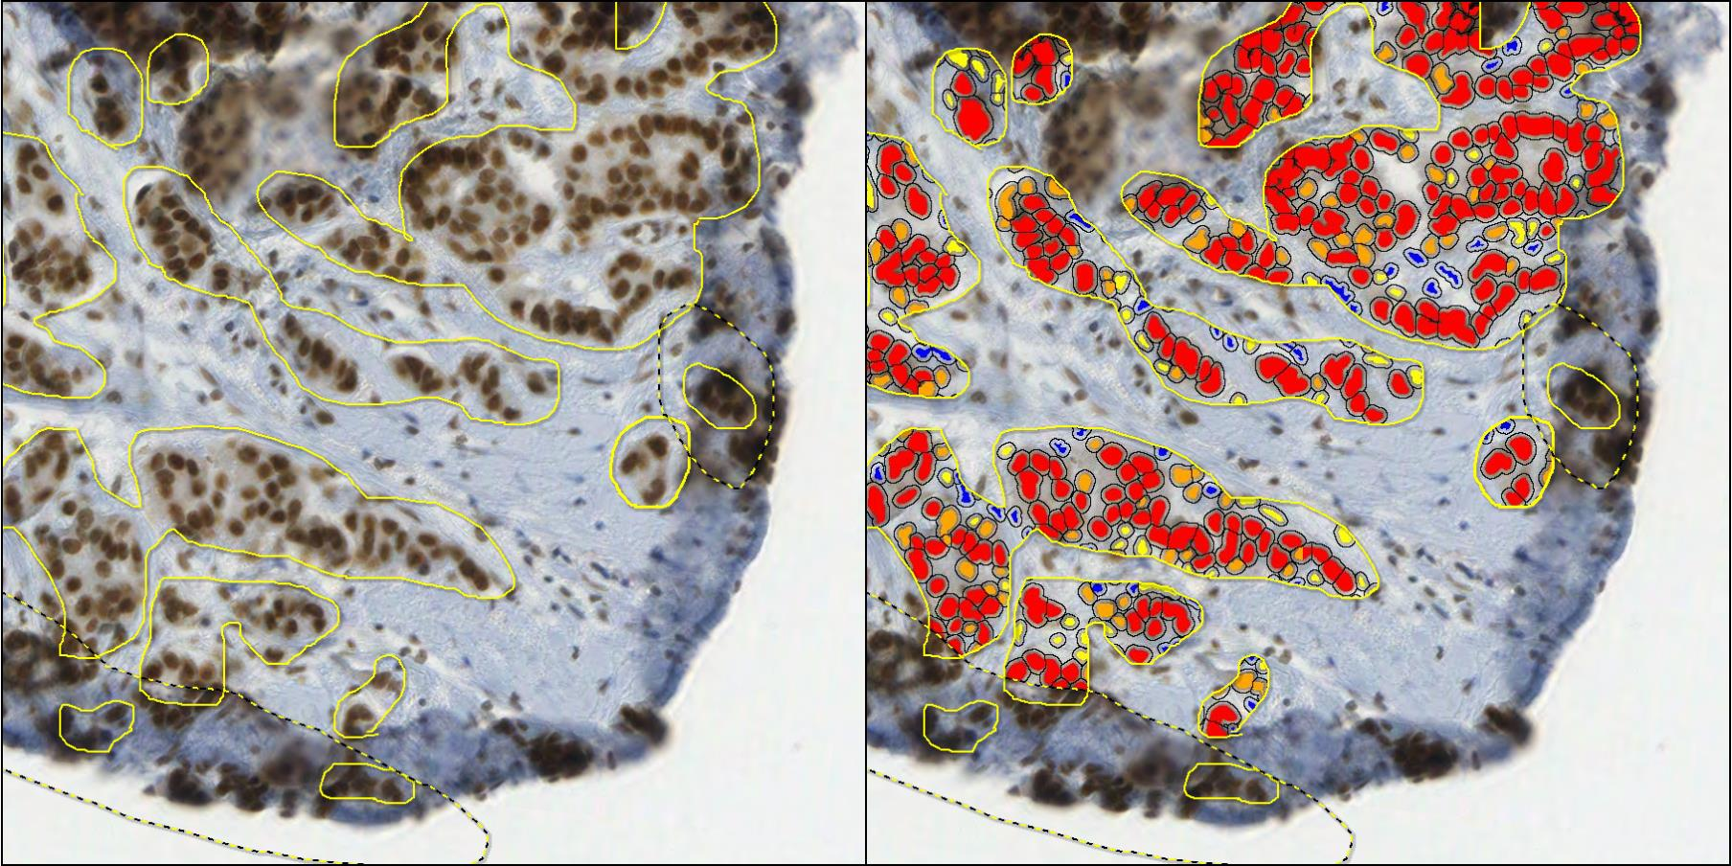
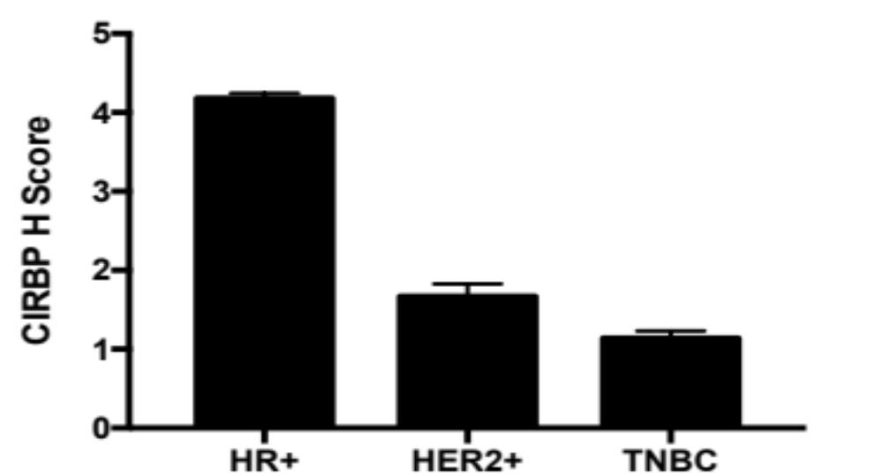
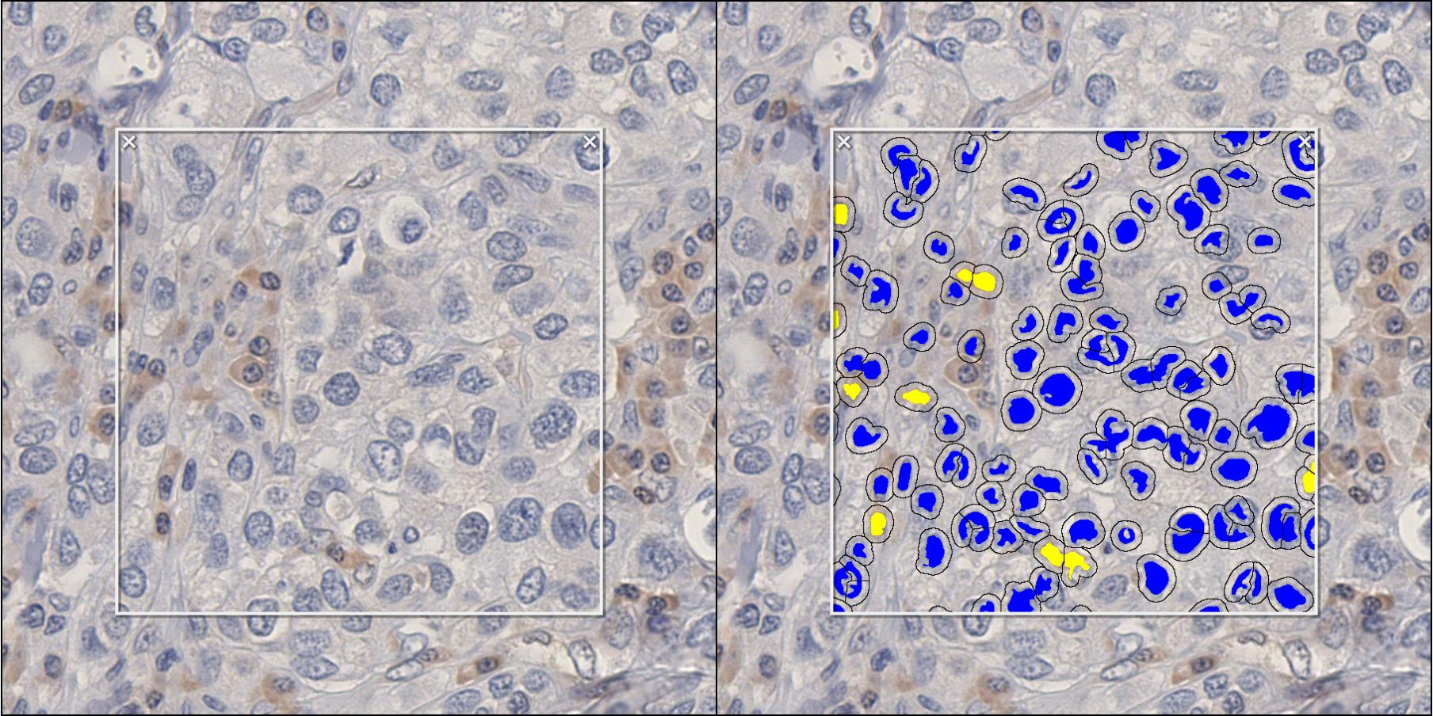
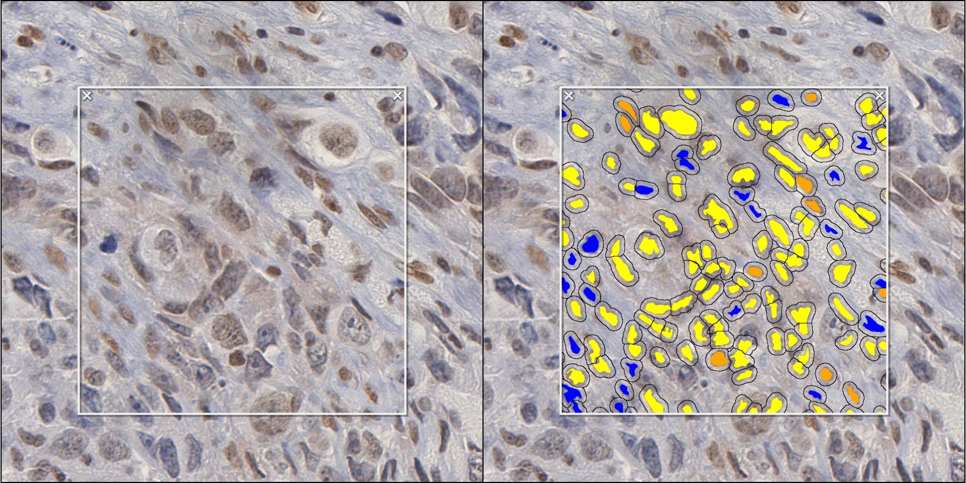
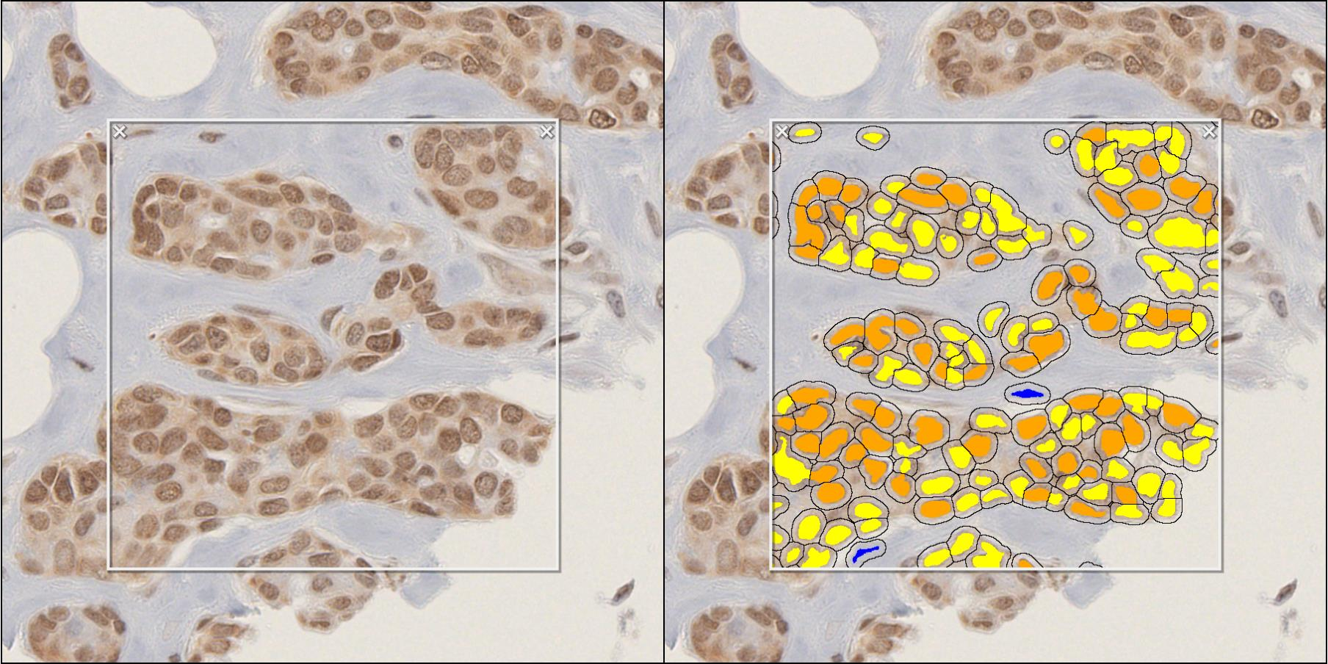
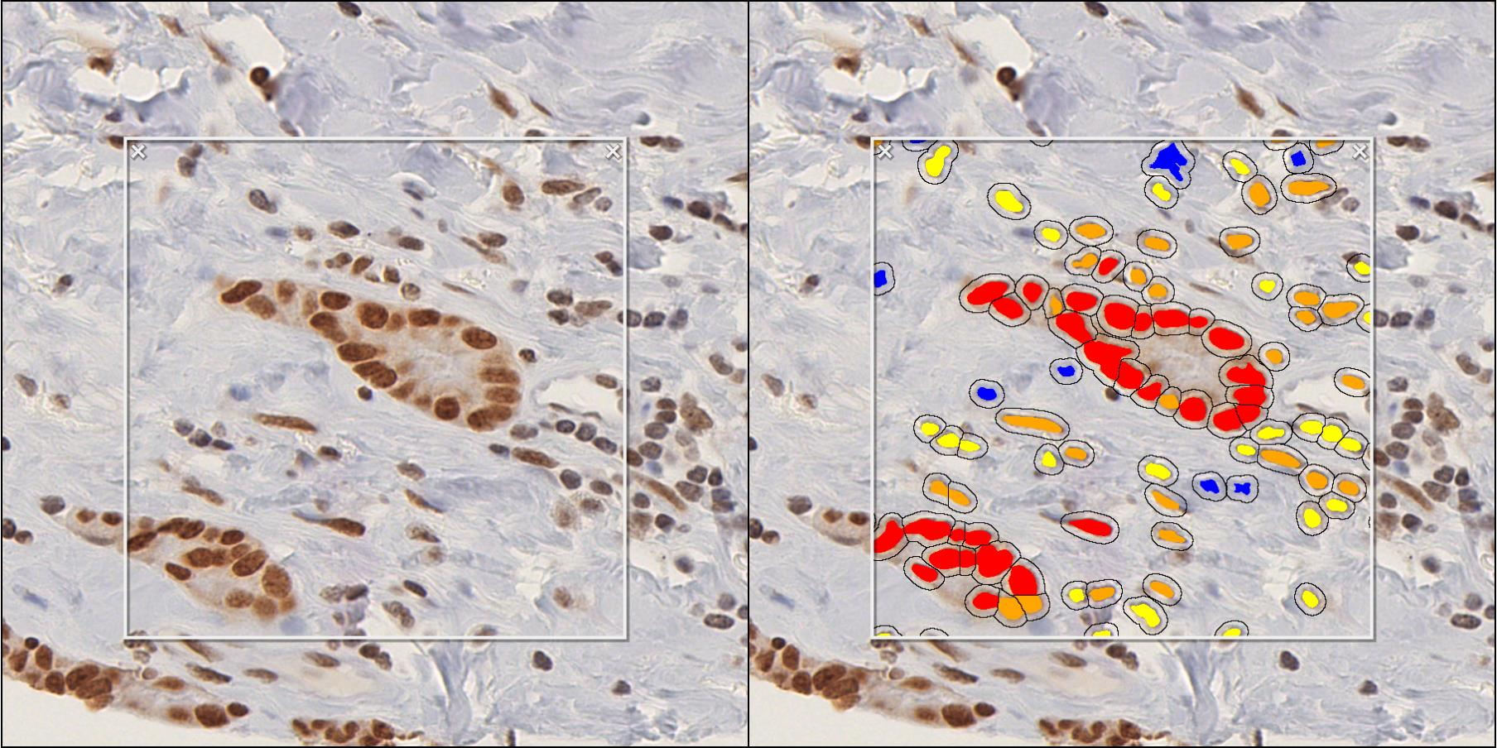
A
0+
1+
2+
3+
B
5
N=1406
ANOVA: P < 0.001
4
3
CIRBP H-Score
N=99
2
N=267
1
0
C
HR+
HER2+
TNBC
0+
1+
2+
3+
Notes:
Supplemental Figure S2: Software algorithm used to define CIRBP positivity. A) Representative images of CIRBP immunohistochemistry staining from hormone receptor positive patients in the Gold Series tissue microarray, with annotation for tumor cells indicated with yellow regions of interest (left), and examples of 0+, 1+, 2+, and 3+ staining cells in matched regions of interest with the HALO digital pathology algorithm (right). Scale bar: 100 µM. B) Quantification of CIRBP H-score by immunohistochemistry from patients in the Gold Series tissue microarray, with means demonstrated on the bar graph. Error bars represent standard error of means. ANOVA was performed to calculate P-value. C) Representative images of CIRBP immunohistochemistry staining from patients in the Triple-Negative Breast Cancer tissue microarray, with examples of 0+, 1+, 2+, and 3+ staining cells in matched regions of interest with the HALO digital pathology algorithm (right). Scale bar: 50 µM. Abbreviations: HR+: hormone receptor positive, HER2+: human epidermal growth factor receptor 2 positive, TNBC: triple-negative breast cancer.

