Slide 1
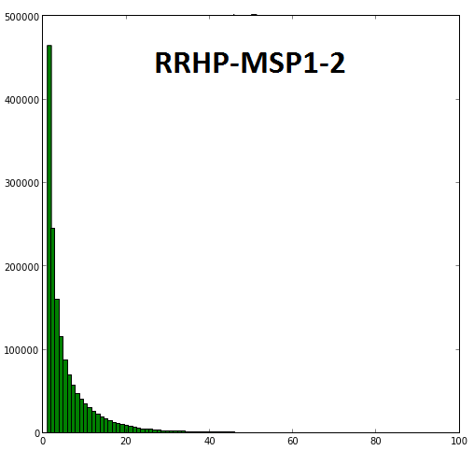
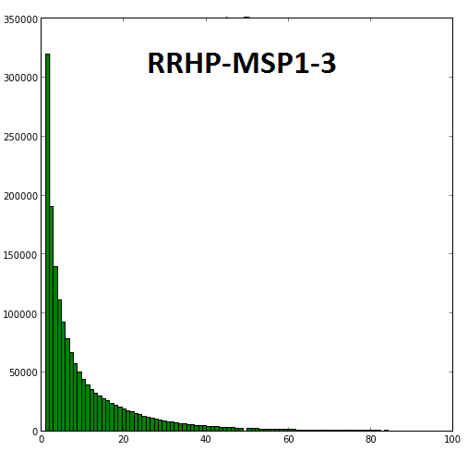
Frequency
Frequency
Number of reads per site
Number of reads per site
Additional file 1

