Slide 1
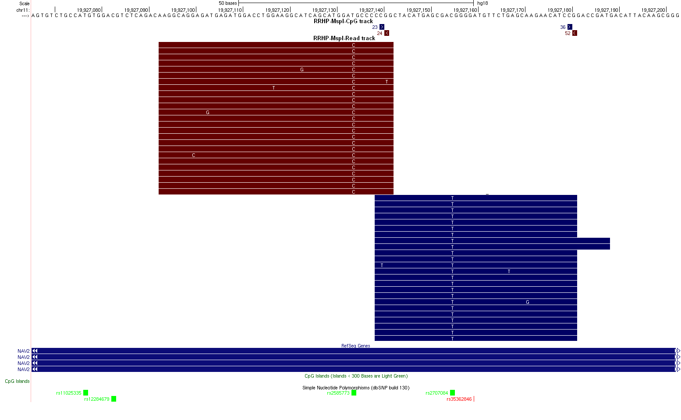
CpG Track
ReadTrack
Additional file 5

