Slide 1
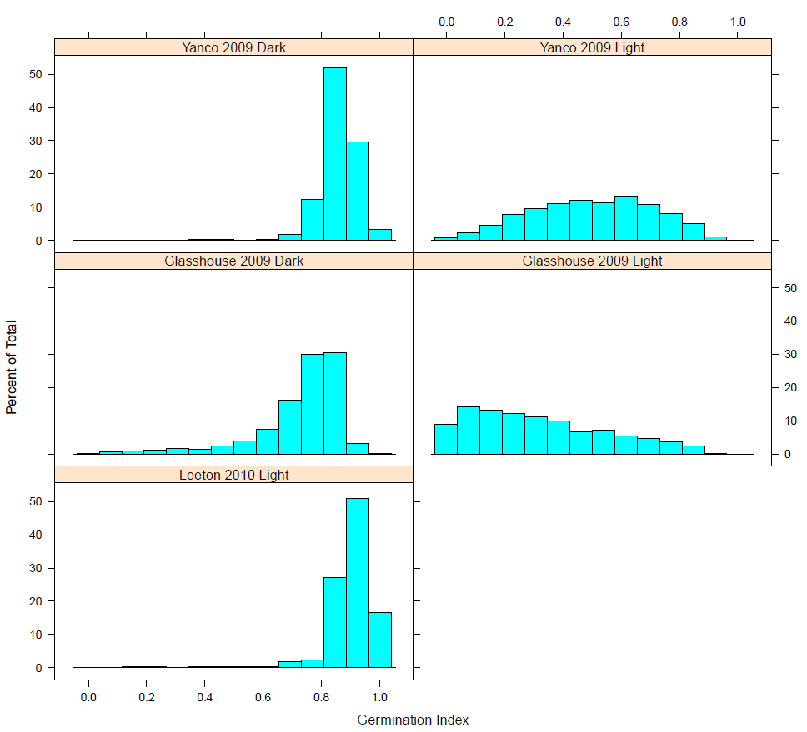
Additional file 1: Supplementary Figure 1

