Slide 1
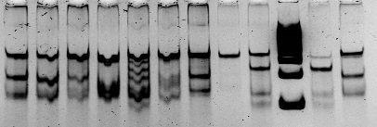

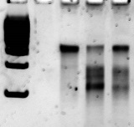

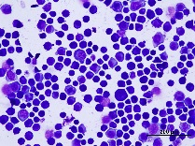
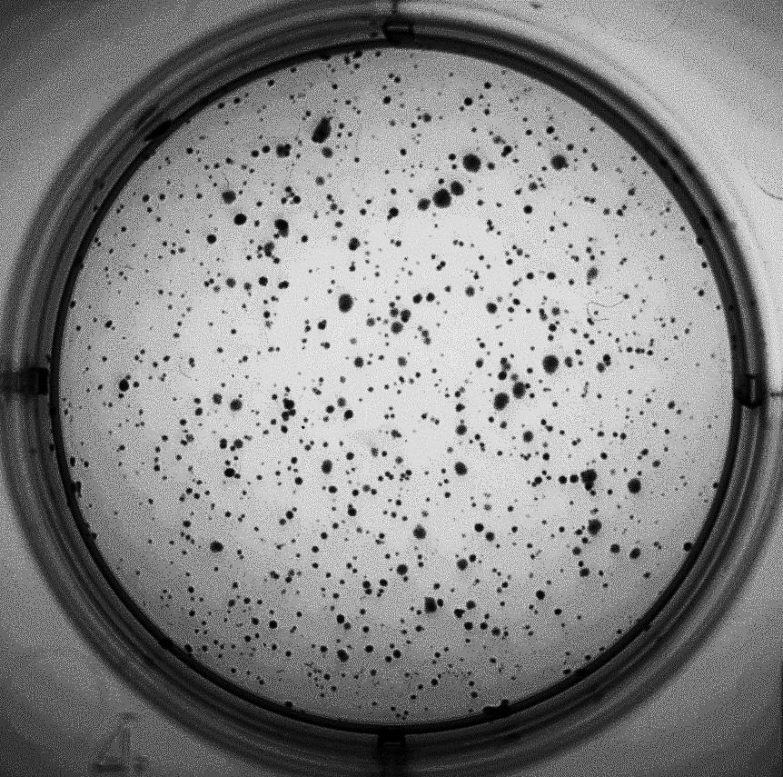
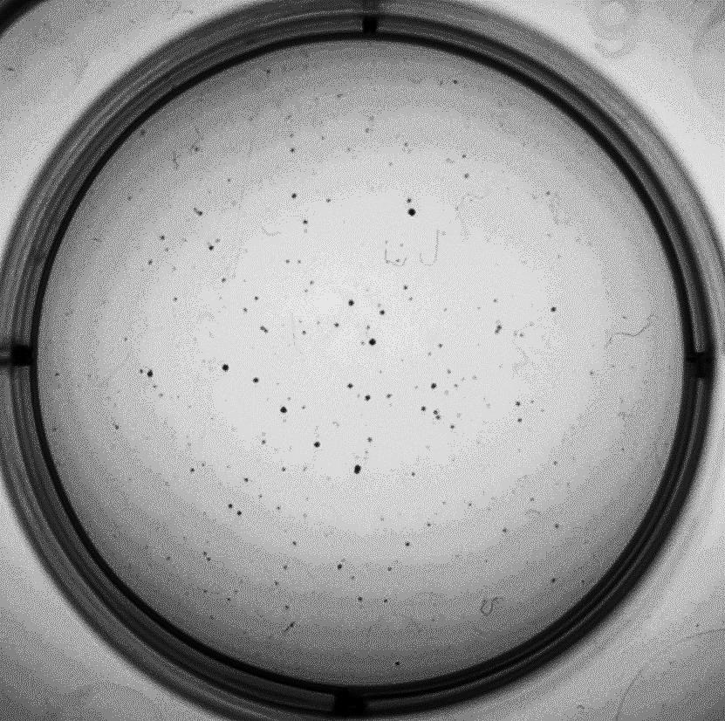
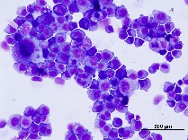
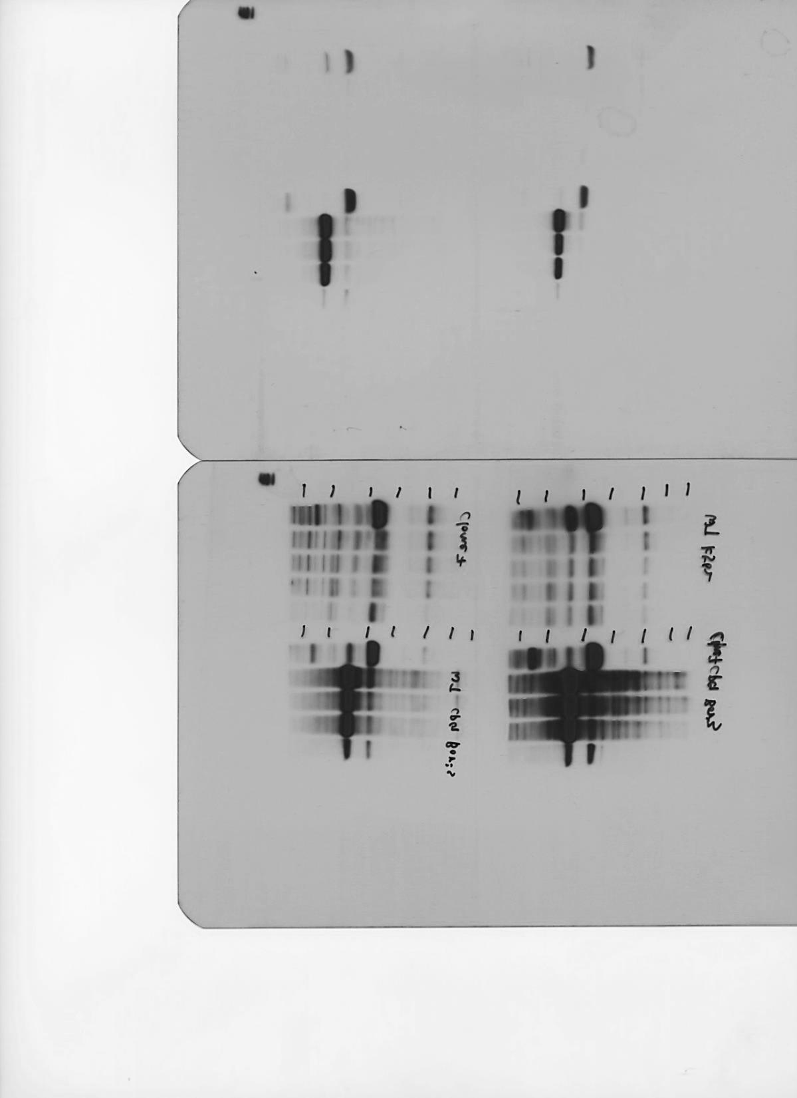

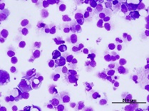
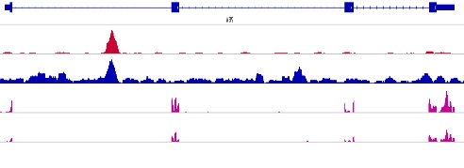
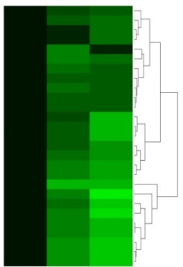
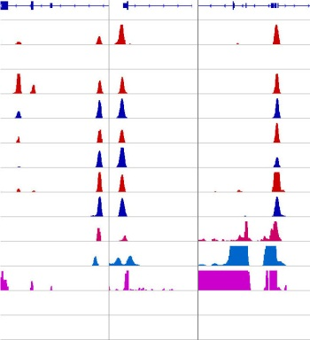
A
CAGGACAGCGTCCTGgaggaaGAAGTGGAGCTGGTGCTG
B
CEL-I Assay
C
ZFNs clones (CEL-I Assay)
D
ZFNs clones (Western)
4 7 M 1 wt 8 11 12 20 23 29 31
wt M 1 4 7 8 11 12 20 23 29 31
BORIS
M
Wt
48h after ZFN
2weeks after ZFN.
wt PCR product
0.4kb
0.2kb
0.1kb
Digested PCR
products
Tubulin
wt PCR product
G
wt + Control
Digested PCR
products
Wild type allele (%):
Mutant allele (%):
100 14 37
0 86 63
20x
20x
20x
F
E
wt + Control
wt + ZFN
K562 differentiation into the
megakaryocytic lineage (by PMA)
wt + ZFN
PMA day: 0 1 2 3 7
BORIS
wt +PMA (3day)
Tubulin
H
WISP2
MCF7+BORIS_CTCF
MCF7+BORIS_BORIS
MCF7+EV
MCF7+BORIS (Cl.1)
MCF7+BORIS (Cl.2)
10
5
120
120
120
I
ChIP-seq
MCF7+BORIS
ADAR
SLC16A6
MOCS2
MOCS3
POLR3G
MAFB
SLC2A6
EIF2AK2
TMSB4X
AMOTL2
TEAD1
PARP14
IFITM1
IRF7
IFITM3
PARP12
OASL
OAS3
MX2
IFI44L
IFIT5
IFI6
ISG15
OAS2
IFI44
OAS1
IFIT1
EV Cl.1 Cl.2
RNA-seq
WISP2 expression (RNA-seq)
P<1E-30
P=0.000297
RPKM
EV/BORIS (log2)
5 0 -5
p < 0.003
K
L
Genes
CTCF
BORIS
CTCF
BORIS
CTCF
BORIS
CTCF
BORIS
RNAPII
H3K4me3
K562
NHEK
NHDF
GAL3ST1 FOXA3 PRAME
CTCF&BORIS targets expression
NHDF
10
1
4
4
1
8
4
13
10
10
10
1
1
OVCAR8
Relative expression (log2)
Delta47
K562
RNA-Seq
Transcription
No Transcription
No Transcription
CTCF(+)/BORIS(-) cells CTCF(+)/BORIS(+) cells

