Slide 1
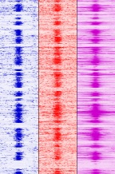
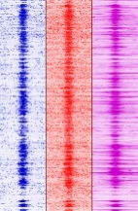


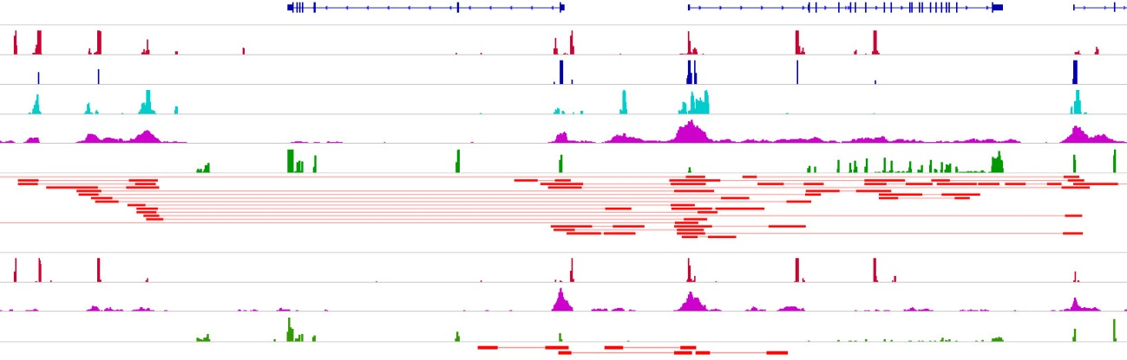
A B
K562-specific loops
K562-specific loops
K562 K562
MCF7 MCF7
BORIS CTCF RNAPII
BORIS CTCF RNAPII
CTCF RNAPII
CTCF RNAPII
~65% loops - BORIS positive
21684 right anchor
21684 right anchor
21684 left anchor
21684 left anchor
-10kb +10kb
K562-specific
Interactions
-10kb +10kb
-10kb +10kb
-10kb +10kb
C
Interactions
different from K562
PET=5, p-value 3.45E-16
K562-specific
loops
PET=9, p-value 2.12E-14
PET=5, p-value 9.22E-14
PET=7, p-value 2.14E-15
Genes
CTCF
BORIS
H3K27ac
RNAPII
RNA-Seq
COMMD7 DNMT3B MAPRE1
10
5
10
5
30
10
5
30
ChIA-PET
MCF7 K562
CTCF
RNAPII
RNA-Seq
ChIA-PET
chr20:31,242,444-31,420,406
D
2xCTS 1xCTS
BORIS-negative
somatic cells
Enh Enh
BORIS-positive germ
or cancer cells
Enh Enh
CTCF
BORIS
Transcriptional loops Enh - Enhancer
Change of transcription

