Slide 1

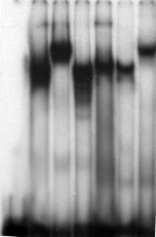


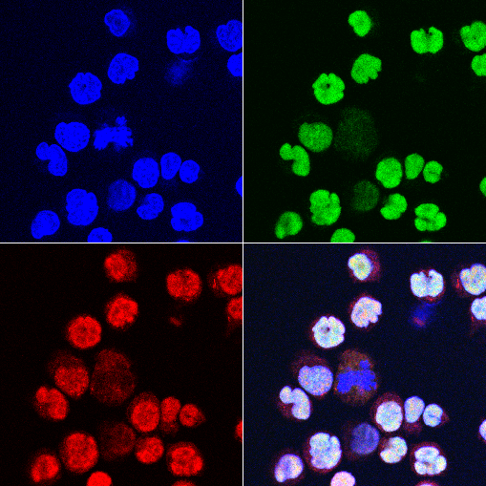
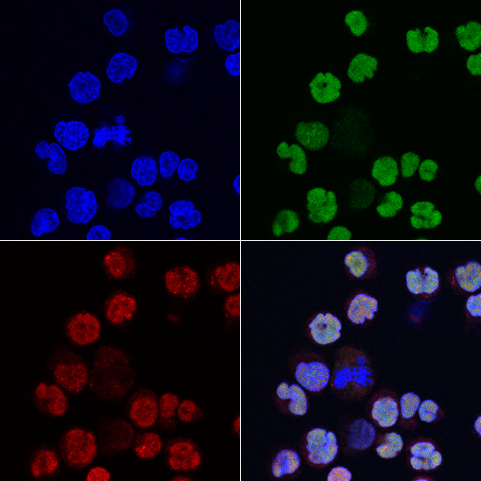

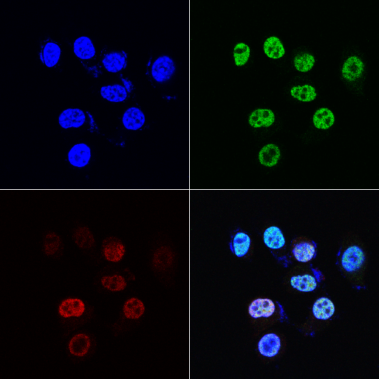
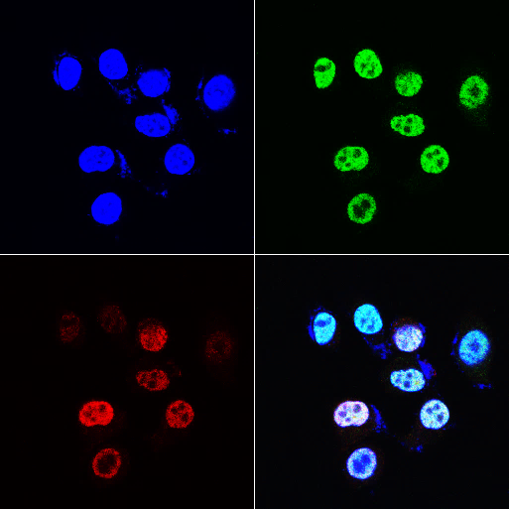
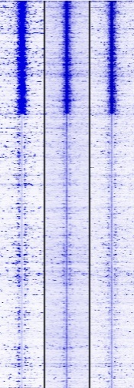
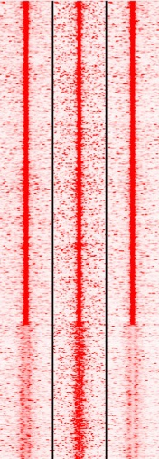
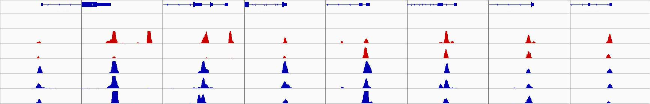
NHDF
K562
Delta47
OVCAR8
A
CTCF and BORIS expression (qPCR, CT Value)
B
D
BORIS MABs + +
CTCF MABs + +
 | GAPDH | BORIS | CTCF
NHDF | 16.9 | Undetermined | 22.5
Testis | 16.9 | 22.7 | 21.4
K562 | 16.3 | 19.1 | 21.8
OVCAR8 | 15.9 | 22.7 | 20.8
Delta47 | 15.5 | 20.4 | 20.9
RoundSpermatids | 15.7 | 24.7 | 22.1
CTCF
MABs
97kDa
Super Shift
BORIS
MABs
CTCF or
BORIS
75kDa
Actin
ABs
43kDa
F
C
CTCF TNT BORIS TNT
K562
E
F
WT1 promoter (Fr.5)
DAPI
CTCF
BORIS
MERGE
CTCF binding
OVCAR (83456)
BORIS binding
OVCAR8 (33555)
K562 (83189)
19%
22%
K562 (34551)
21%
12%
28%
18%
47531
57%
17536
51%
Ovcar8
6%
9%
16%
10%
Delta47(65563)
11%
Delta47 (31193)
14%
47531 invariant CTCF peaks
17536 invariant BORIS peaks
DAPI
CTCF
BORIS
MERGE
BORIS
CTCF
K562 OVCAR8 Delta47
K562 OVCAR8 Delta47
G
~30%
Set of CTCF sites from ENCODE
(38 cell lines)
326840
10577 BORIS-only regions mapped
in K562 cells
~70%
47531 invariant CTCF peaks
17536 invariant BORIS peaks
91%
overlap
9% do not overlap
CTCF occupancy in Ovcar8,
but not in K562 and Delta47
0
0
H
-5kb +5kb
-5kb +5kb
BORIS-only bound regions in K562, CTCF&BORIS bound regions in OVCAR8/Delta47
Genes
CTCF_K562
CTCF_OVCAR8
CTCF_Delta47
BORIS_K562
BORIS_OVCAR8
BORIS_Delta47
GAS2L3 EXT1 PMERA NEK4 CSRP1 PEX2 ZNF878 PLGRKT
1
2
3
10
5
5

