Slide 1
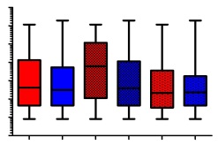
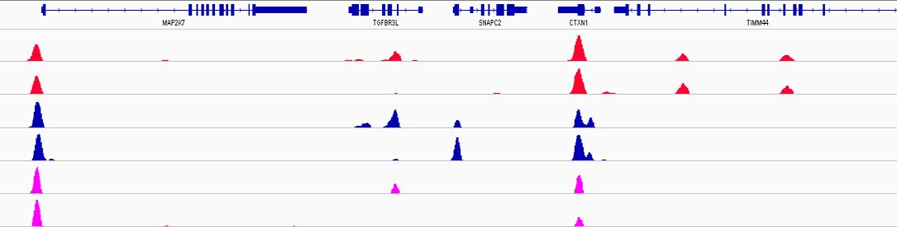
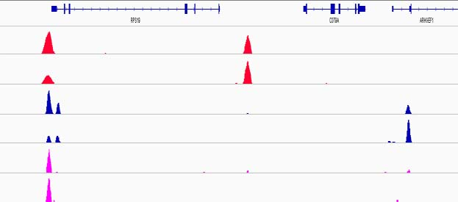
A
K562
***
***
1024
512
256
128
64
32
16
8
Peak Intensity
AllCTCF
AllBORIS
CTCF&BORIS
BORIS&CTCF
CTCF-only
BORIS-only
B
ChIP-Re-ChIP
chr19:7,967,181-8,002,176 (hg19)
chr19:42,359,061-42,392,015
CTCF_Delta47
CTCF_K562
BORIS_Delta47
BORIS_K562
ChIP-ReChIP_Delta47
ChIP-ReChIP_K562
40
40
40
20
10
3
CTCF&BORIS
BORIS-only
CTCF&BORIS
CTCF-only
BORIS-only
Figure S16

