Slide 1
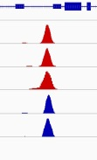
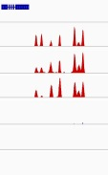
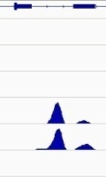
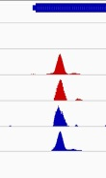
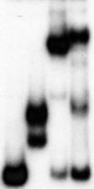
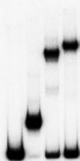
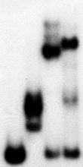
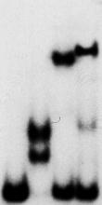
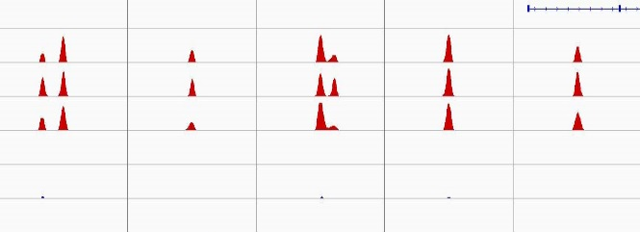
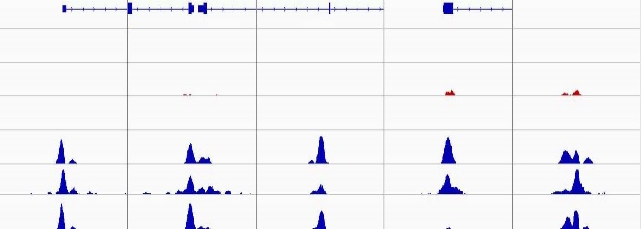

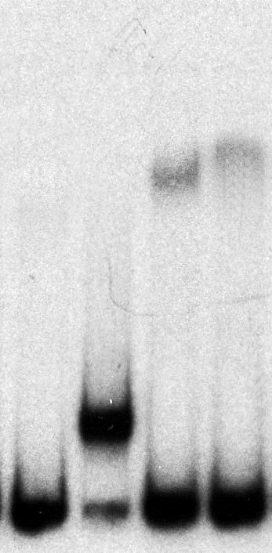








A
CTCF&BORIS CTCF-only BORIS-only
BORIS-only
CTCF&BORIS
TP53
H19
BMI
PROB1
CTCF_K562
CTCF_Delta47
CTCF_NHDF
BORIS_K562
BORIS_Delta47
BORIS_NHDF
13
13
13
10
10
1
20
20
20
2
2
1
5
5
5
14
30
1
5
20
15
5
20
1
Luc.
11ZF
CTCF
BORIS
Luc.
11ZF
CTCF
BORIS
Luc.
11ZF
CTCF
BORIS
Luc.
11ZF
CTCF
BORIS
BORIS
CTCF
11ZF
chr17:7,591,409
-7,591,597
chr11:2,021,926
-2,022,099
chr10:22,609,712
-22,609,890
chr5:138,728,305
-138,728,524
B
CTCF-only bound regions
C
BORIS-only bound regions
C20orf197
Genes
CTCF_K562
CTCF_OVCAR8
CTCF_Delta47
BORIS_K562
BORIS_OVCAR8
BORIS_Delta47
ZNF258 BOP1 RNF220 CLN5
10
10
15
5
5
5
2
2
2
10
3
10
chr3:187397489
-187397720
chr19:29370166
-29370365
chr11:130304466
-130304665
chr5:143204776
-143204975
chr20:58632526
-58632725
chr19:7580821
-7581083
chr8:145514892
-145515166
chr1:45097614
-45097886
chr13:77566036
-77566434
chr11:66495423
-66495724
Luc.
11ZFs
CTCF
BORIS
Luc.
11ZFs
CTCF
BORIS
Luc.
11ZFs
CTCF
BORIS
Luc.
11ZFs
CTCF
BORIS
Luc.
11ZFs
CTCF
BORIS
Luc.
11ZFs
CTCF
BORIS
Luc.
11ZFs
CTCF
BORIS
Luc.
11ZFs
CTCF
BORIS
Luc.
11ZFs
CTCF
BORIS
Luc.
11ZFs
CTCF
BORIS
BORIS
CTCF
11ZF
Figure S16

