Slide 1
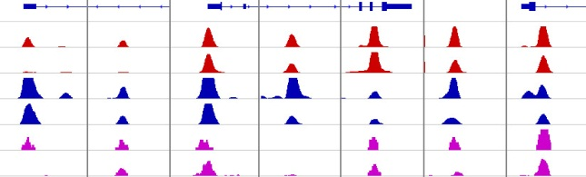
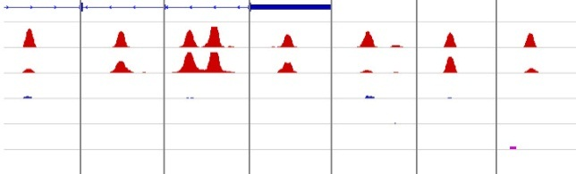














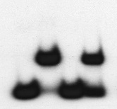
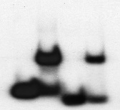
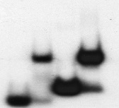






A
CTCF&BORIS bound regions CTCF-only bound regions
Genes
CTCF_K562
CTCF-Delta47
BORIS_K562
BORIS_Delta47
ChIP-Re-ChIP_K562
ChIP-Re-ChIP_Delta47
DNMT3B GAL3ST1 MDM2 BIVM EFNA3 Chr13 NUDT15 IQGAP2 OBFC1 INS-IGF2 MPEG1 Chr12 Chr18 Chr4
25
25
30
20
2
3
15
15
3
3
1
1
protein:
- 11ZFs - 11ZFs - 11ZFs - 11ZFs - 11ZFs - 11ZFs - 11ZFs - 11ZFs - 11ZFs - 11ZFs - 11ZFs - 11ZFs - 11ZFs - 11ZFs
Occupancy
Double
Single
Free probe
B
CTCF&BORIS bound regions
TP53 promoter (200bp)
IRF2BP1 3’UTR(200bp)
Chr17 Intergenic (200bp)
CTCF CTCF
CTCF CTCF
CTCF CTCF
5’ 3’
5’ 3’
5’ 3’
Site 1+2 Site 1+2 Site 1+2
Site 1 Site2
Site 1 Site2
Site 1 Site2
Protein: - 11ZFs - 11ZFs - 11ZFs - 11ZFs - 11ZFs - 11ZFs
Single
Site 1 Site2
Site 1 Site2
Site 1 Site2
C
KDM3B promoter
FOXA3 promoter
TP53 promoter
CTCF
BORIS
CTCF
BORIS
CTCF
BORIS
CTCF
BORIS
CTCF
BORIS
CTCF
BORIS
Abs - - - - - - - - -
F
F
F
K562 NHDF K562 NHDF K562 NHDF

