Slide 1
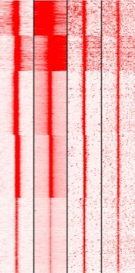
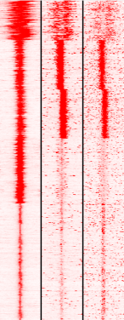
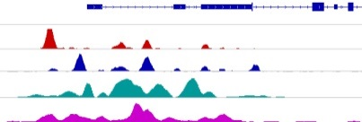
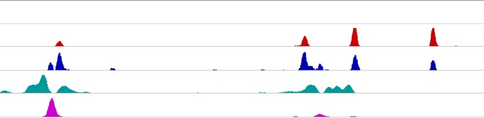
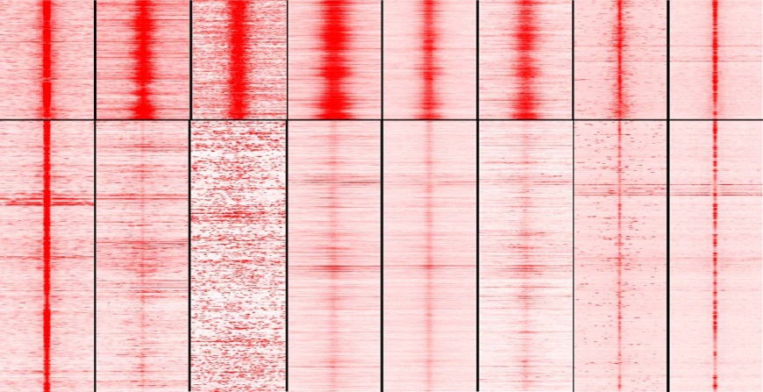
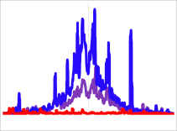
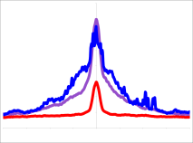
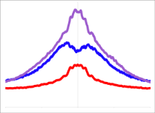
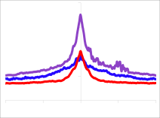
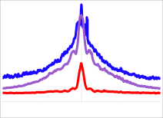
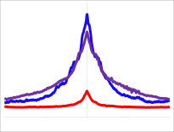
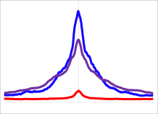
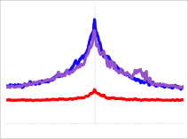
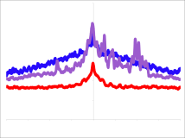
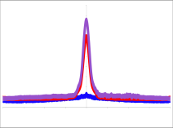
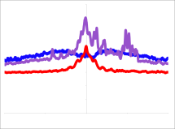
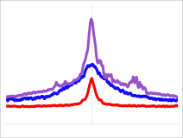
A
ChIP-seq (K562)
ChIP-seq (K562)
B
76% of Super Enhancers are BORIS targets in K562 cells
H3K4me3 RNAPII BORIS CTCF
H3K27ac BORIS CTCF
BRD2
chr6:32,933,901-32,944,516 (hg19)
Genes
CTCF
BORIS
H3K27ac
p300
10
10
60
20
K-means clustering (5 clusters)
K-means clustering (5 clusters)
17656 active promoters in K562 cells
17798 active enhancers in K562 cells
Genes
CTCF
BORIS
H3K27ac
p300
chr1:31,236,343-31,258,087(hg19)
30
5
70
140
0
0
-5kb +5kb
-5kb +5kb
C
87% BORIS targets
50% BORIS targets
E
K562
CTCF RNAPII CAGE H3K4me3 H2AZ H3K27ac ZNF143 SMC3
D
59215 CTCF -only 23974 CTCF&BORIS
n=1000
% of overlapping
F
K562 cells: CTCF-only ~ 50K, CTCF&BORIS~24K, BORIS-only-10K
CAGEs
ZNF143
H2AZ
p300
0
40
CTCF&BORIS
BORIS-only
CTCF-only
1.6
CTCF&BORIS
BORIS-only
CTCF-only
2
CTCF&BORIS
BORIS-only
CTCF-only
0.5
CTCF&BORIS
BORIS-only
CTCF-only
-5kb +5kb
Tag Density
Tag Density
Tag Density
Tag Density
G
-2000 0 2000
-2000 0 2000
-2000 0 2000
-2000 0 2000
Genomic Distribution
DNaseI
HCFC1
YY1
SET1B
4
CTCF&BORIS
BORIS-only
CTCF-only
3
CTCF&BORIS
BORIS-only
CTCF-only
6
CTCF&BORIS
BORIS-only
CTCF-only
1
CTCF&BORIS
BORIS-only
CTCF-only
Tag Density
Tag Density
Tag Density
Tag Density
% binding sites
-2000 0 2000
-2000 0 2000
-2000 0 2000
-2000 0 2000
SUZ12
CTCF&BORIS
BORIS-only
CTCF-only
SMC3
CTCF&BORIS
BORIS-only
CTCF-only
EZH
cMYC
CTCF&BORIS
BORIS-only
CTCF-only
4
Tag Density
5
1.4
1
Tag Density
Tag Density
CTCF&BORIS
BORIS-only
CTCF-only
Tag Density
-2000 0 2000
-2000 0 2000
-2000 0 2000
-2000 0 2000

