Slide 1
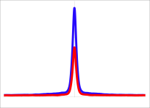
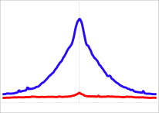
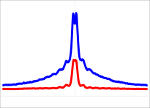
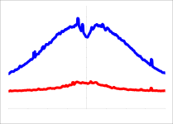
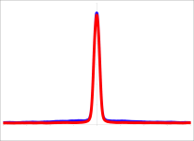
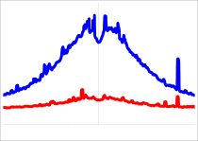
A
BORIS-negative - GM12878
B
GM12878
DNAseI
RNAPII
MAZ
H2AZ
ZNF143
SMC3
2XCTS n=20676, 1XCTS n=38307
ELF1
H3K4me3
NRF1
RAD21
CTCF
RNAPII
2xCTS
EZH
NFKB
16
2XCTS
1XCTS
5
2XCTS
1XCTS
Tag Density
Tag Density
1xCTS
-2000 0 2000
-2000 0 2000
K562vsGM12878
CTCF-only
DnaseI
H3K4me3
2XCTS
1XCTS
CTCF-only (K562)
1.5
2XCTS
1XCTS
1
Tag Density
Tag Density
-2000 0 2000
-2000 0 2000
1xCTS (GM12878)
RAD21
H3K27ac
2XCTS
1XCTS
K562vsGM12878
CTCF&BORIS
8
2XCTS
1XCTS
Tag Density
1
CTCF&BORIS (K562)
Tag Density
-2000 0 2000
-2000 0 2000
2xCTS (GM12878)

