Slide 1

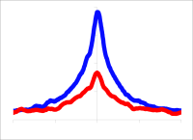
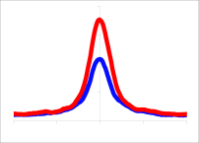
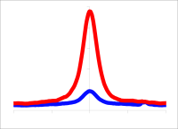


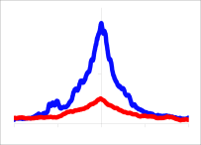
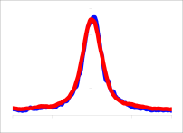
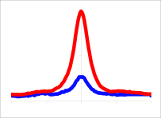



A
Conserved mouse binding regions
B
Mouse
Gene
CTCF
BORIS
RALGDS SMARCA4
30
30
2557 BORIS-only
7299CTCF&BORIS
19447 CTCF-only
Human
RALGDS SMARCA4
BORIS-only
0.8
0.4
BORIS
CTCF
Gene
CTCF
BORIS
10
30
0.4
0.2
BORIS
CTCF
Tag Density
0.5
BORIS
CTCF
Mouse
Kdm3b Vps36
OVCAR8
Tag Density
OVCAR8
Tag Density
OVCAR8
Gene
CTCF
BORIS
12
3
-2000 0 2000
-2000 0 2000
-2000 0 2000
Human
KDM3B VPS36
CTCF&BORIS
1.2
0.6
0.8
0.4
1.2
0.6
BORIS
CTCF
Gene
CTCF
BORIS
20
30
BORIS
CTCF
BORIS
CTCF
Delta47
Mouse
Tag Density
Delta47
Tag Density
Delta47
Tag Density
Gene
CTCF
BORIS
2310046K01Rik
Rtn2
-2000 0 2000
-2000 0 2000
-2000 0 2000
15
2
Human
chr20:795,181-802,566
CTCF-only
Gene
CTCF
BORIS
RTN2
15
2

