Slide 1
Supplementary Figure 1
Supplementary Figure 1. A schematic illustration of the workflow for identifying novel master regulators and gene signature for MA-TAMs

Slide 2
Supplementary Figure 2
Supplementary Figure 2. MA-TAM target gene pathway analysis in GBM. Go analysis of pathway enrichments in MA-TAM encoding genes.

Slide 3
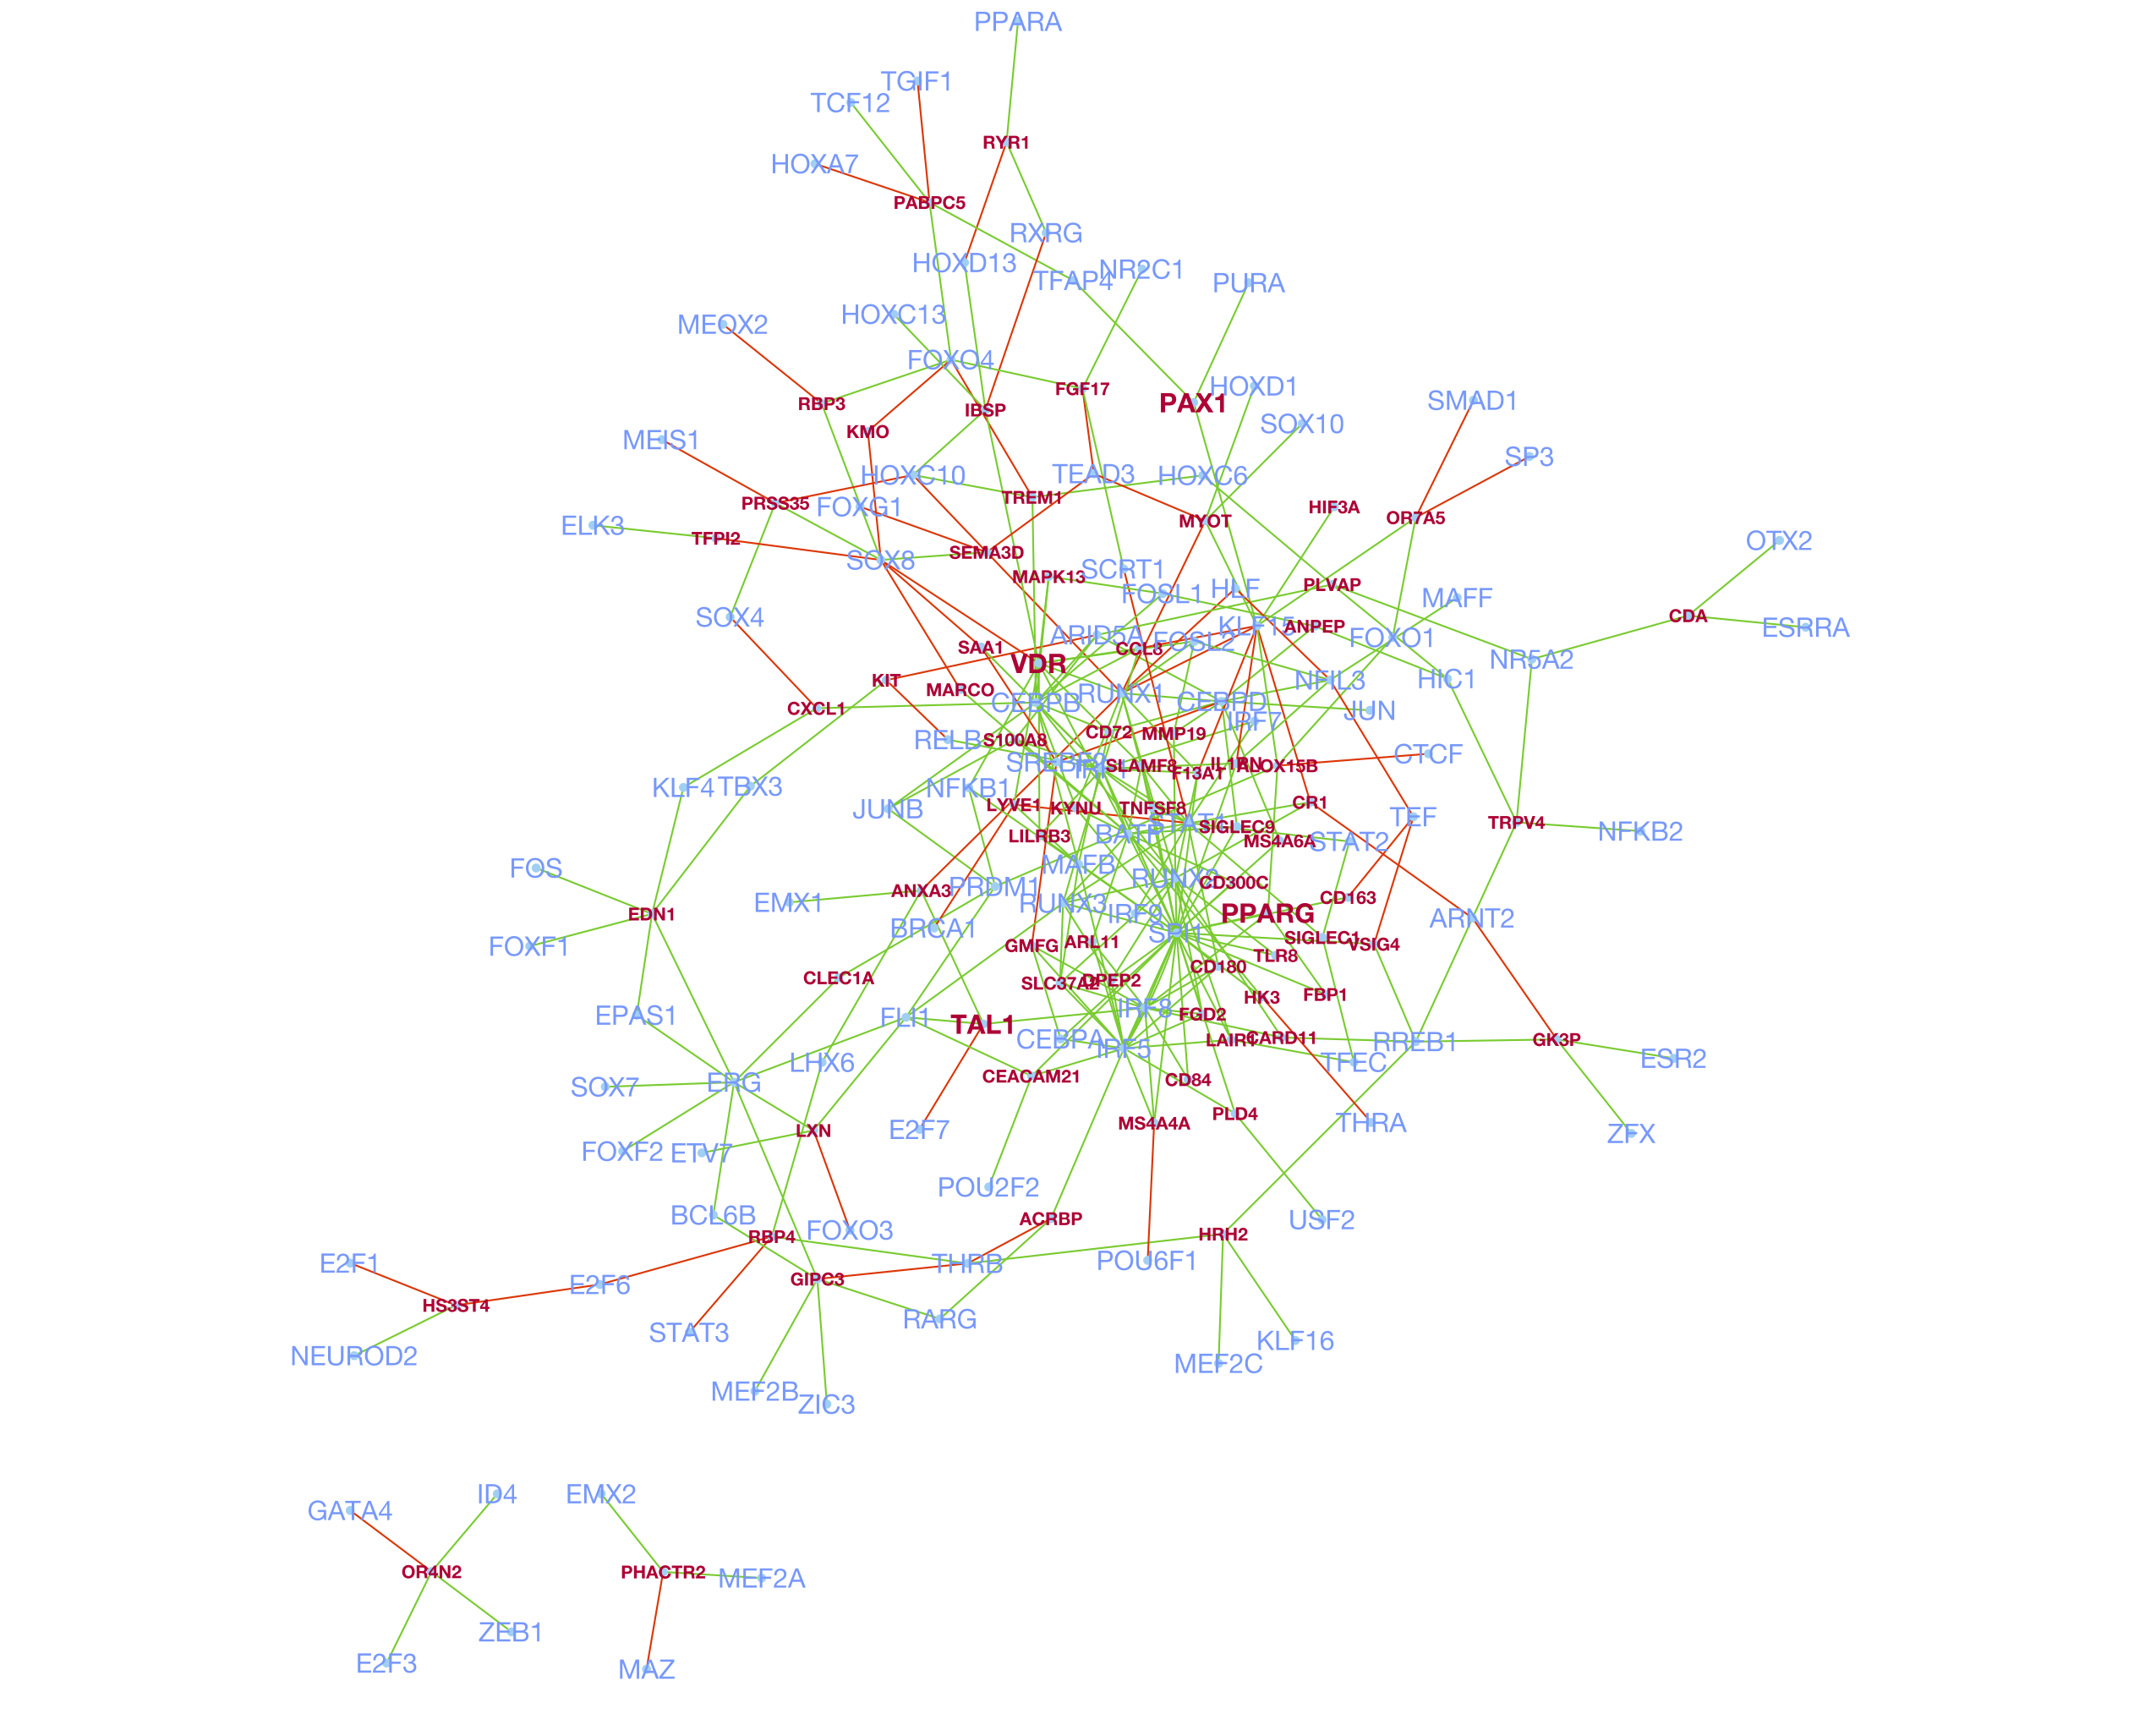
Supplementary Figure 3
Supplementary Figure 3. Global regulatory network of MA-TAM master regulators and target genes.

Slide 4
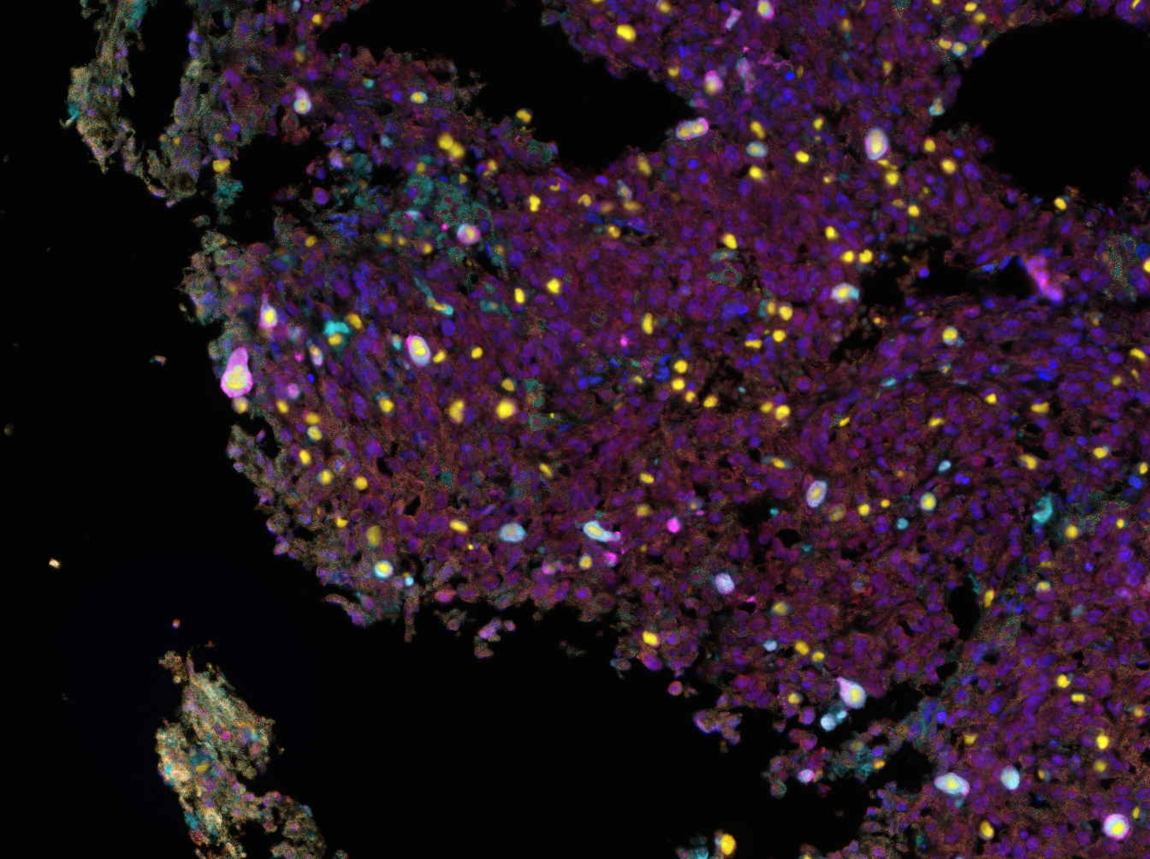
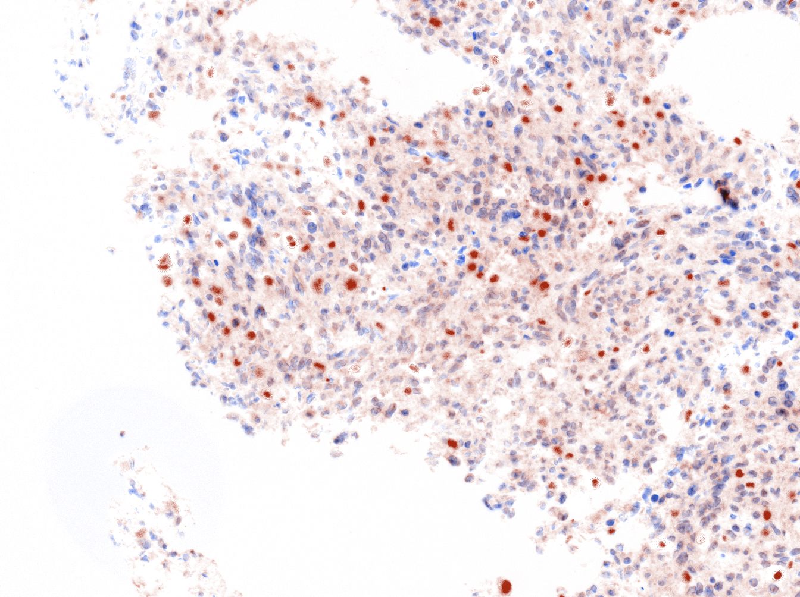
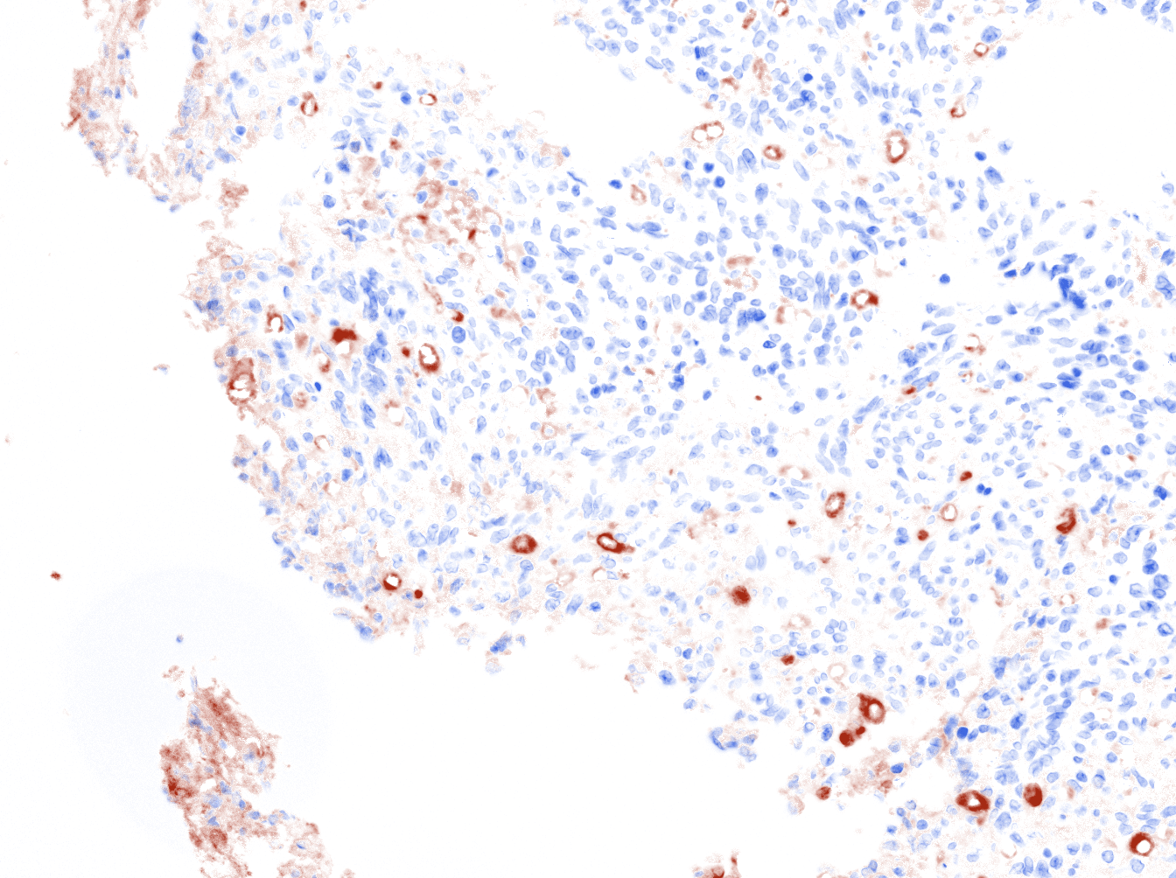
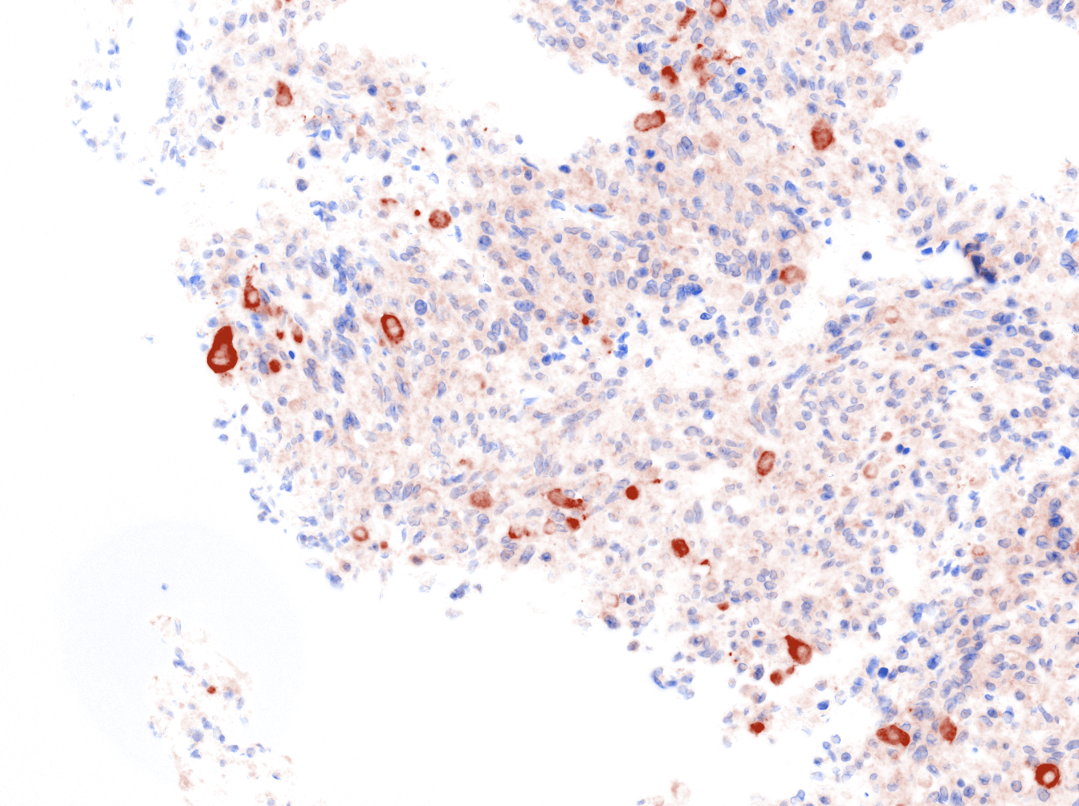
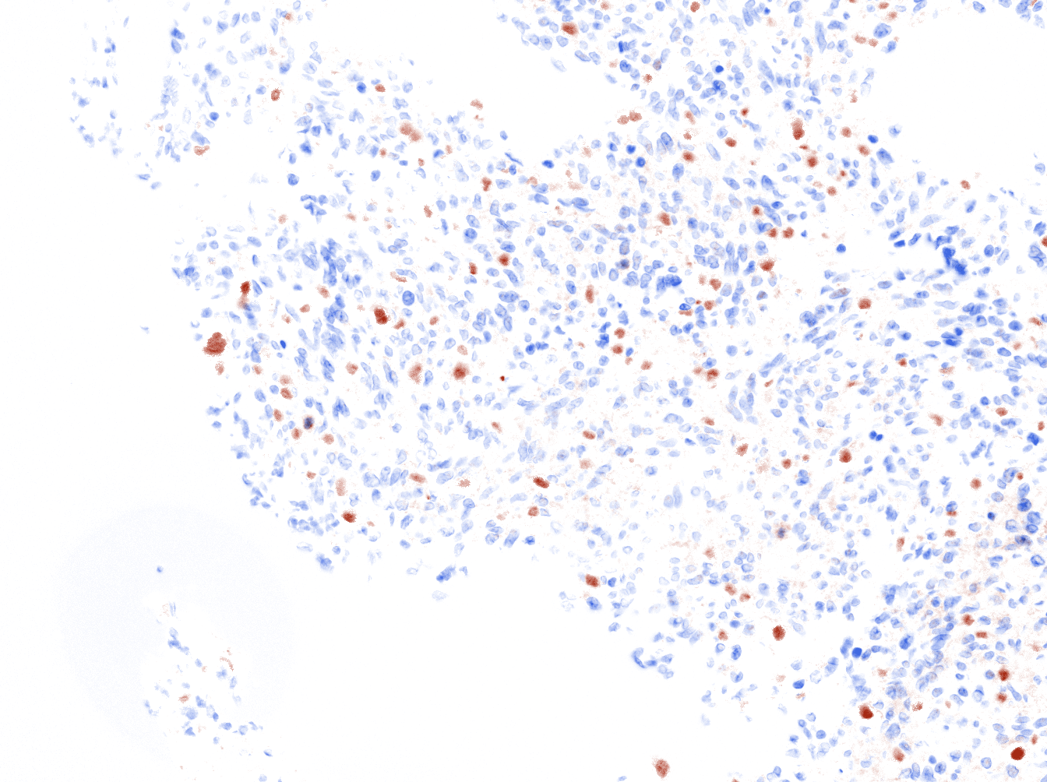
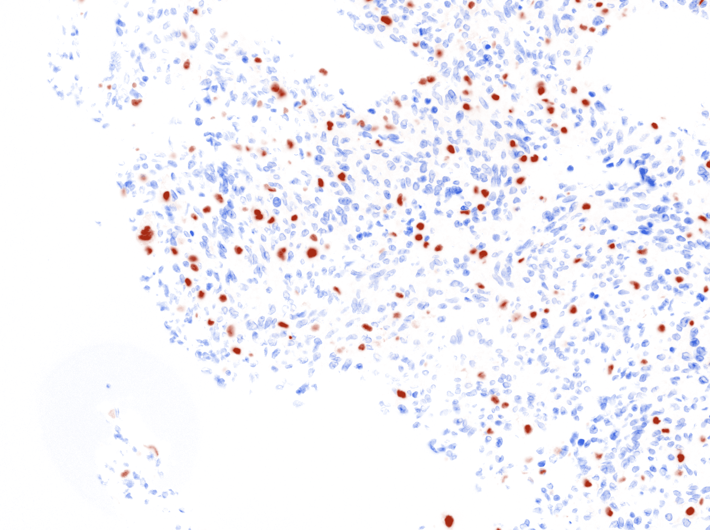
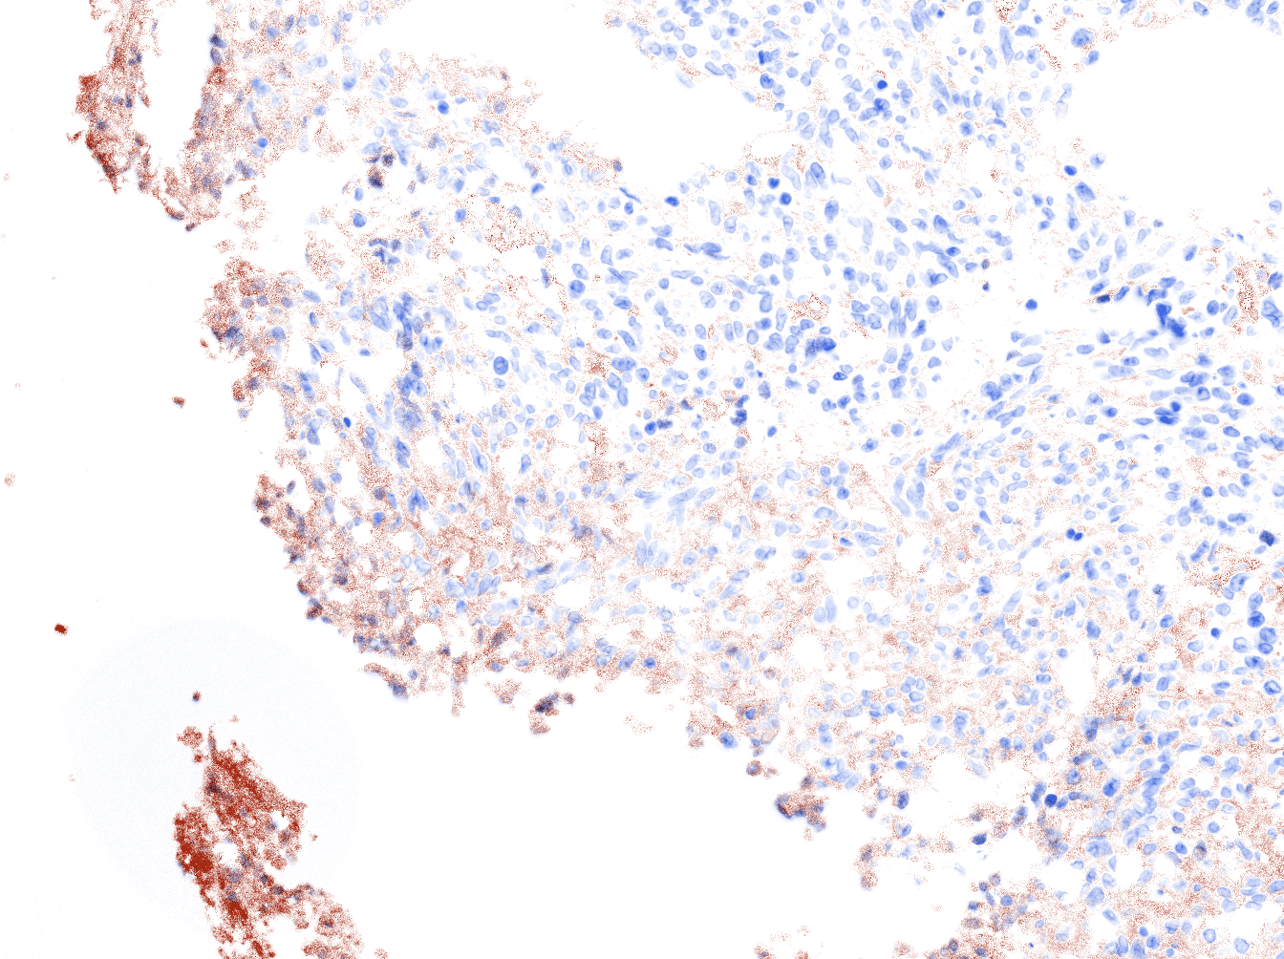
Supplementary Figure 4
Merged
BATF
CD68
MARCO
PPARy
SPI1
YKL40
Supplementary Figure 4. Multi-color immunohistochemical images of MA-TAM encoding molecules and master regulators in mesenchymal GBM.

Slide 5

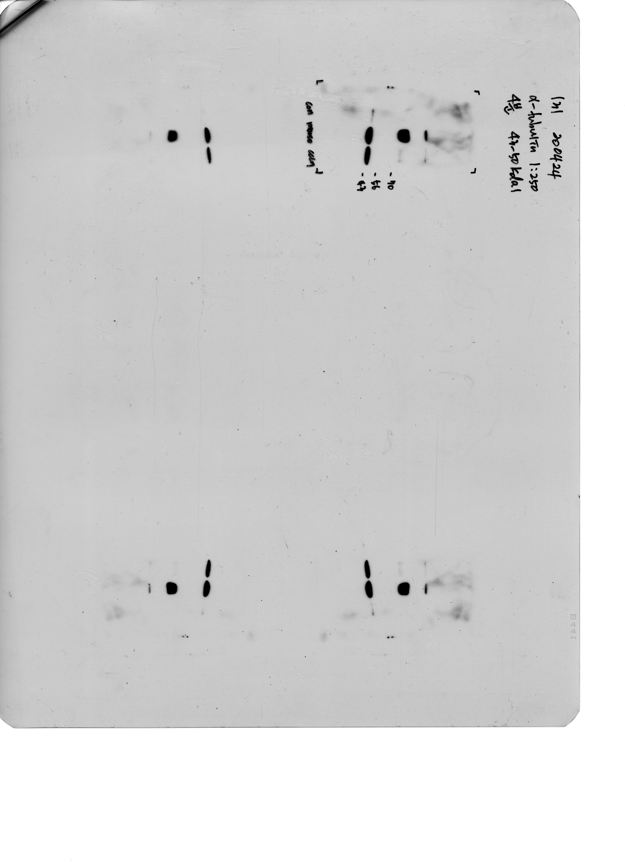


Supplementary Figure 5
A
B
GBM3
Control
MARCO
CCL7
+
-
-
***
Control
MARCO
-
+
-
*
CCL
-
-
+
CD44
Relative mRNA expression (Log₂ scale)
TAZ
**
***
**
NANOG
*
Vinculin
GBM3
Supplementary Figure 5. qRT-PCR and immunoblot analysis of CD44, NANOG, LIF, MMP-2, TAZ in GSCs treated with either MARCO or CCL7 recombinant protein.

Slide 6
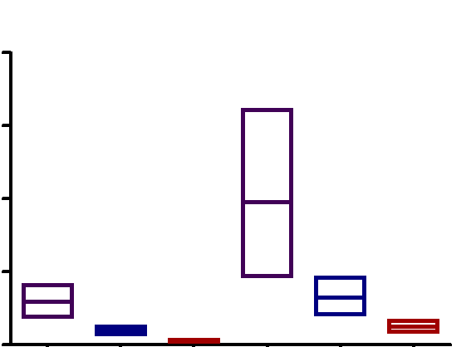
Supplementary Figure 6
Monocyte CM
MARCO^{low} CM
MARCO^{high} CM
800
***
600
1/Stem Cell Frequency
400
***
200
***
**
0
0 Gy
2 Gy
GBM2
Supplementary Figure 6. 1/stem cell frequency of GSCs that were treated with either Monocyte-derived CM, MARCO^{low} TAM-derived CM or MARCO^{high} TAM-derived CM and subjected to 2Gy of ionizing radiation. Stem cell frequency was calculated by extreme limiting dilution analysis. P-values were calculated using two-tailed student’s t test. *, P ≤ 0.05; **, P ≤ 0.01; ***, P ≤ 0.001

Slide 7
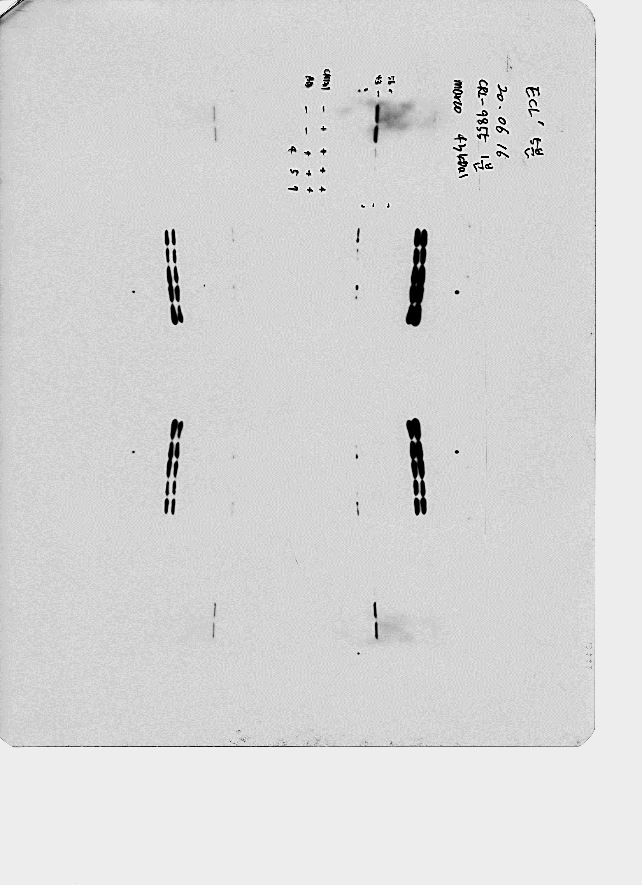

Supplementary Figure 7
A
TAM CM
- + + + +
Anti-MARCO Ab
- - #4 #5 #7
MARCO
β-actin
B
IgG
Anti-MARCO Ab #4
Anti-MARCO Ab #5
Anti-MARCO Ab #7
Relative mRNA expression
Supplementary Figure 7. qRT-PCR and immunoblot analysis of MARCO in macrophages and CD44, NANOG, LIF, MMP-2, TAZ in GSCs treated with IgG or Anti-MARCO antibodies.

Slide 8
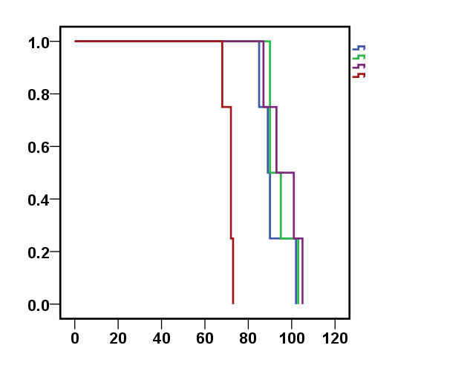
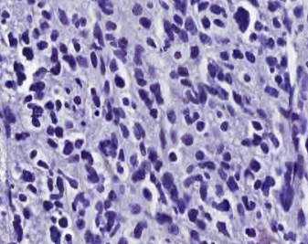
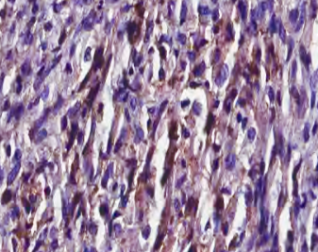
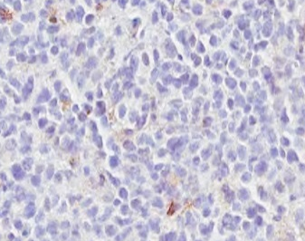
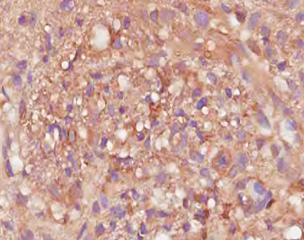
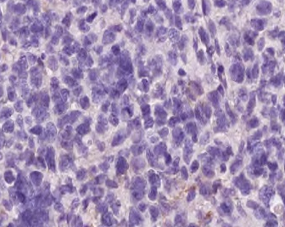
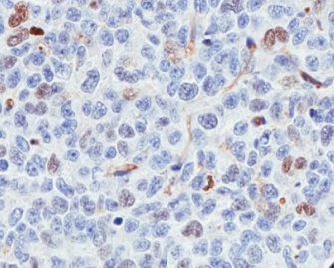
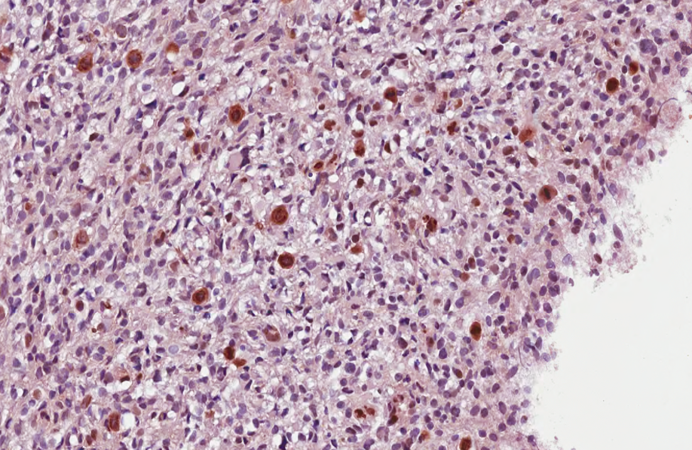
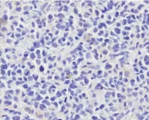
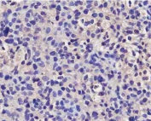
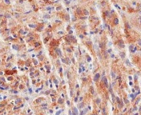
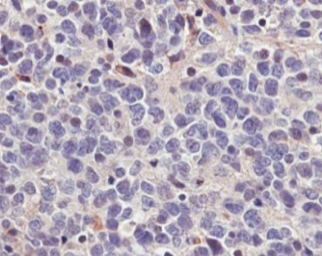
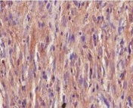
Supplementary Figure 8
A
B
GBM2
GBM2
Control
Control
Monocyte
MARCO^{low} TAM
MARCO^{high} TAM
Monocyte
MARCO^{low} TAM
CD44
MARCO^{high} TAM
Percent Survival
YKL40
TOP2A
P < 0.01
Survival days
SERPINE1
BCL2A1
Supplementary Figure 8. In vivo effects of MARCO^{high} tams in PDX models. (A) Kaplan-Meier survival curve analysis of mice that were co-transplanted with non-mesenchymal GSCs and respective cell populations. (B) Representative immunohistochemical iamges of mesenchymal representative markers, including CD44, YKL40, TOP2A, SERPINE1 and BCL2A1 of mice in A.

Slide 9
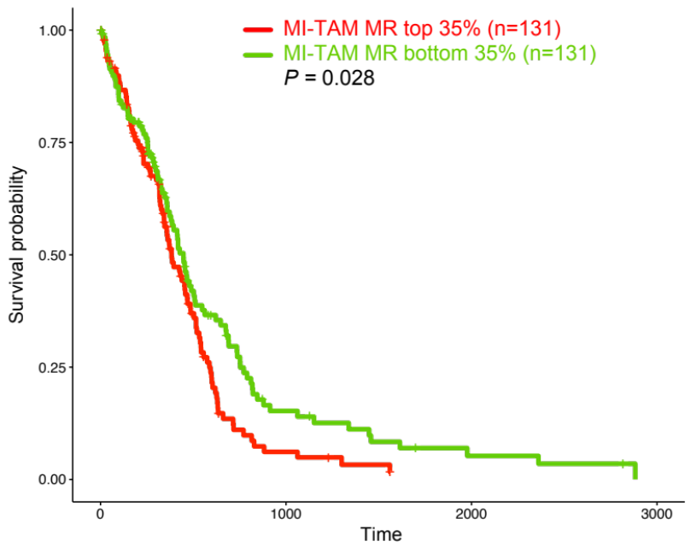
Supplementary Figure 9
Supplementary Figure 9. Clinical correlation of MA-TAM encoding genes. (A) Kaplan-Meier survival curve analysis of GBM patients based on MA-TAM master regulator activity.

Slide 10
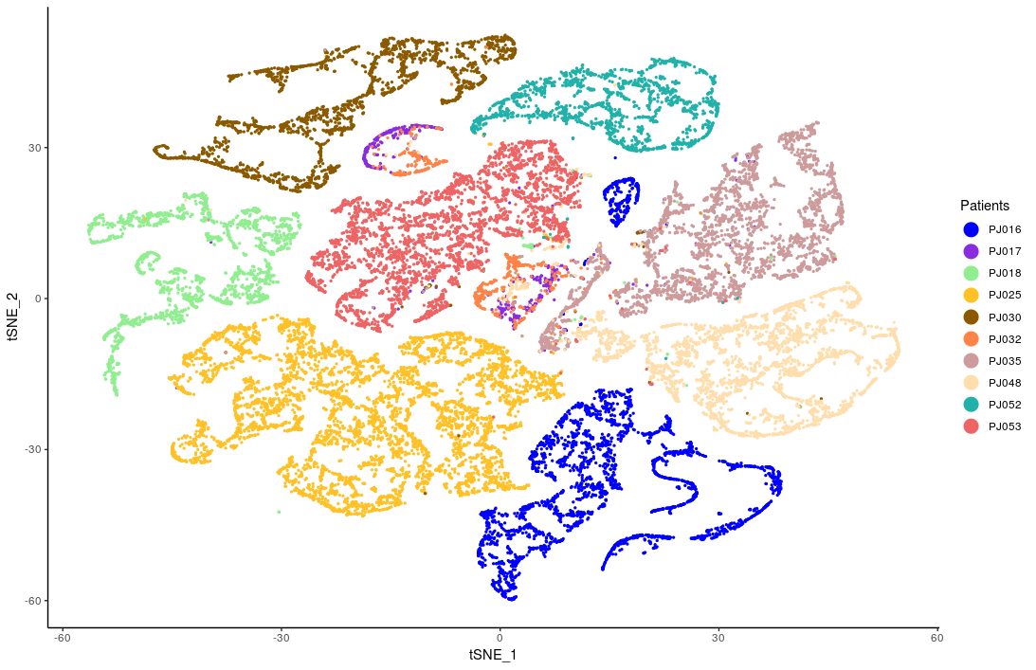
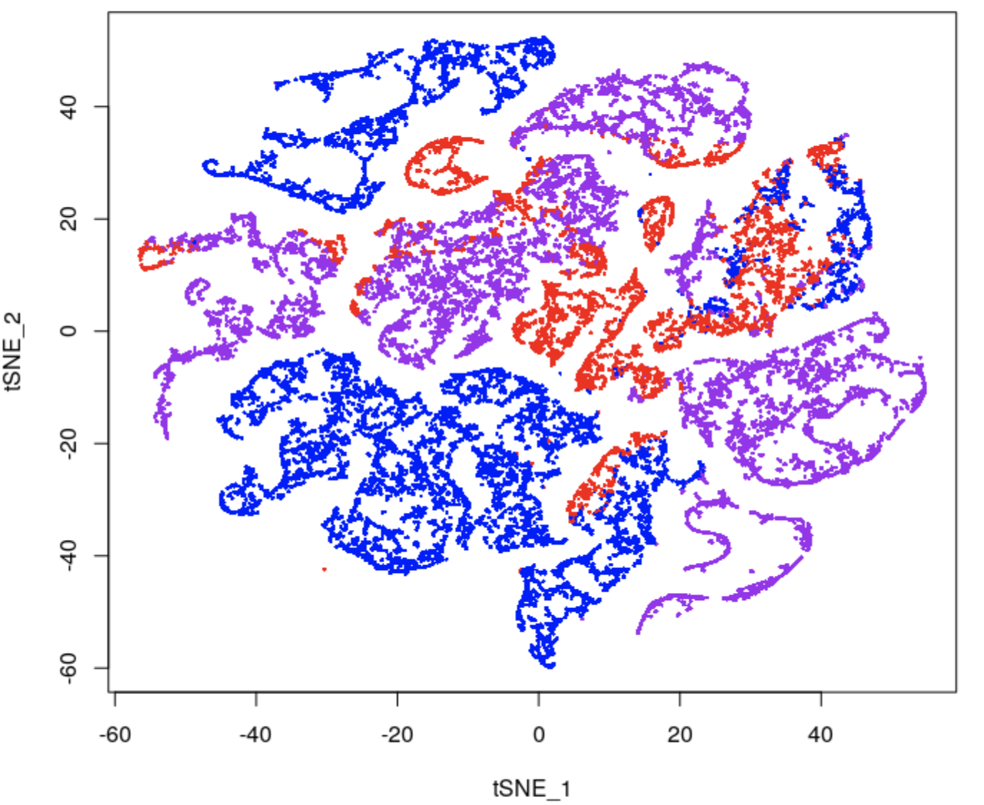
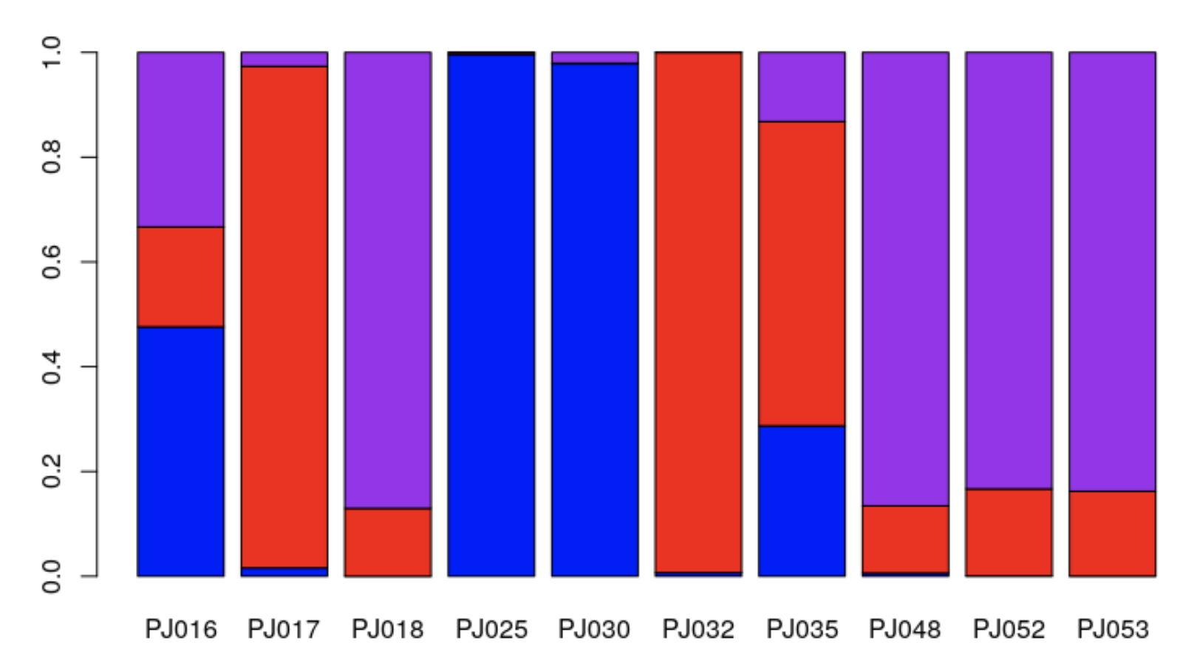
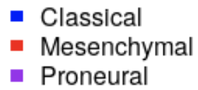
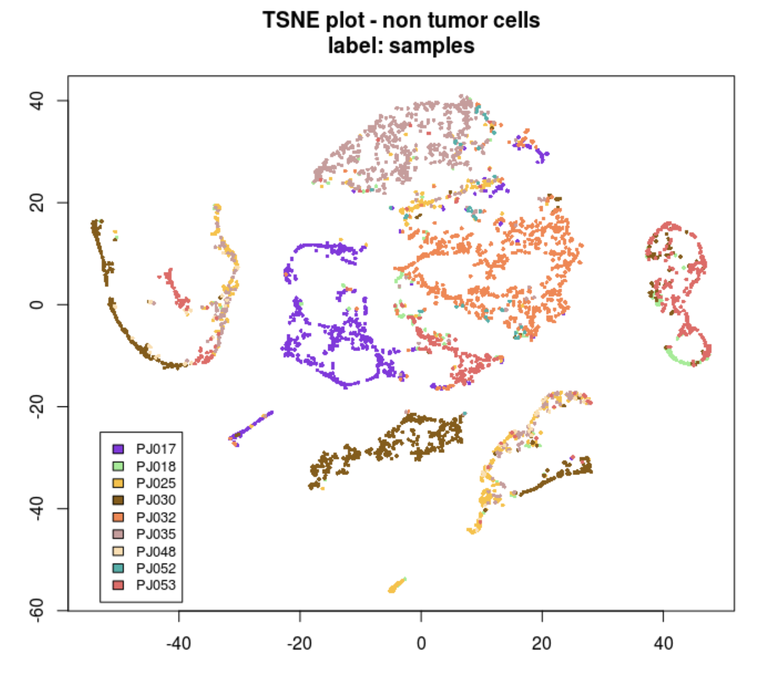
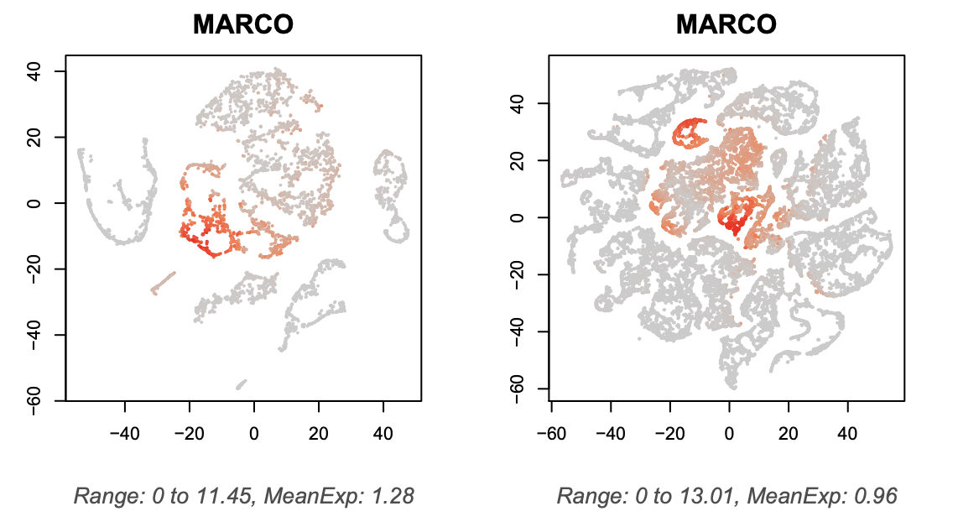
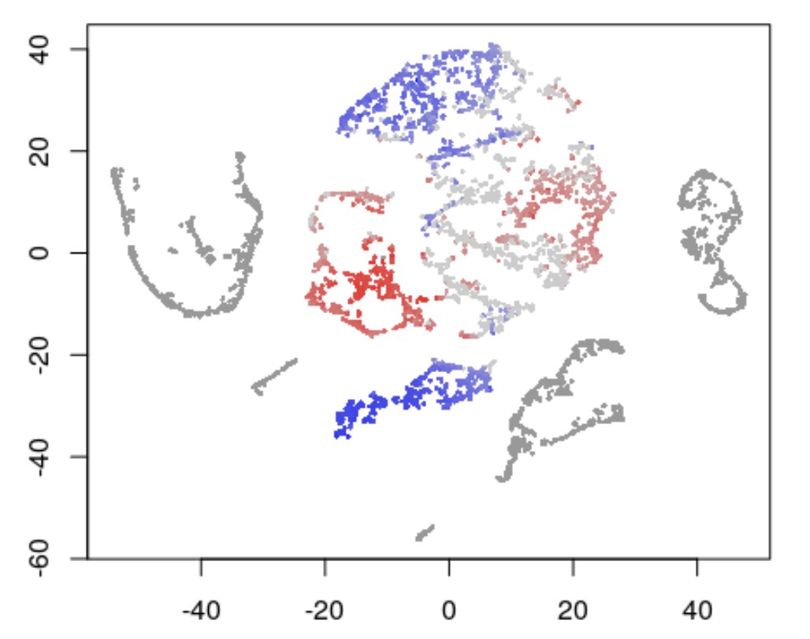
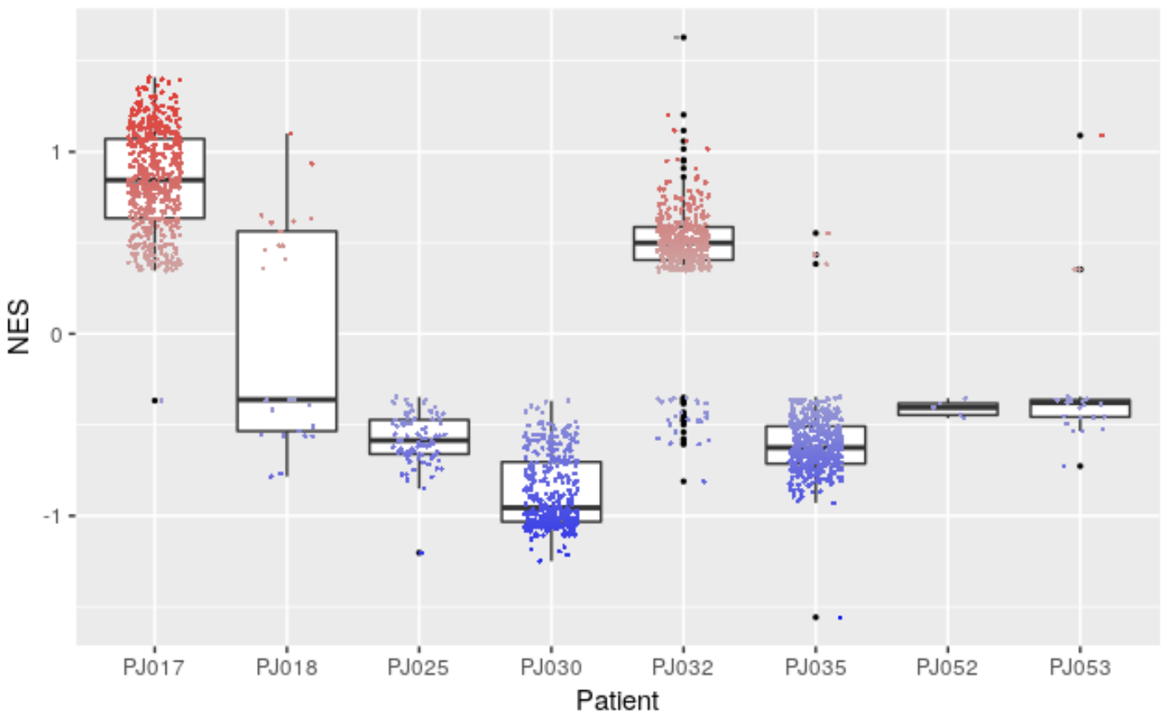

Supplementary Figure 10
Single-cell Verhaak Classification
A
B
Single cell fraction
C
MARCO expression
MA-TAM signature enrichment
1.5
-1.5
Supplementary Figure 10. Transcriptome analysis of MA-TAM signature and MARCO expression at single-cell resolution. (A) t-SNE analysis of single-cell transcriptomes based on patient (left panel) and GBM subtype (right panel) in malignant tumor cells. (B) Single cell fraction of mesenchymal, classical, and proneural tumor cells based on individual patient. (C) Patient-level distribution of non-malignant cells on the tSNE space (left panel), expression of MARCO (middle left panel), MA-TAM signature enrichment (middle right panel), and boxplot representation of MA-TAM signature enrichments in individual patients.

Slide 11
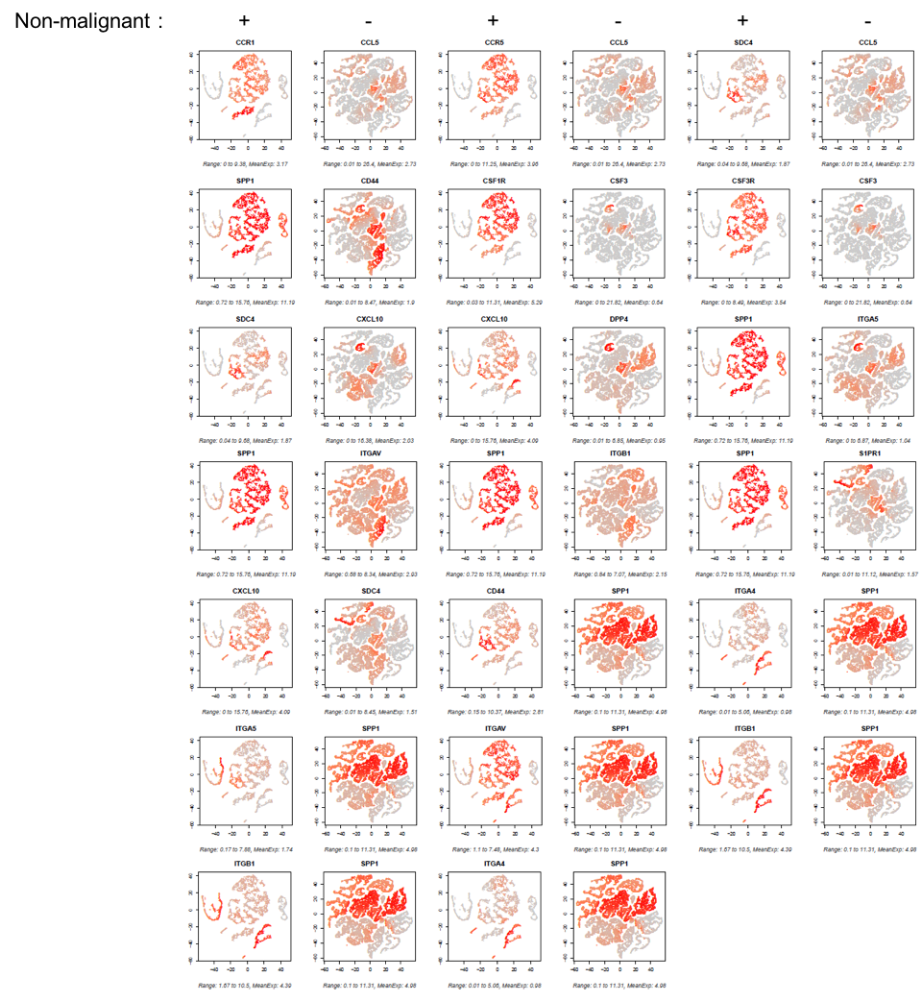
Supplementary Figure 11
Supplementary Figure 11. Transcriptome analysis of scTHI at single-cell resolution. Single cells were plotted on the tSNE space based on their malignant or non-malignant state. A total of 20 receptor-ligand interactions were plotted and demonstrated based on the expression level of each partner molecules.

Slide 12
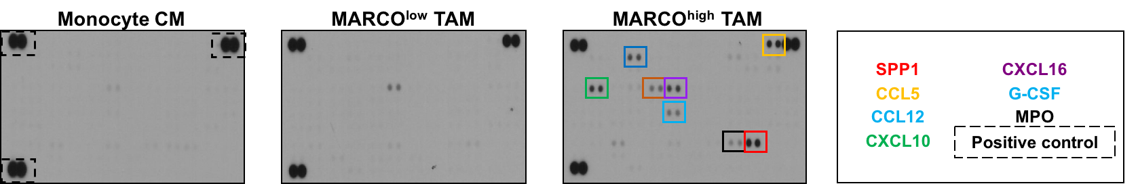
Supplementary Figure 12
Supplementary Figure 12. Cytokine array-based characterization of conditioned media that are collected from Monocytes, MARCO^{low} TAMs, MARCO^{high} TAMs. Each corresponding molecules have been colored and annotated.

Slide 13
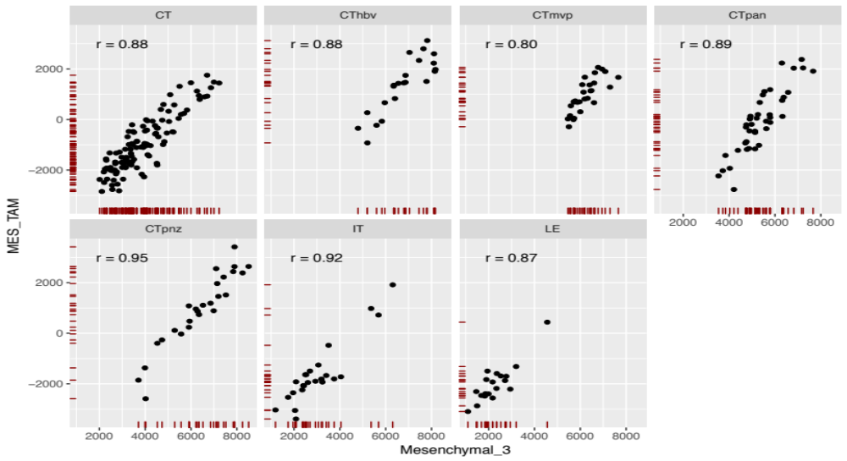
Supplementary Figure 13
MA-TAM signature score
All P < 0.05
GBM-intrinsic mesenchymal subtype score
Supplementary Figure 13. Anatomical expression levels of MA-TAM encoding genes. Scatter plot correlations of MA-TAM signature score with GBM-intrinsic mesenchymal subtype score in IVY Glioblastoma Atlas Project (IGAP) dataset.

