Slide 1
a
(%)
b
Percentage of peaks passing IDR cutoff of 0.05
Pearson’s correlation coefficient
Fig. S1 Statistics of percentage of peaks passing IDR cutoff of 0.05 (a) and Pearson’s correlation coefficients (b) for replicated DAP-seq datasets of 11 randomly selected TFs.

Slide 2
Fig. S2 Clustering of the top motif identified for each TF with canonical binding motif.

Slide 3
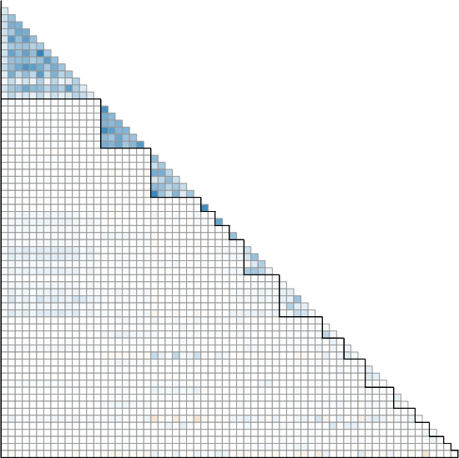
ERF
R
WRKY
HSF
B3
TCP
SBP
bZIP
MYB
Dof
NAC
MYB-related
G2-like
ZH-HD
HD-ZIP
GRF
C2H2
AP2
Fig. S3 Correlation matrix based on the presence and absence of TF peaks within 2 kb windows across the genome among all TFs with canonical binding motifs. Each square represents the Pearson’s correlation coefficient between a pair of TFs.

Slide 4
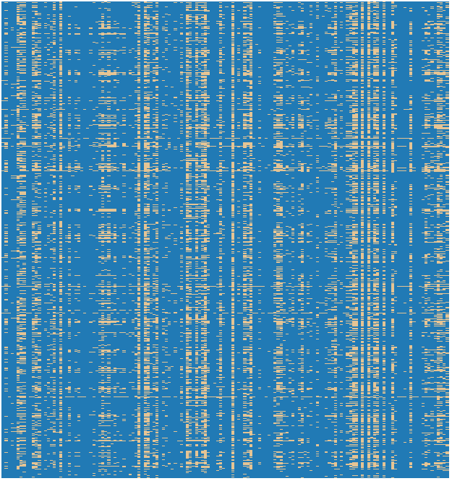
Presence
Absence
Fig. S4 Heatmap representing the presence and absence of individual TFs across a set of merged TF binding regions. Each row corresponds to a unique TF binding region, while each column represents a specific TF.

Slide 5
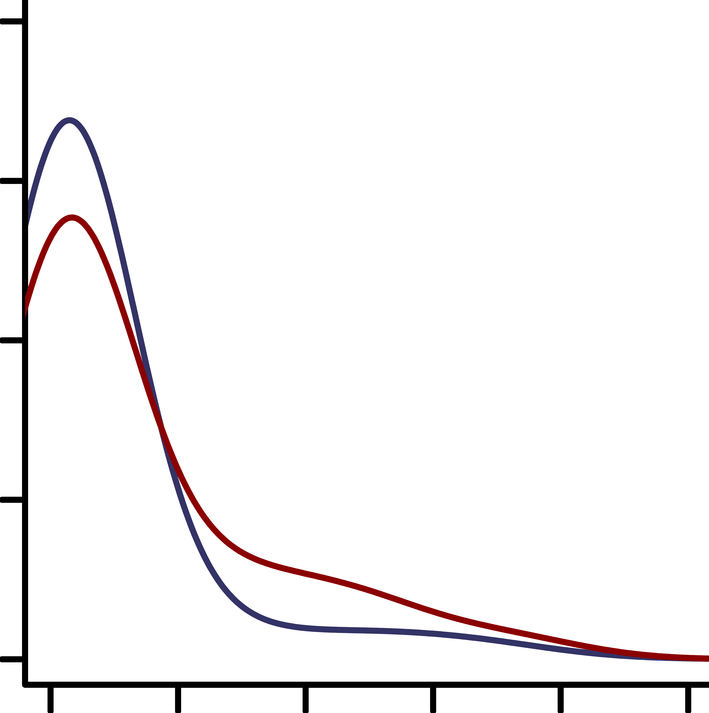
Random TF pairs
TF pairs from the same families
Density
Shared target genes (%)
Fig. S5 Percentage of shared target genes among random TF pairs or among TF pairs from the same families.

Slide 6
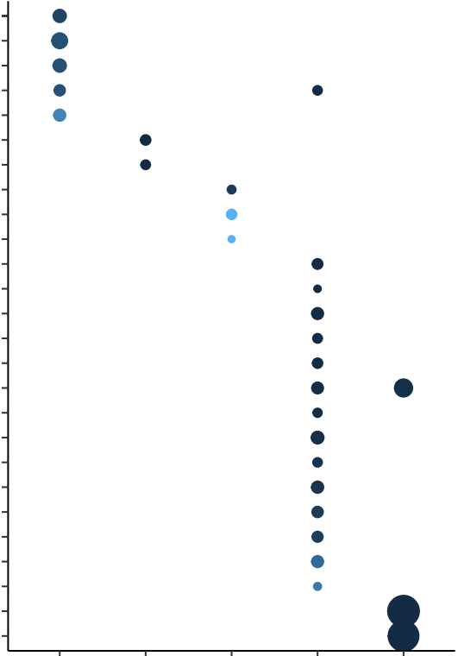


response to external stimulus
secondary metabolic process
response to biotic stimulus
response to stress
response to endogenous stimulus
cell differentiation
anatomical structure morphogenesis
cellular protein modification process
cytoskeleton
plasma membrane
response to abiotic stimulus
cellular process
cell cycle
cellular component organization
protein metabolic process
translation
nucleobase-containing compound metabolic process
cell death
cellular protein modification process
cellular homeostasis
DNA metabolic process
embryo development
epigenetic regulation of gene expression
biosynthetic process
photosynthesis
generation of precursor metabolites and energy
FDR
0
0.02
0.04
FE
0 1~5 6~10 11~20 >20
# TFs bound in promoters
Fig. S6 Gene Ontology (GO) enrichment of biological process of the genes bound by different number of TFs in promoters. The circle color and size indicate FDR value and fold enrichment, respectively.

Slide 7
0.6
0.03
Block 1
Block 2
1.0
0.4
0.02
0.8
0.6
mCHG level
mCHH level
Normalized ATAC-seq
read counts
0.2
0.01
0.4
0.2
0
-2kb
Summit
+2kb
0
-2kb
Summit
+2kb
0
-2kb
Summit
+2kb
1.0
1.0
1.0
0.8
0.8
0.8
0.6
0.6
0.6
Fold change of
H3K27ac / Input
Fold change of
H3K4me3 / Input
Fold change of
H3K27me3 / Input
0.4
0.4
0.4
0.2
0.2
0.2
0
-2kb
Summit
+2kb
0
0
-2kb
Summit
+2kb
-2kb
Summit
+2kb
Fig. S7 Distribution of epigenetic features throughout 4kb flanking sequences of the peak summit of each TF for the two blocks of duplicated genome in soybean.

Slide 8
a
b
**
c
**
# Random genes (x1,000)
Gene pairs without shared promoter-bound TFs (%)
Gene pairs with exact same TF motifs (%)
% Shared TFs
Fig. S8 Characteristics of TF bound in promoters of WGD and random gene pairs. a Frequency of random gene pairs with different percentages of shared TFs bound in promoters. The total number of random gene pairs were the same as the number of WGD paralogs. b Percentage of WGD and random gene pairs without shared TFs bound in promoter. ** indicates P < 0.01 (Chi-square test). c Percentage of WGD and random gene pairs containing the exact same motif sequences in both copies. ** indicates P < 0.01 (Chi-square test).

Slide 9
a
Bound
Not bound
b
Bound
Not bound
Density (x10⁻³)
Density (x10⁻⁴)
-1kb
-500bp
TSS
+500bp
-1kb
-500bp
TSS
+500bp
Fig. S9 Density distribution of the distance between TFBSs and TSSs. The TFBSs in promoters bound by TFs in one copy of WGD (a) / random (b) gene pairs were compared to same TFBS motif sequences but not bound by TFs in another copy.

Slide 10
Motif pairs (%)
Motif pairs (%)
Motif pairs (%)
mCG change
mCHG change
mCHH change
Fig. S10 Fractions of TFBS motif pairs in promoters, comparing TF non-binding in one copy of WGD paralogs versus binding in the other copy, with varying degrees of methylation level increase in the non-bound copy.

Slide 11
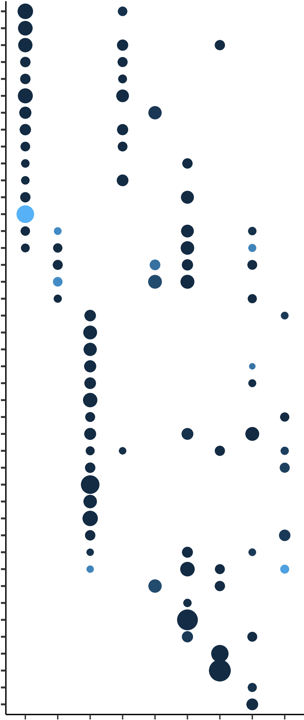


DNA metabolic process
cell cycle
translation
nucleobase-containing compound metabolic process
cellular component organization
epigenetic regulation of gene expression
reproduction
embryo development
post-embryonic development
multicellular organismal development
protein metabolic process
flower development
behavior
anatomical structure morphogenesis
cell differentiation
carbohydrate metabolic process
pollination
transport
response to stress
response to biotic stimulus
response to external stimulus
signal transduction
response to endogenous stimulus
cell death
cellular protein modification process
secondary metabolic process
response to abiotic stimulus
cell communication
fruit ripening
pollen-pistil interaction
abscission
response to extracellular stimulus
catabolic process
lipid metabolic process
cellular homeostasis
biosynthetic process
cell-cell signaling
cell growth
generation of precursor metabolites and energy
photosynthesis
growth
tropism
FDR
0
0.02
0.04
FE
M1
M2
M3
M4
M5
M6
M7
M8
M9
Fig. S11 Gene Ontology (GO) enrichment of biological process of the genes in each module. The circle color and size indicate FDR value and fold enrichment, respectively.

Slide 12
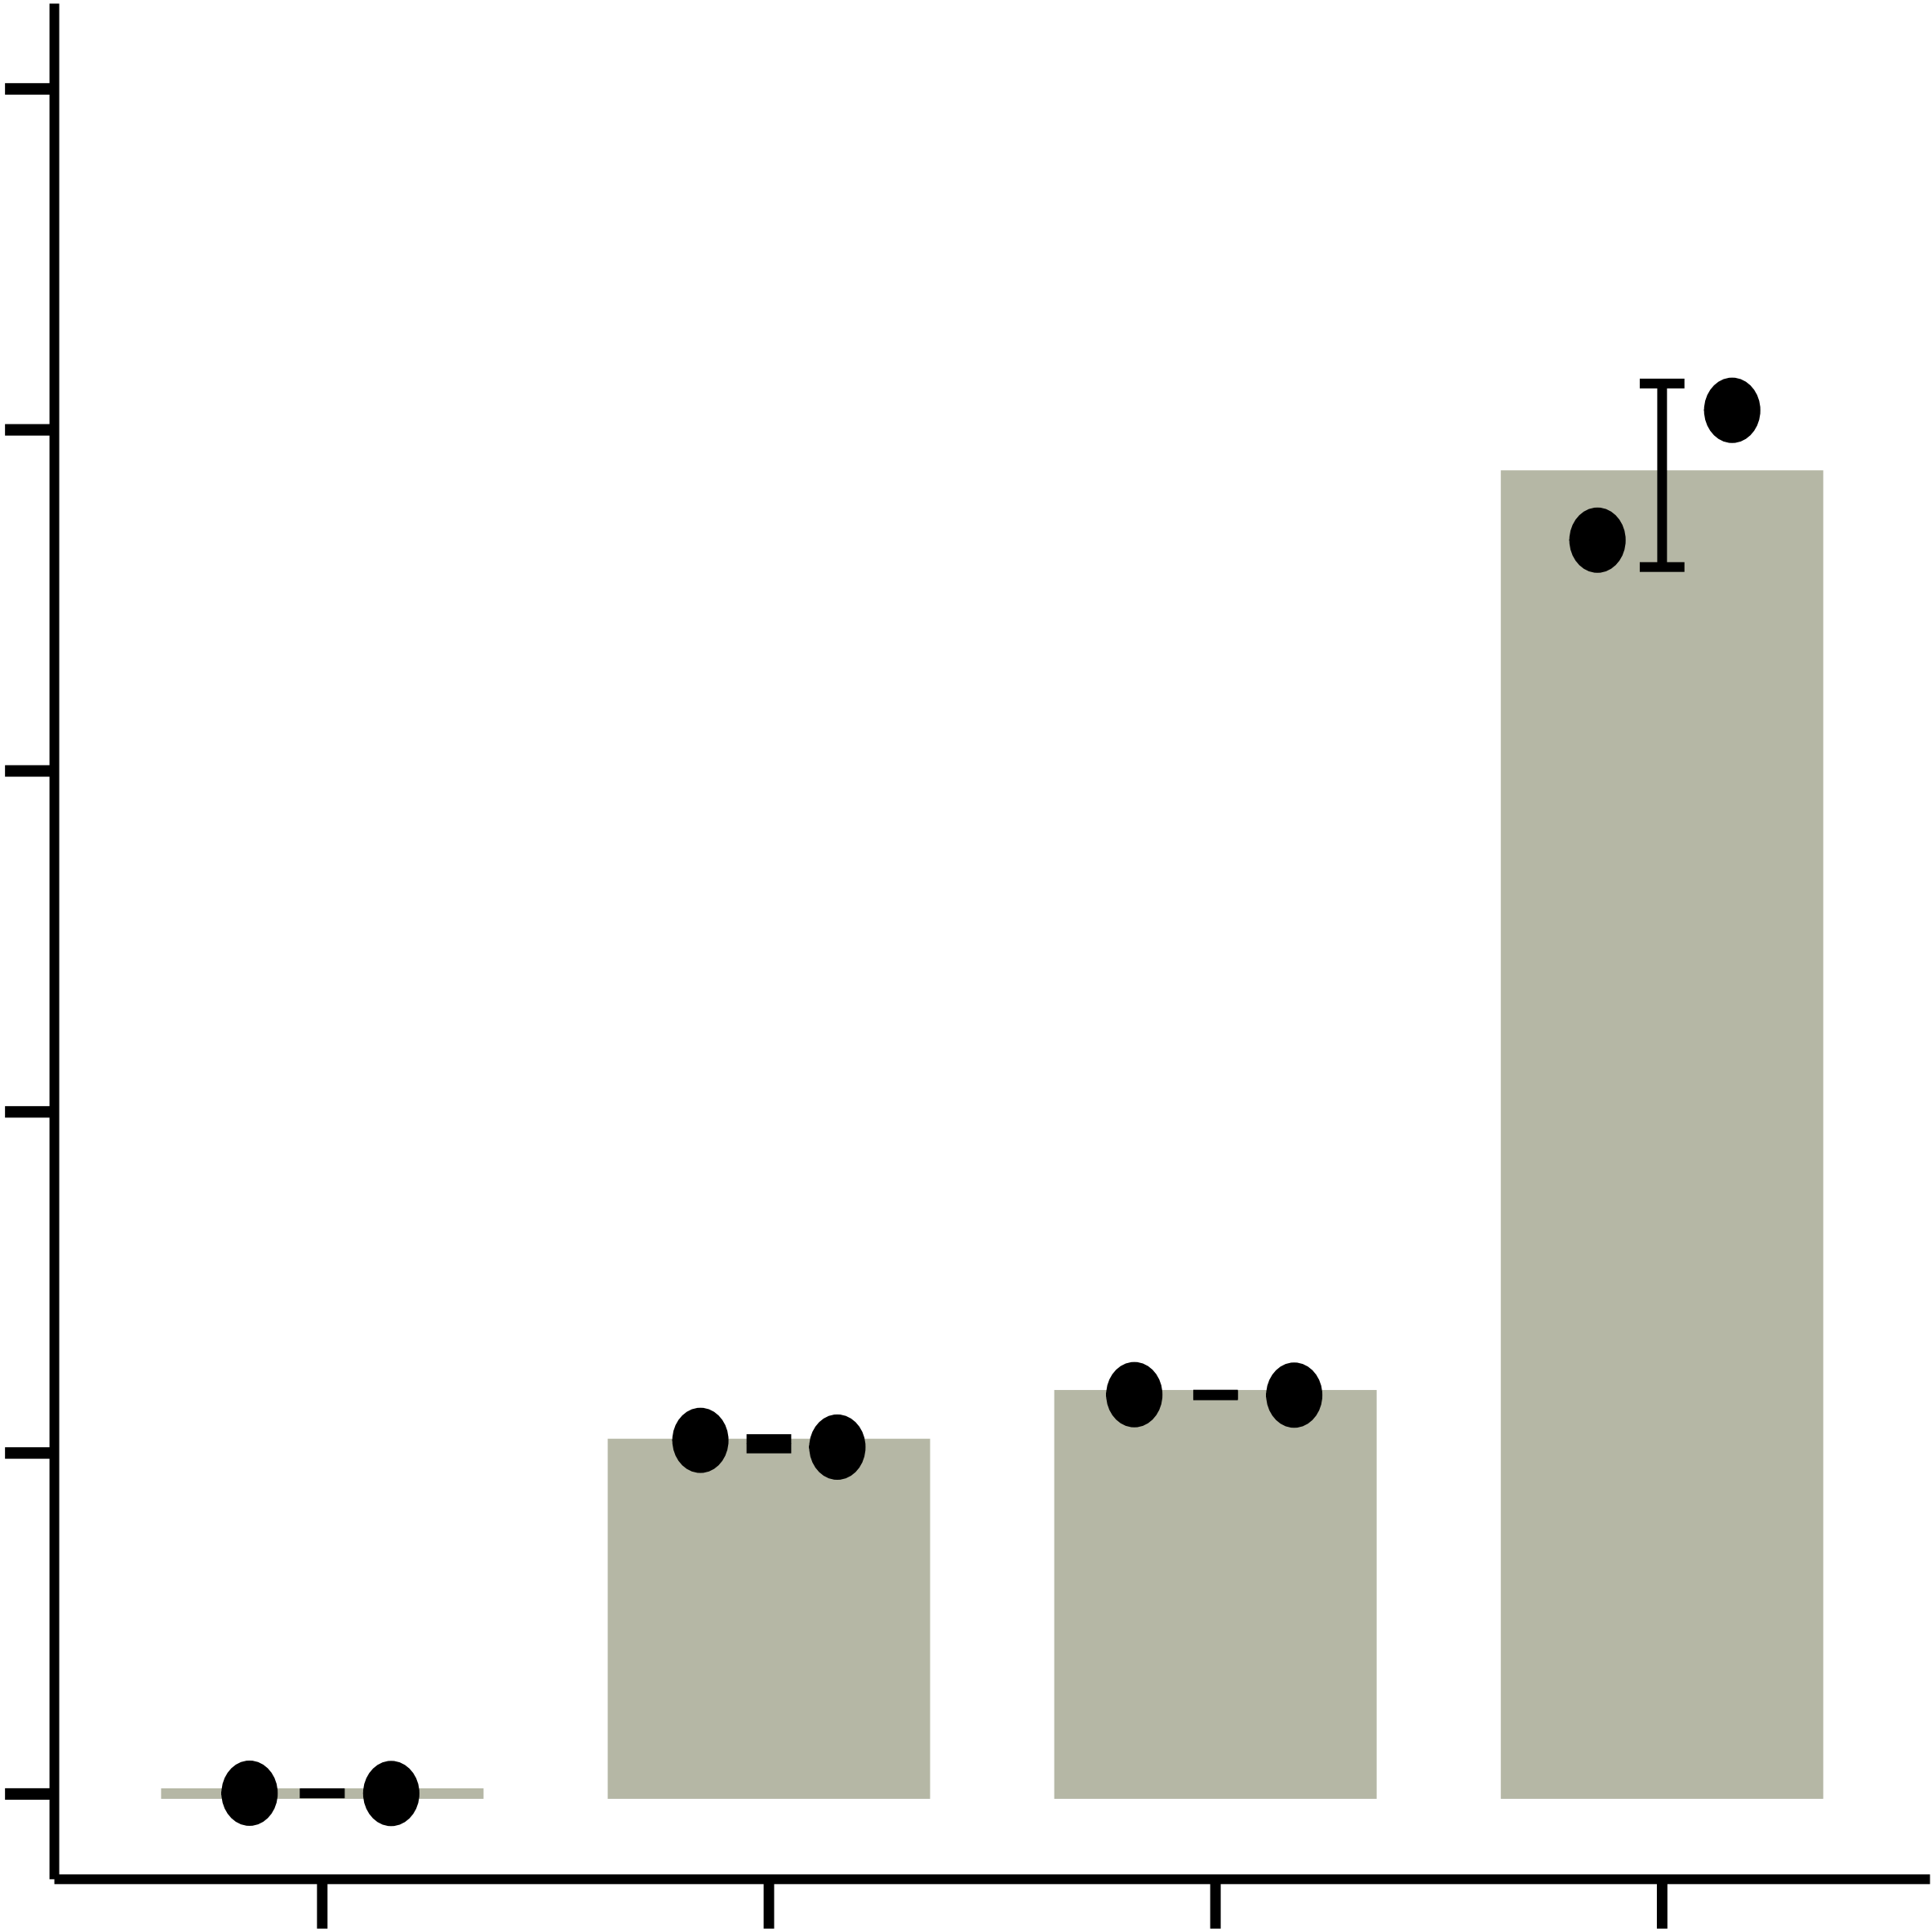
a
Brara.I02317
b
AtTT8
Zm00001d019170
Glyma.19G155300
Relative expression
Glyma.03G152800
Glyma.10G026000
(GmTT8b)
Glyma.02G147800
(GmTT8a)
WT OE-1 OE-2 OE-3
Fig. S12 Generation of GmTT8b overexpression lines. a Phylogenetic analysis of GmTT8b with other bHLH proteins from different plants. b Expression level of GmTT8b in transgenic lines analyzed by RT-qPCR using total RNA isolated from two-week-old leaves of W82 and GmTT8b transgenic plant. The relative expression level of GmTT8b was normalized using GmTUBULIN as an internal control. Error bars indicate SD (n = 2).

Slide 13
WT
glyma.01g075900
glyma.02g264700
glyma.05g111400
glyma.05g225100
glyma.05g245900
glyma.08g057400
glyma.08g119900
glyma.09g038900
glyma.09g235600
glyma.09g270000
glyma.14g058100
glyma.17g080900
glyma.17g155600
glyma.18g182400
**
**
**
**
**
**
**
**
**
**
**
**
**
**
Oil content (%)
Fig. S13 Seed oil content of wild type (WT) and ethyl methanesulfonate mutant lines with stop gain mutations in TFs predicted to regulate seed oil content (mean ± SD, n = 3). ** indicates P < 0.01 (Student’s t-test) for comparison between WT and mutant lines.

Slide 14
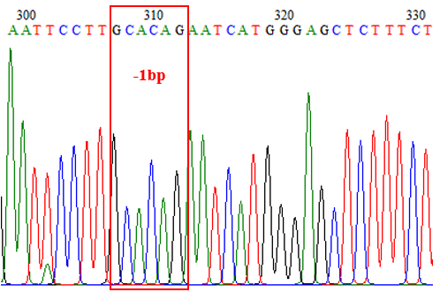
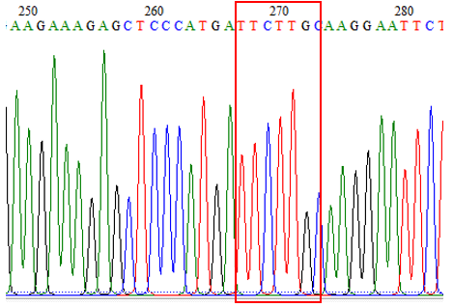
a
b
Glyma.01G075800
Glyma.11G163828
PAM
Target sequence
Target sequence
PAM
WT: TTCCTTGCAACAGAATCATGGGAGCTCTTTC
WT: AAGAGCTCCCATGATTCTGTTGCAAGGAAT
Mutant: TTCCTTGC- ACAGAATCATGGGAGCTCTTTC
Mutant: AAGAGCTCCCATGATTCT - - TGCAAGGAAT
Fig. S14 Generation of CRISPR-Cas9 mutants of Glyma.01G075800 and Glyma.11G163828. a,b Detailed sequences of the target sites in mutant lines for Glyma.01G075800 (a) and Glyma.11G163828 (b).

Slide 15
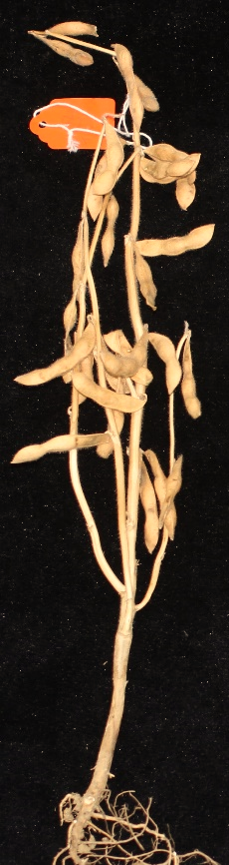
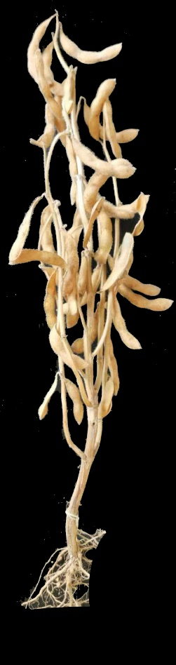
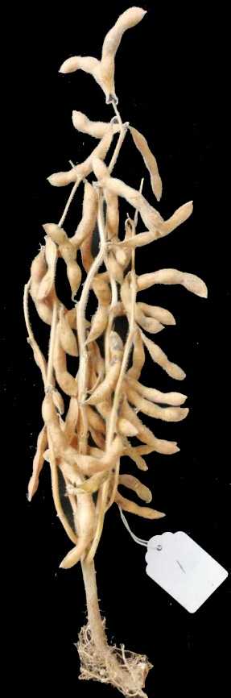
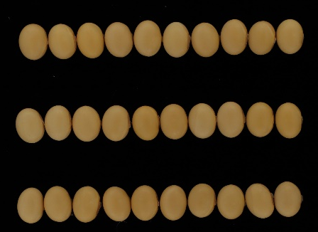
a
b
*
**
Seed number per plant
WT
glyma.01g075800
glyma.11g163828
c
*
Seed weight per plant (g)
**
WT
glyma.01g075800
glyma.11g163828
WT
glyma.01g075800
glyma.11g163828
d
e
WT
100-seed weight (g)
glyma.01g075800
glyma.11g163828
WT
glyma.01g075800
glyma.11g163828
Fig. S15 Disruption of Glyma.01G075800 and Glyma.11G163828 changed yield-related traits. a Plant architecture of wild type (WT) and knockout lines of Glyma.01G075800 and Glyma.11G163828. Scale bar, 5 cm. b, c The seed number per plant (b) and seed weight per plant (c) of WT and knockout lines of Glyma.01G075800 and Glyma.11G163828 (mean ± SD). * and ** indicate P < 0.05 and P < 0.01 (Student’s t-test) for comparison between WT and knockout lines, respectively. d The representative seeds of WT and ﻿knockout lines of Glyma.01G075800 and Glyma.11G163828. Scale bar, 1 cm. e 100-seed weight of WT and knockout mutants of Glyma.01G075800 and Glyma.11G163828 (mean ± SD).

