Slide 1
LOGO of the multiple alignment of the SAMD9 branch in the phylogenetic tree (XP_012791283.1, XP_004582357.1, XP_017199853.1, XP_012934202.1, XP_008062458.1, NP_060124.2, XP_003782717.1)
Conclusion: of the 14 disease-associated mutations in the SAMD9 gene, 13 are in strictly conserved positions in the branch. Therefore, these sequences have not sufficiently diverged for functionally inference to be feasible.

Slide 2
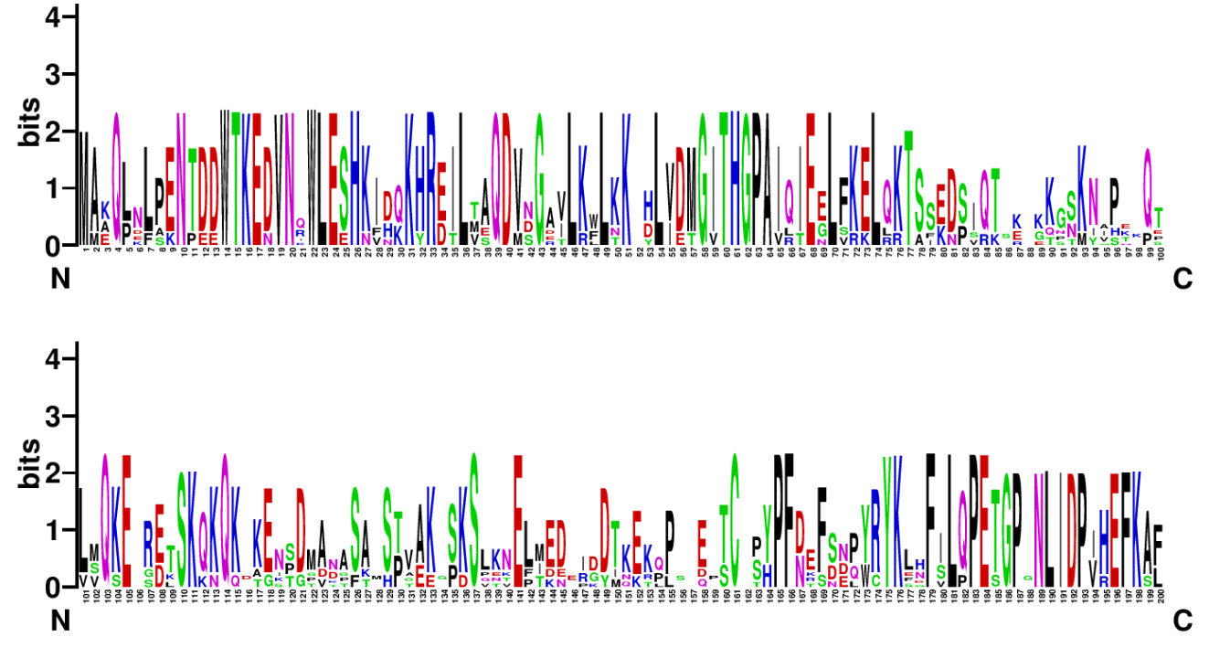

Slide 3
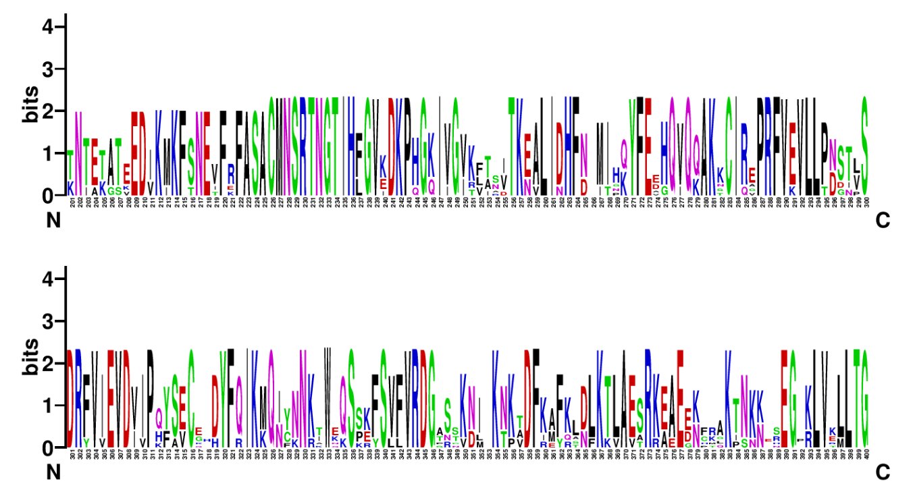

Slide 4
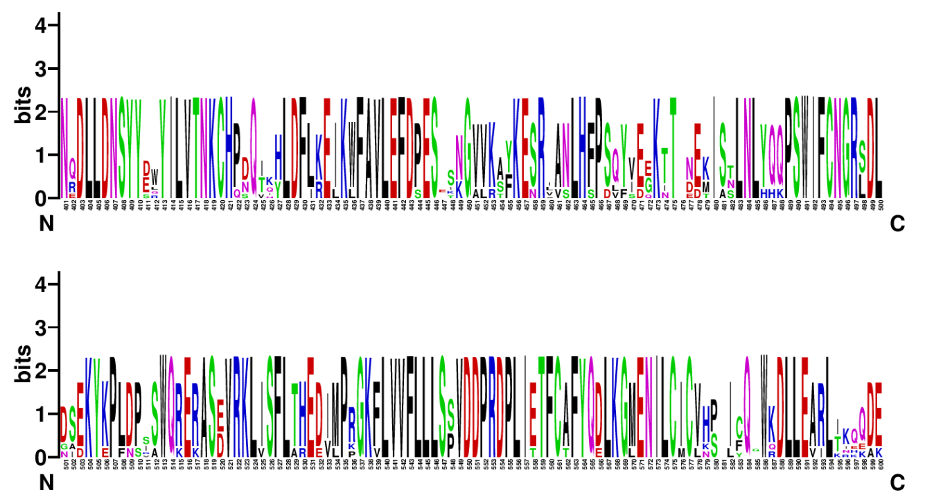
E457K
R459Q

Slide 5
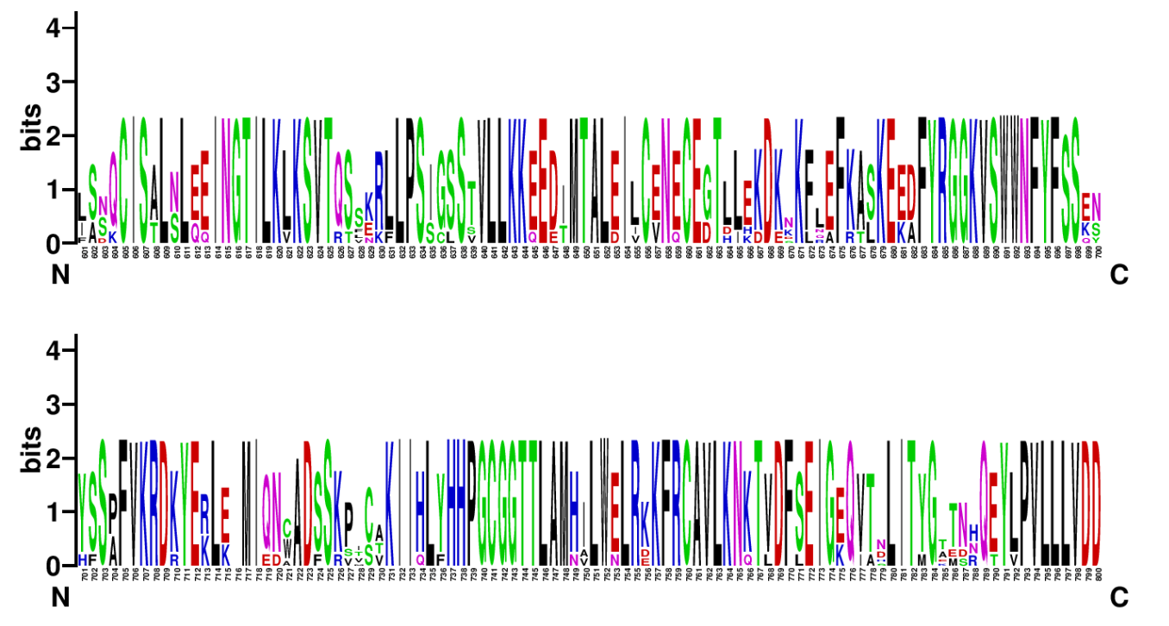
Walker A motif
K764E
D769N
Walker B motif

Slide 6
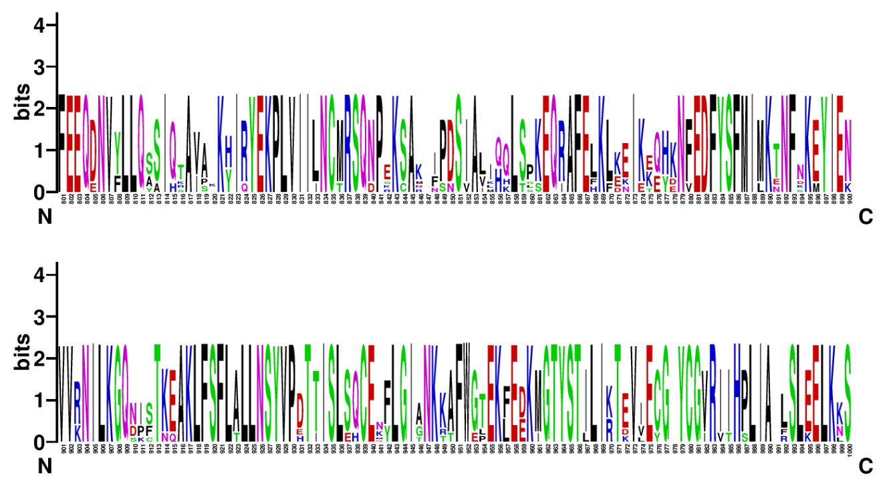
N834Y
S838L
E975KE

Slide 7
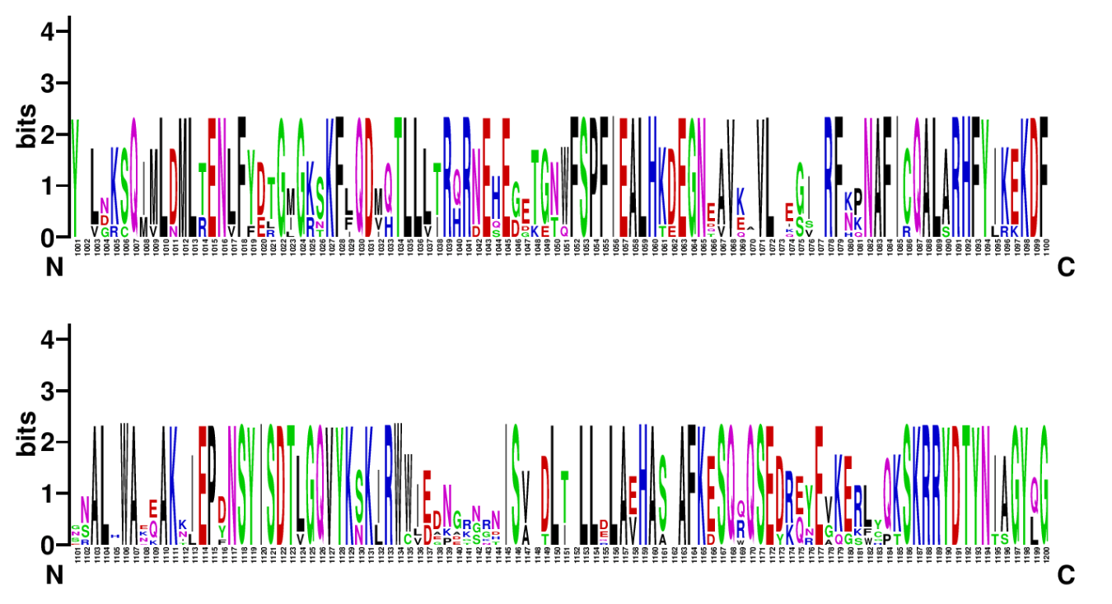
R1188Q
A1195V

Slide 8
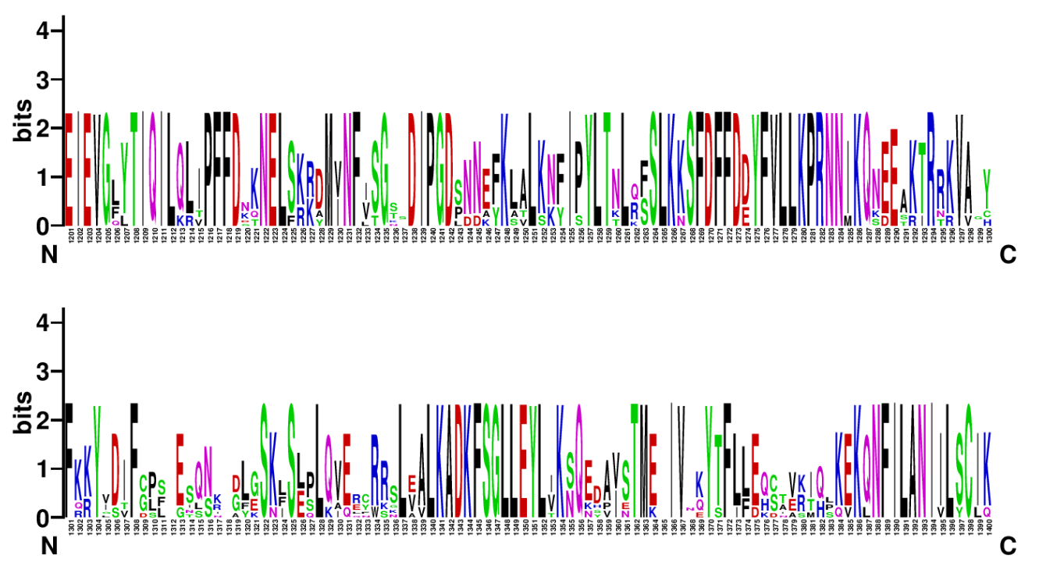
P1280L
V1276E
Q1286K
R1293W

Slide 9
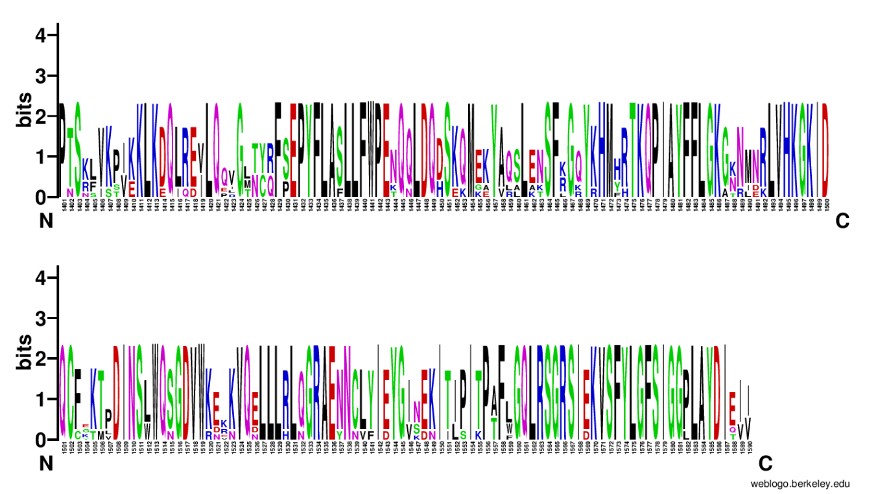
K1495E

