Slide 1
Supplymentary figures

Slide 2
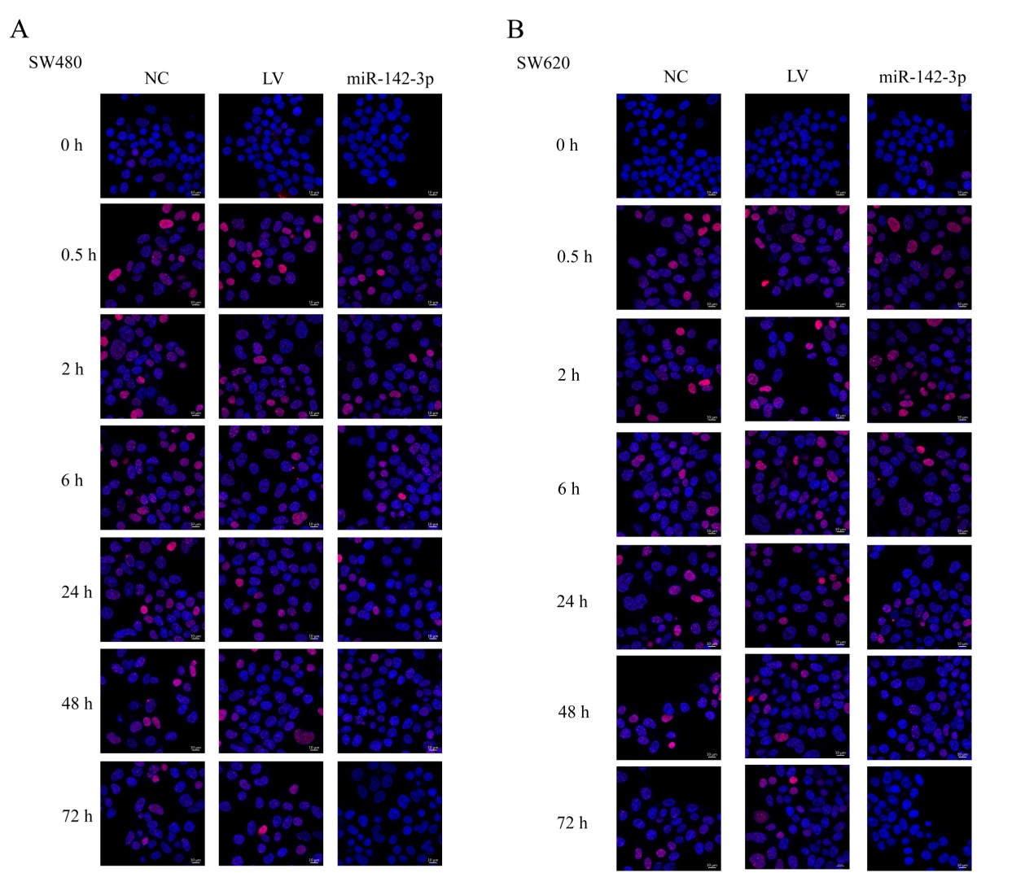
Figure S1
Figure S1, A:The kinetics of foci γH2AXin SW480 cells at various time points post-irradiation, including 0, 0.5, 2, 6, 24, 48 and 72 hours.B:The kinetics of foci γH2AXin SW620 cells at various time points post-irradiation, including 0, 0.5, 2, 6, 24, 48 and 72 hours.

Slide 3
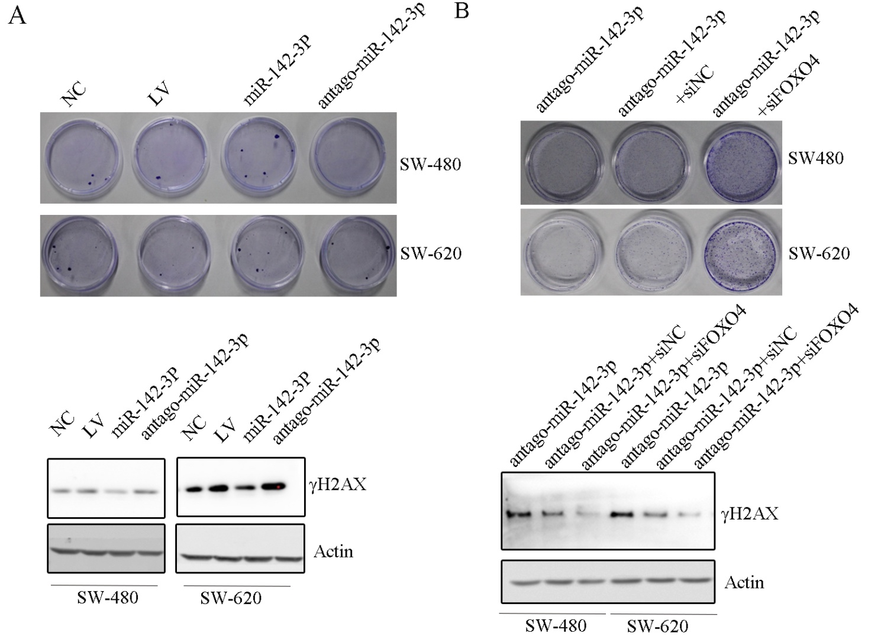
Figure S2
Figure S2,A: The colony formation assay showed the colony formation ability of NC, LV, miR-142-3p and antago-miR-142-3p of SW480 and SW620. Western blot showed the expression of γH2AX in NC, LV, miR-142-3p and antago-miR-142-3p of SW480 and SW620; B: The colony formation assay showed the colony formation ability of antago-miR-142-3p, antago-miR-142-3p+siNC, antago-miR-142-3p+siFoxo4 in SW480 and SW620. Western blot showed the expression of γH2AX in antago-miR-142-3p, antago-miR-142-3p+siNC, antago-miR-142-3p+siFoxo4 of SW480 and SW620.

