Slide 1
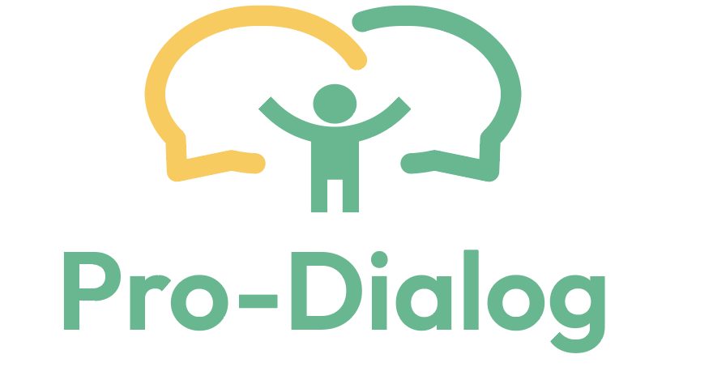
Key
A logic model of
ASSUMPTIONS
There are available resources
Sufficient information to teachers and parents
Management commitment to the project
Willingness of parents to participate
Adequate digital infrastructure and communication with project coordinator
ACTIVITIES
Recruitment of kindergarten organisations
Recruitment of parents of kindergarten children
Project coordinator emit EWQ biannually
Parents &
kg teachers respond
Project coordinator emits EWQ report
Kg teacher prepares for p-t conference
Kg teacher holds the p-t conference
INDIVIDUAL LEVEL: IMMEDIATE OUTCOMES
More equal participation between parents and teachers in meetings
Increased father participation in parent-teacher meetings
Behavior within the normal range are normalized/de-dramatized during the meeting/the dialogue
Parents and teachers more agreed on the outcome of DBED (conclusion)
INDIVIDUAL LEVEL: INTERMEDIATE OUTCOMES
… and will be offered appropriate interventions earlier ²
Children with mental health problems or developmental delay identified earlier
Improved communication and cooperation between parents and teachers
Reduced teacher stress
Reduced parental
Stress ²
More sensitive and specific problem identification
SYSTEM LEVEL: SHORT TERM OUTCOMES
Better competence in managing discrepancies between parents and teachers
Increased awareness about child mental health
Improved teacher-teacher communication
Better cooperation between health and education
LONG-TERM OUTCOMES
A more systematic use of the parent-teacher conference
Better child
mental health ¹
Less family stress
Health and development informed quality education to the child
Right service at the right time
More efficient use of the teacher's time
Health and development informed quality education to teachers (HVL)
Reduced socio-economic costs
Lower costs of care
Higher quality of care
¹ Primary outcome
² Secondary outcomes
Kg – kindergarten, EWQ – Early Worry Questionnaire, DBED – Dialogue-Based Early Detection, p-t – parent - teacher

