Slide 1
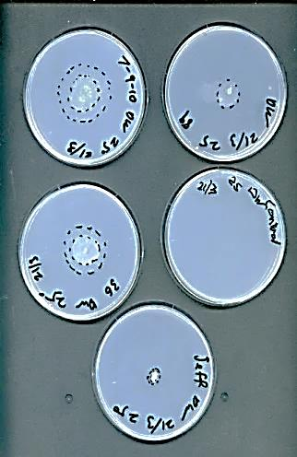
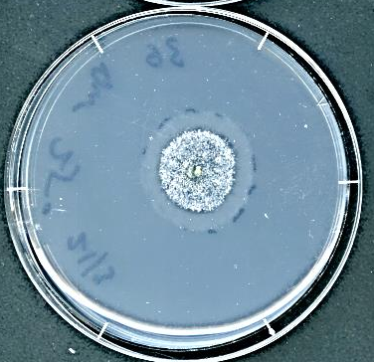
A
a
b
c
1
2
3
B
12 hr
24 hr
Growth ratio
12 hr
24 hr
Growth ratio
Fungal strains
Additional file 3

