Slide 1
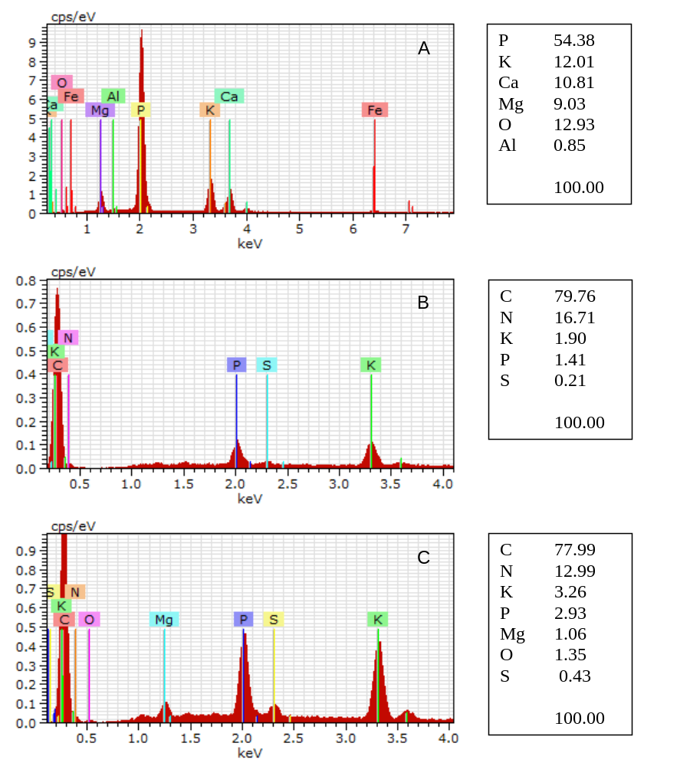
A
B
C
Additional file 8

