Slide 1
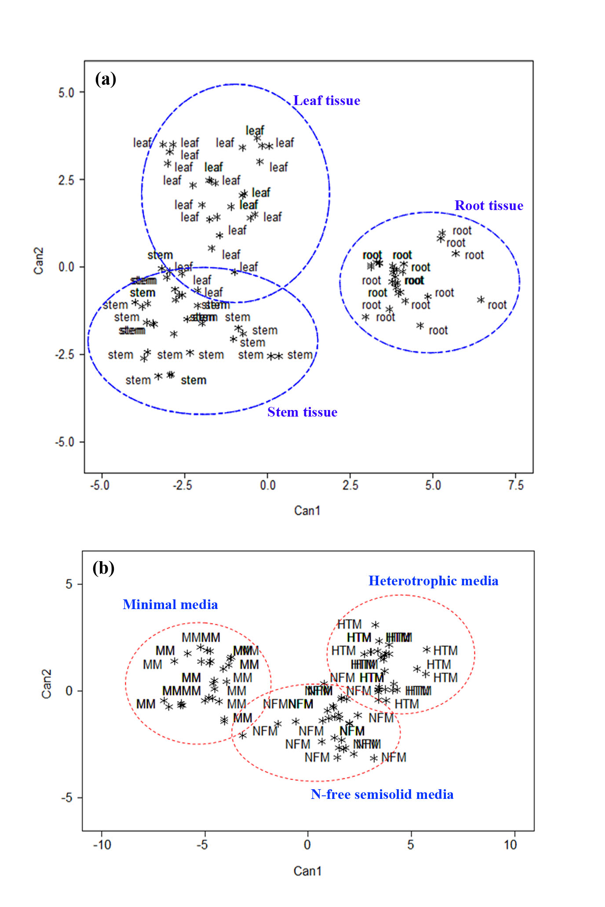
Notes:
Additional file 2: Figure S2. Discriminant function analysis. Ordination plots of variables resulting from the first (CAN1) and second (CAN2) canonical functions for different plant tissue types (a) and media (b). The variables were generated based on the total populations from different plant tissues (leaf, stem and root) and media (HTM, NFM and MM).

