Slide 1
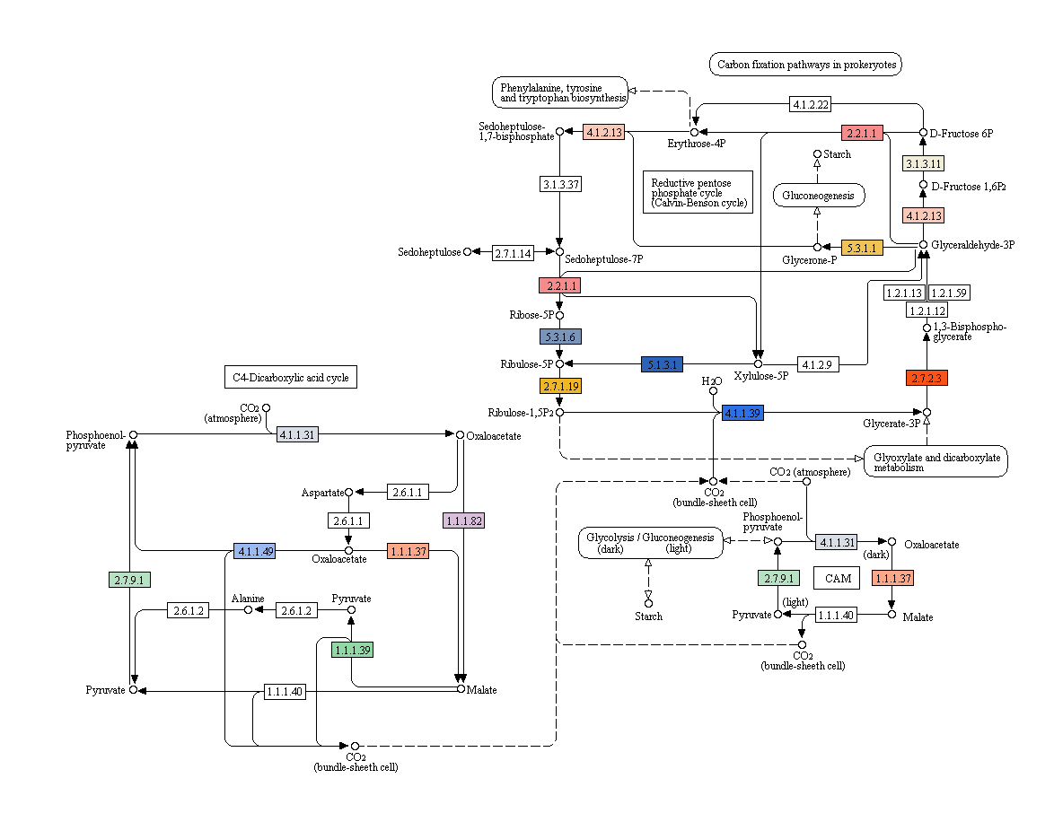
Carbon Fixation in Photosynthetic Organisms

