Slide 1
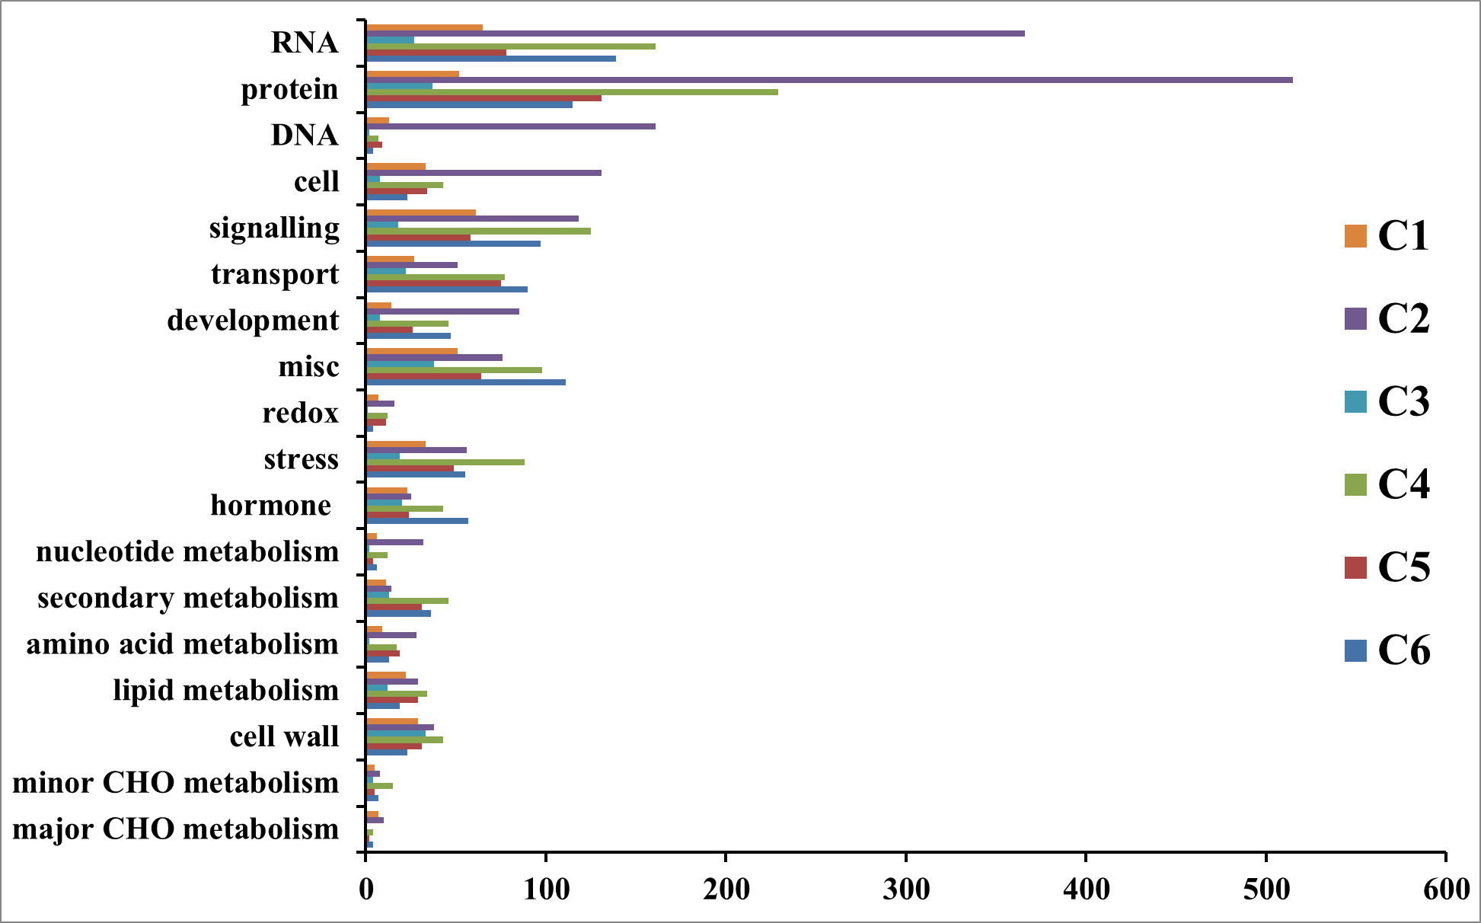
Number of genes
Additional file 10. Functional groups in one of the six clusters with at least ten differentially expressed genes between any two of the four successive sub-apical internodes (Int1-Int4) of bioenergy sorghum inbred R.07020.

