Slide 1
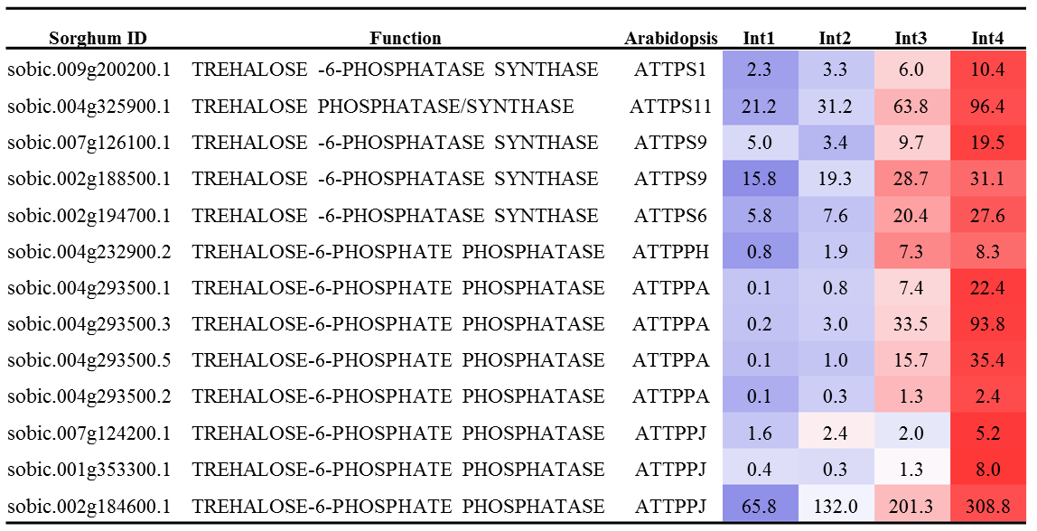
Additional file 11. The expression level in RPKM of trehalose biosynthesis genes in four sub-apical internodes (Int1-Int4) of bioenergy sorghum inbred R.07020. Int1 is the youngest internode below the shoot apex and Int4 is the oldest lower internode. Each value represent mean RPKM of three biological replicates. The expression level in each row highlighted with blue is lower and highlighted with red is higher.

