Slide 1
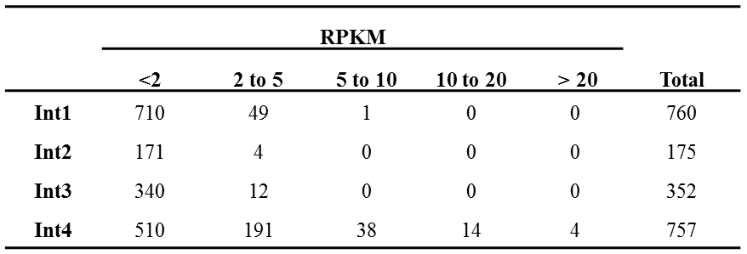
Additional file 5. The mean RPKM level of transcripts specifically expressed in one of the successive sub-apical vegetative internodes of bioenergy sorghum genotype R.07020.

