Slide 1
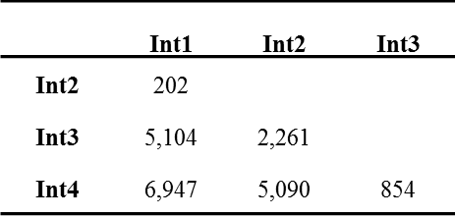
Additional file 7. The number of differentially expressed transcripts between any two successive sub-apical internodes of bioenergy sorghum genotype R.07020. Int1 is the youngest sub-apical and Int4 is the oldest internode.

