Slide 1
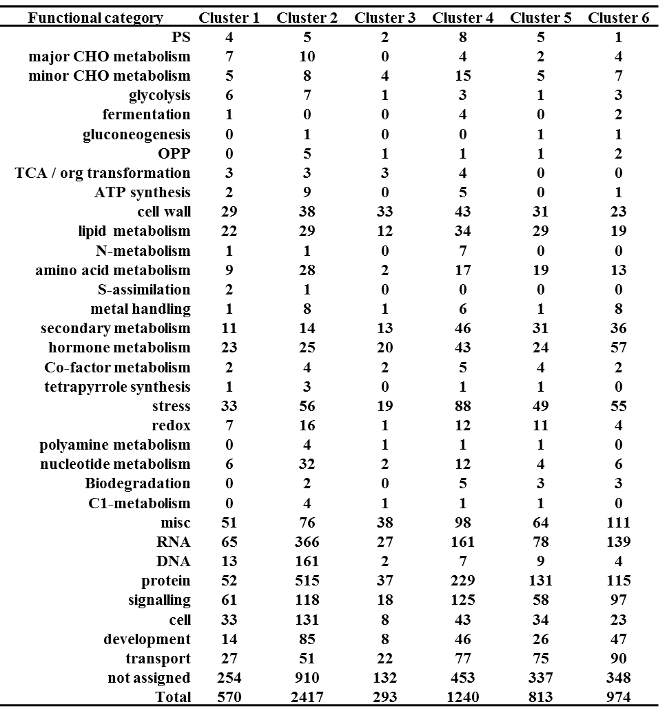
Additional file 9. MapMan classification of differentially expressed transcripts between four successive sub-apical internodes (Int1-Int4) of bioenergy sorghum inbred R.07020 grouped in six clusters.

