Slide 1
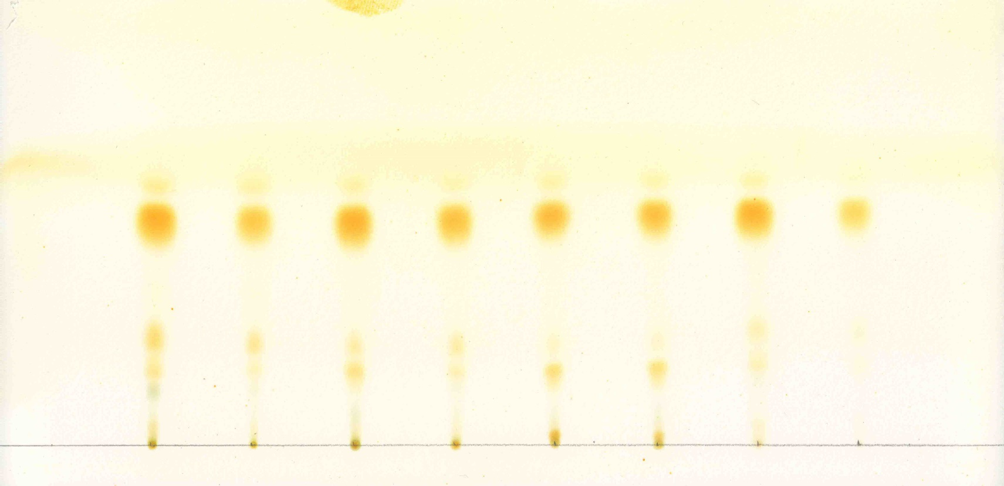
Thin-layer chromatography of the lipids extracted from Graesiella sp. WBG-1 cultivated in the 1000 m² raceway pond (sample at the 14th day)
TAGs
Thin-layer: Silica Gel GF254
Chromatographic solution: Hexane/diethyl ether/acetic acid, 7/3/1
Staining condition: Iodine Vapor 37°C 8min

