Slide 1
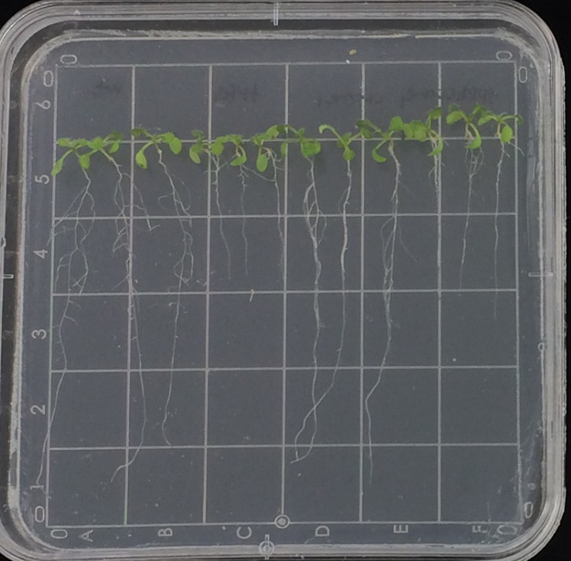
WT
fpgs1
ccoaomt1
fpgs1
ccoaomt1
Additional file 2: Fig. S1. The phenotype of 9-day-old seedlings of WT, fpgs1, ccoaomt1 and fpgs1ccoaomt1 plants. Similar to fpgs1 single mutants, fpgs1ccoaomt1 double mutants had short roots during early development.

