Slide 1
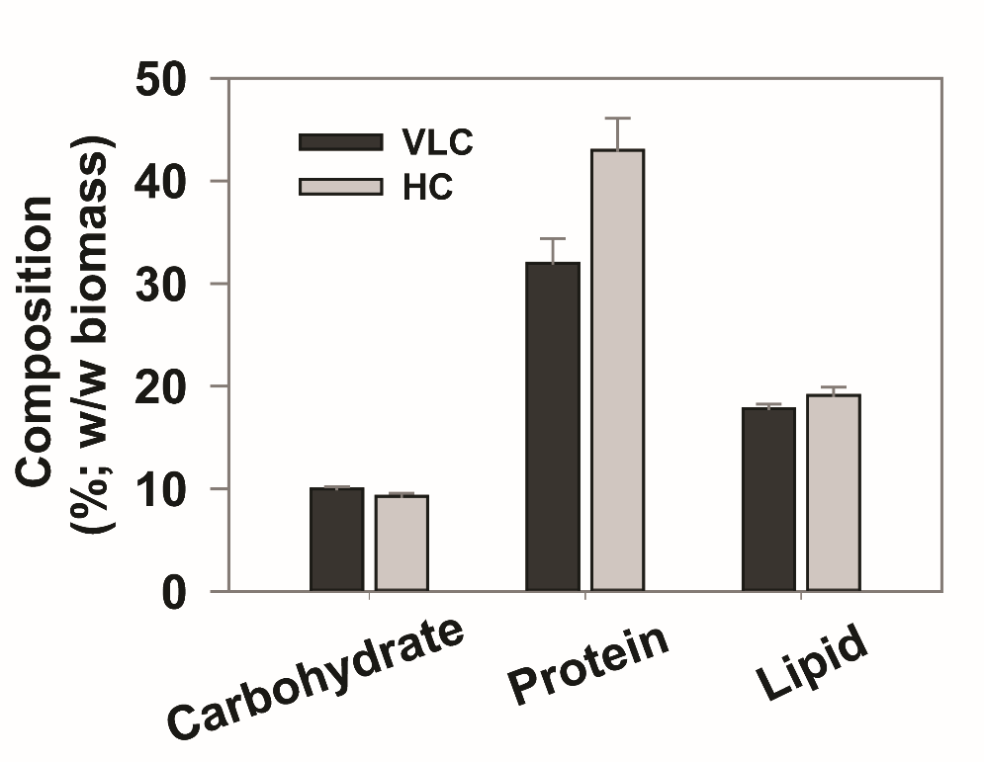
Figure S5. Contents of carbohydrate, protein and lipid under VLC and HC. The biochemical compositions of carbohydrates, proteins and lipids were measured under VLC and HC.
Data are the means ± SD of three replicates.

