Slide 1
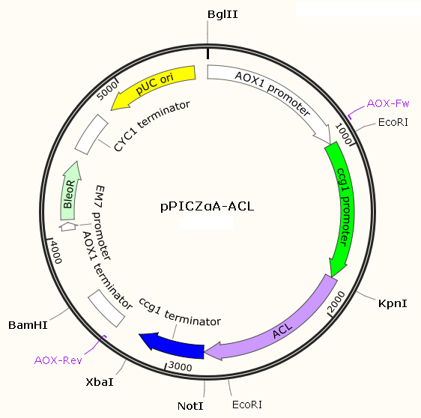
Figure S1
Figure S1. Physical map of overexpression plasmid pPICZαA-ACL.
Notes:
Additional file 1: Figure S1. Physical map of overexpression plasmid pPICZαA-ACL.

