Slide 1
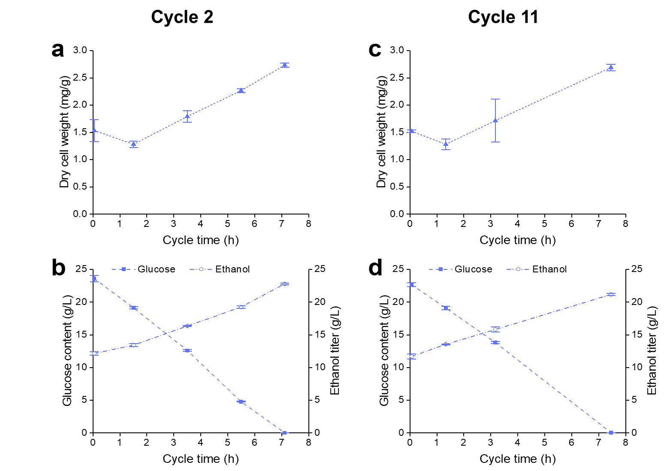
Additional Figure S5

