Slide 1
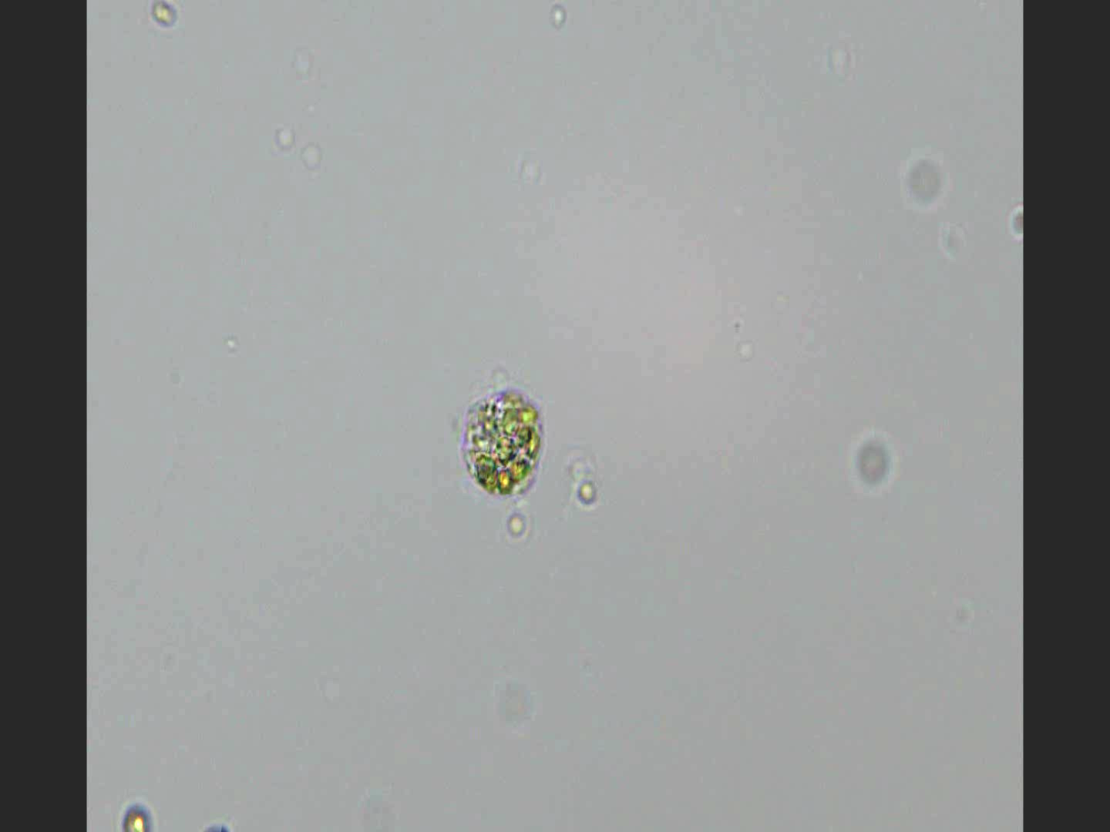


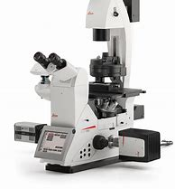
Additional file 3:
Videos showing disintegration of the grazer cells once SDBS concentration in the cell chamber got close to the minimal effective concentration (10 mg /L)
Schematic diagram of the device used to assist video recording
Cell chamber
Flagellates/Ciliates
Absorbent
paper
SDBS solution
(10 mg/L)
Micro-groove and
Liquid flow
Microscope slide

