Slide 1
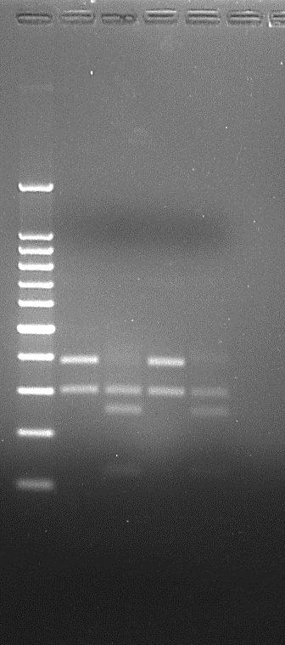
(a)
(b)
Digestion of F5H amplicon with MseI
(c)
Amplification of F5H
AnAXE 1
HrGHypAc
fah 1-2
WT
AnAXE 1
fah 1-2
AnAXE 1
fah 1-2
WT
fah 1-2
HrGHypAc
HrGHypAc
WT
Amplification of
AnAXE1
(d)
(e)
(f)
F2 Generation HrGHypAc representatives +ve for AnAXE1
F3 Generation HrGHypAc Representatives +ve for AnAXE gene
AnAXE 1
fah 1-2
HrGHypAc
WT
(g)
(h)
Day 0
Day 3
**
**
**
**
Figure S1. a. Gene specific amplification of F5H gene b. MseI digestion of F5H gene amplicon, c. Qualitative analysis through HPLC-DAD of sinapoyl malate in methanolic extract of fresh leaves. d. Gene specific amplification of AnAXE gene e. Genotyping of F2 and F3 generation representatives of HrGHypAc line positive for AnAXE. f. Expression analysis of AnAXE in 35S:AnAXE and HrGHypAc. g. Defense response of parents and HrGHypAc to the infection of Pst DC3000 with respect to the wild type in bacterial accumulation of the infiltrated leaves. h. Expression of defense-related genes in Day 0 and Day 3 leaf of Pst DC3000 infected samples. Data represents mean, n = 3 biological replicates, Student’s t-test at ***p ≤ 0.01, **p ≤ 0.05, * p ≤ 0.1.

Slide 2
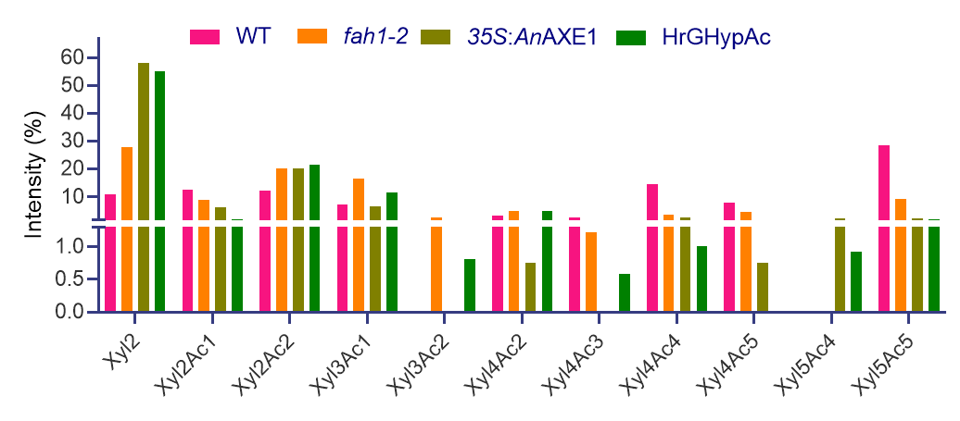
(a)
(b)
WT
Xyl2Ac1, m/z 347
Xyl4Ac5, m/z 779
Xyl2Ac2, m/z 389
Xyl3Ac2, m/z 521
Xyl5Ac5, m/z 911
Xyl3Ac1, m/z 479
Xyl4Ac3, m/z 695
Xyl2, m/z 305
Xyl4Ac4, m/z 737
Xyl4Ac2, m/z 653
Xyl5Ac4, m/z 869
(c)
fah1-2
Xyl2
Xyl2Ac2
Xyl3Ac1
Xyl4Ac2
Xyl2Ac1
Xyl4Ac3
Xyl4Ac4
Xyl3Ac2
Xyl4Ac5
Xyl5Ac4
Xyl5Ac5

Slide 3
(d)
35S:AnAXE1
Xyl2
Xyl2Ac2
Xyl2Ac1
Xyl3Ac1
Xyl4Ac4
Xyl5Ac5
Xyl4Ac3
Xyl4Ac5
Xyl5Ac4
Xyl3Ac2
Xyl4Ac2
(e)
HrGHypAc
Xyl2
Xyl2Ac2
Xyl3Ac1
Xyl2Ac1
Xyl4Ac2
Xyl4Ac3
Xyl5Ac4
Xyl5Ac5
Xyl3Ac2
Xyl4Ac4
Xyl4Ac5
Figure S2. MALDI TOF analysis. a. Representation of relative intensity of xylo-oligosaccharides after xylanase digestion calculated from raw mass spectra of b. Wild type, c. fah1-2, d. 35S:AnAXE1, e. HrGHypAc by MALDI-TOF.

Slide 4
(a)
(b)
(c)
(d)
Figure S3. a. ABSL content after pectin extraction in sequential extraction, b. ABSL content after xylanase digestion in sequential extraction, c. ABSL content after saccharification in sequential extraction. d. Xylose extractability through glycome antibody profiling in 1M KOH, 4M KOH samples and their combined representation. Data represents mean ± SE, n = 3 biological replicates, Student’s t-test at ***p ≤ 0.01, **p ≤ 0.05, * p ≤ 0.1.

Slide 5












WT
fah1-2
35S:AnAXE1
HrGHypAc
Cellulose
Xylan
O-Acetyl groups
S-Lignin
G-Lignin
Xylanase
Figure S4. A proposed model based on xylan digestibility experiments that explains WT xylan accessibility is limited because of hyper-acetylation, and the presence of abundant S lignin. fah1-2 and 35S:AnAXE1 xylan accessibility is increased because of less proximity between lignin-xylan and deacetylation of xylan, respectively. Enhancement in HrGHypAc xylan accessibility is because of the slight decrease in xylan acetylation and G lignin abundance. HrGHypAc line deposits more cellulose probably because of change in cell wall integrity.

