Slide 1
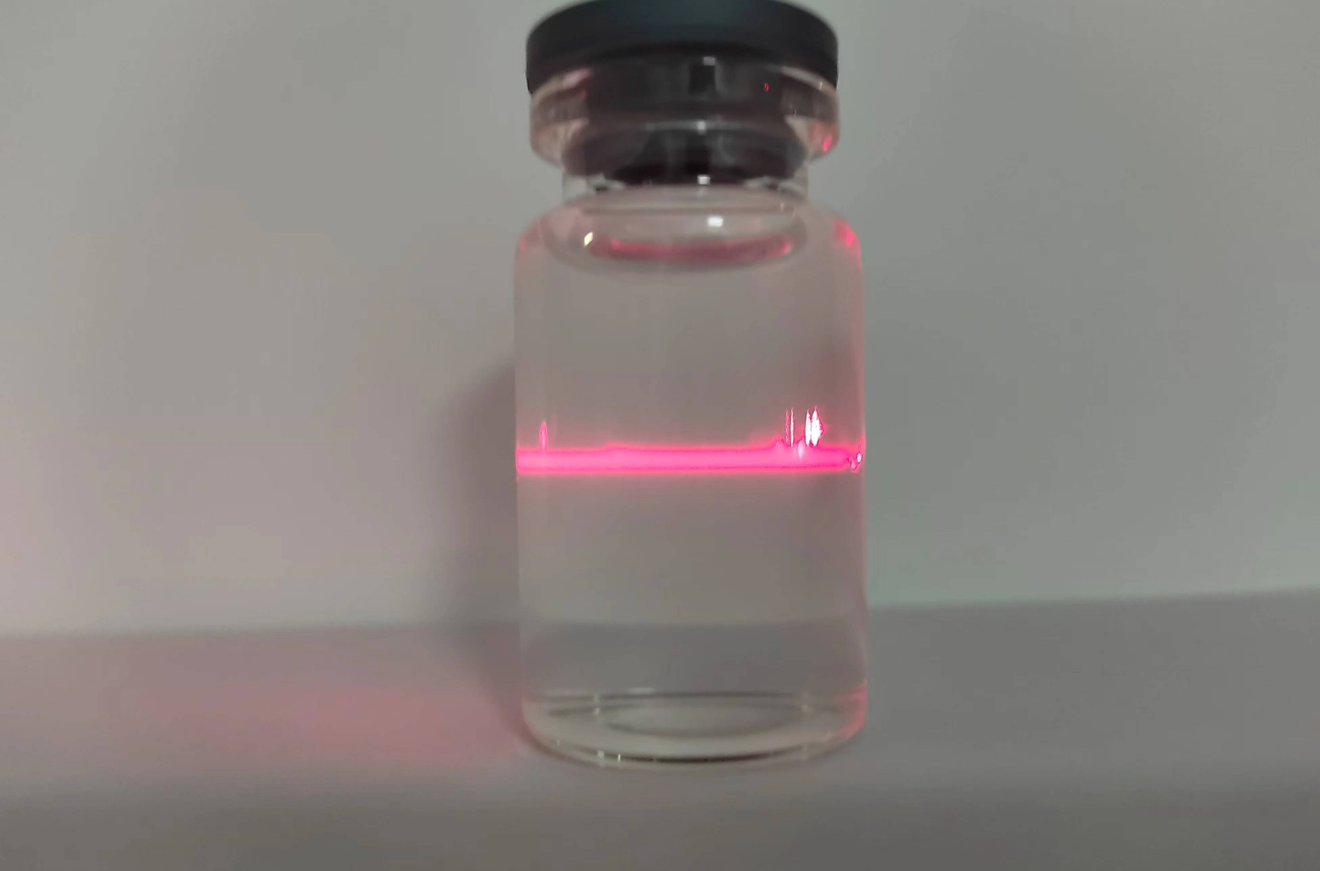
A
Lignocellulose
B
8% NaClO₂
De-lignin
Holocellulose
4 M KOH
Supernatant
Residues
Neutralized
Ethanol
Precipitate
Crude cellulose
Ultrasonication
Self assembly
Nanocrystals/Nanoparticles
Supplemental Figure 3. Schematic overview of xylan isolation, purification and nanoparticles synthesis.

