Slide 1
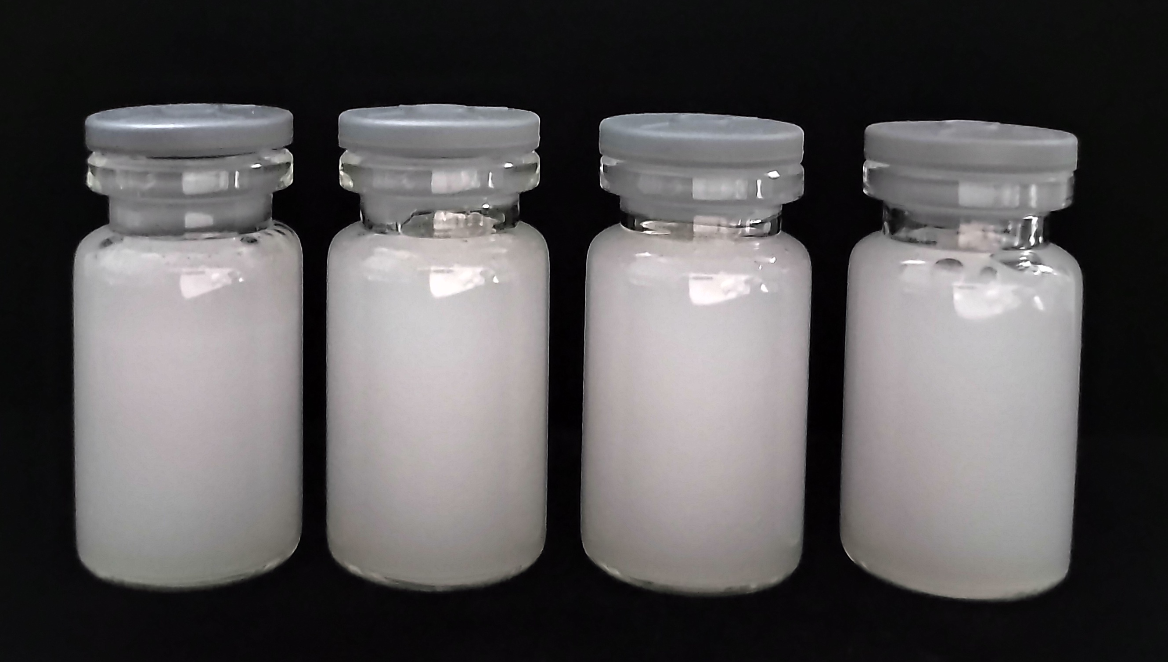
A
B
AtXAT2/Col.0
AtXAT2/atdgux
Nanocrystals/Nanoparticles
Col.0
atdgux
Dodecane
Coarse oil-in-water emulsions
High shear blender
Pickering emulsions
Supplemental Figure 4. Schematic overview of purification Preparation Pickering emulsion.

