Slide 1
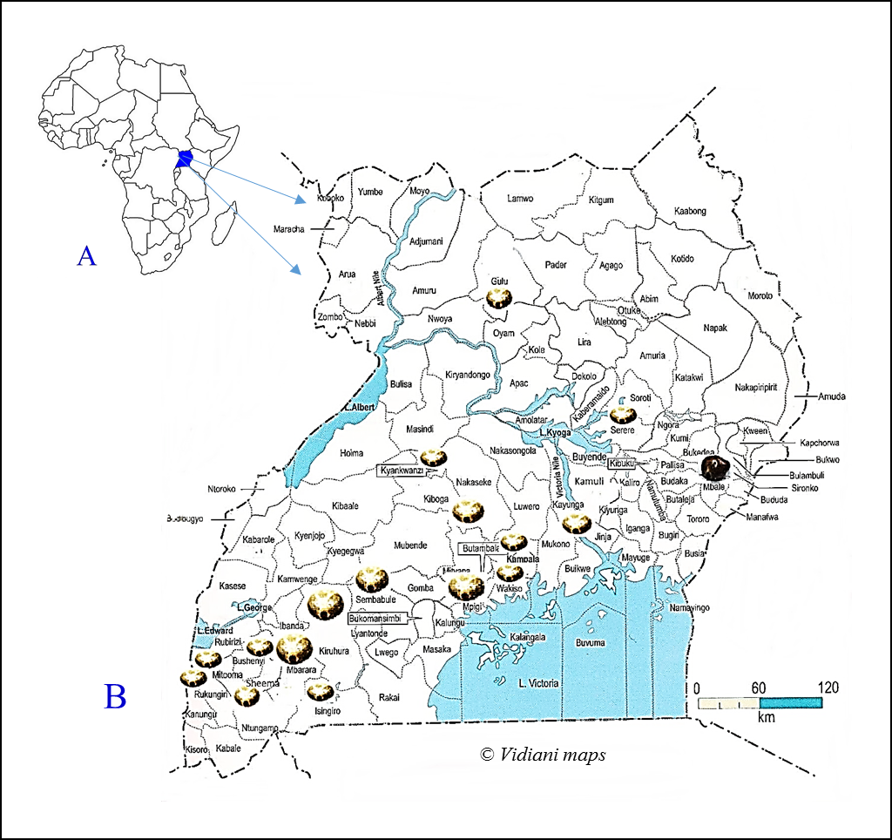
Additional file 1: Figure S1. Map of Uganda showing the various districts from which tick samples were collected.
A, Map of Africa showing Uganda. B, Map of Uganda showing the areas from which ticks were collected (depicted by ticks).

