Slide 1
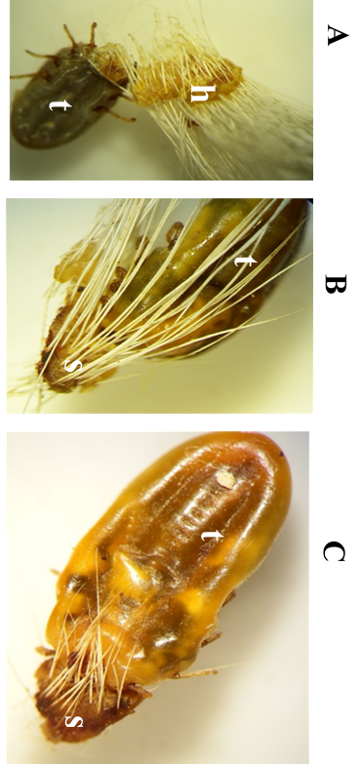
Additional file 2: Figure S2. R. decoloratus picked from cattle with acaricide induced skin damage.
A, Hair bundle (h) that detached from the skin of cattle as the tick (t) was picked;
B, Damaged cattle skin (s) that was easily detached with the tick (t);
C, The piece of damaged skin (s) firmly attached to the mouth part thus altering the gross morphological appearance of the cephalus region of tick (t); farmer considered these “new” species of ticks.

