Slide 1
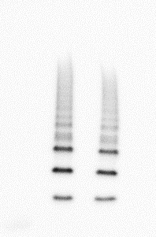
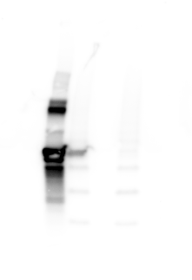
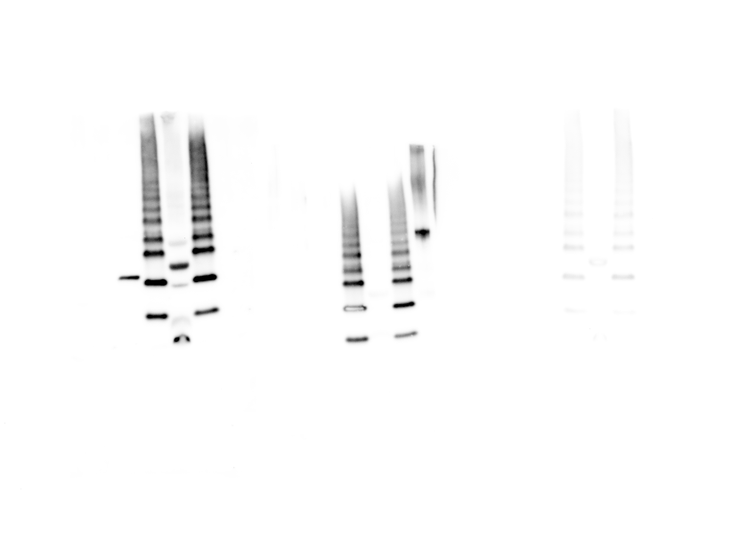
B. caballi anti-Sbp4
B. bovis anti-Hap2
pre-immune rabbit
B. caballi anti-Rap1
1 2 L 3 L 4
1 2 L 3 L 4
1 2 L 3 L 4
1 2 L 3 L 4
~80 kDa
~50 kDa
~30 kDa

