Slide 1
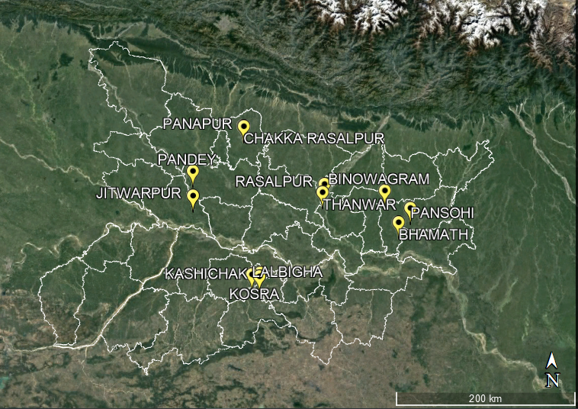
KA OUTBREAKS | BIHAR

Slide 2
Villages in Dumra Block, Sitamarhi
Visceral leishmaniasis cases
Year and month of fever onset

Slide 3
Villages in 3 blocks of Purnia
Visceral leishmaniasis cases
Year and month of fever onset

Slide 4
Jitwarpur village, Dariyapur Block, Saran
Visceral leishmaniasis cases
Year and month of fever onset

Slide 5
Villages in 2 blocks of Saharsa
Visceral leishmaniasis cases
Year and month of fever onset

Slide 6
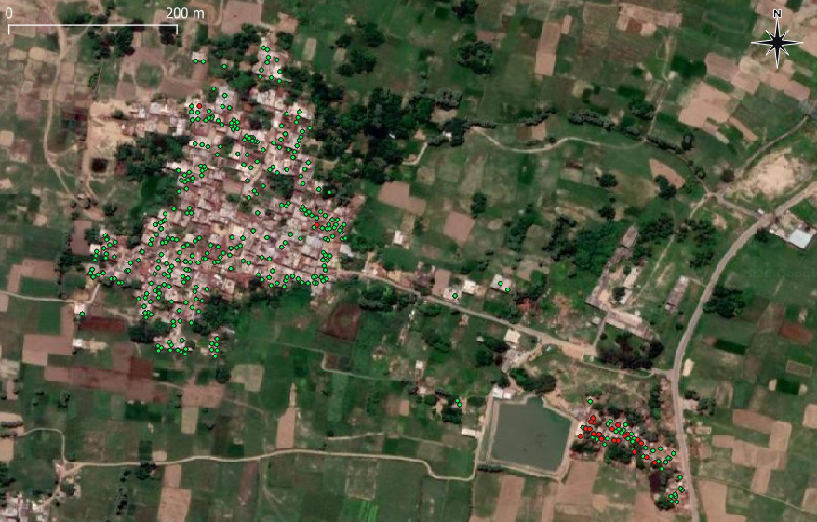
LALBIGHA, NAWADA
● CASE
● NON CASE

Slide 7
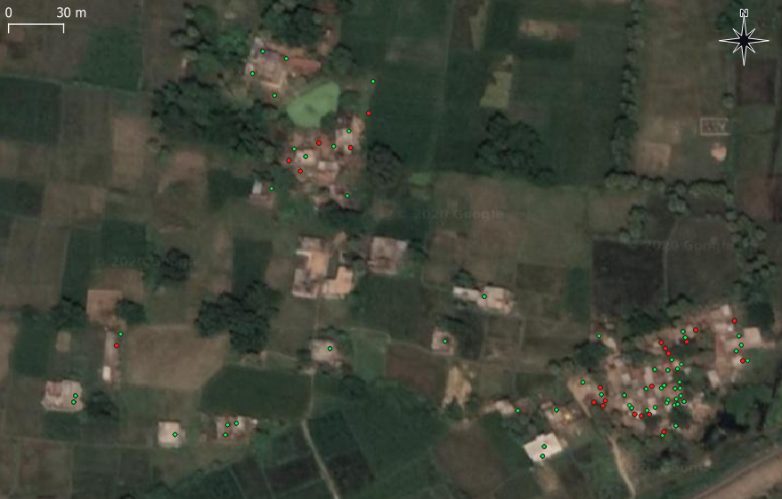
KASHICHAK, NAWADA
● CASE
● NON CASE

Slide 8
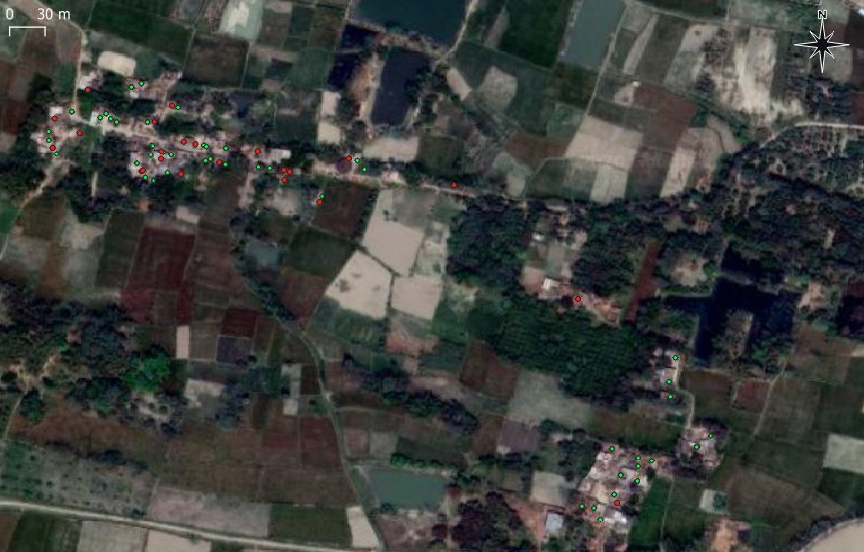
CHAKKA MAJHAULIYA, SITAMARHI
CHAKKA MAJHAULIYA
● CASE
● NON CASE
CHAKKA RASALPUR
PANAPUR

