Slide 1
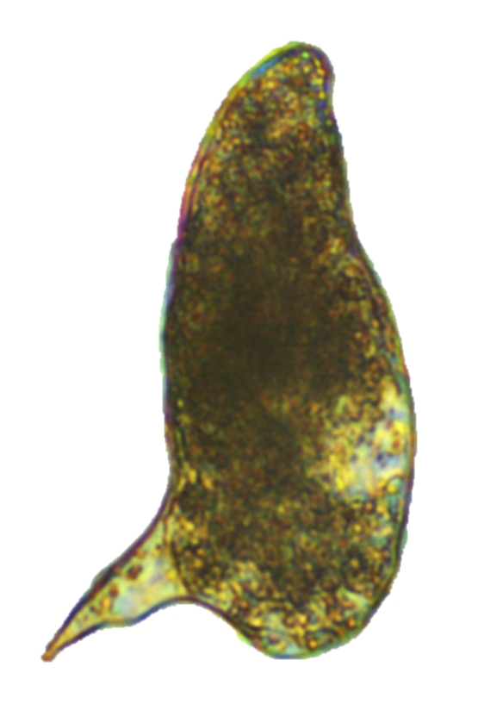
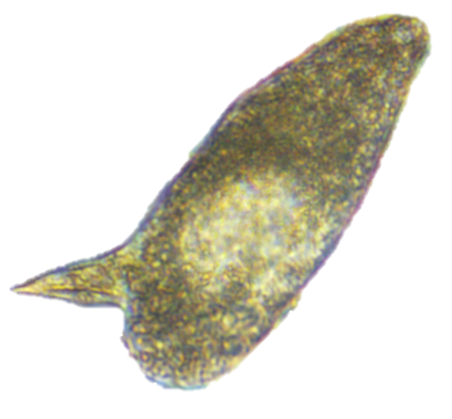
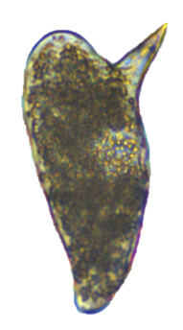
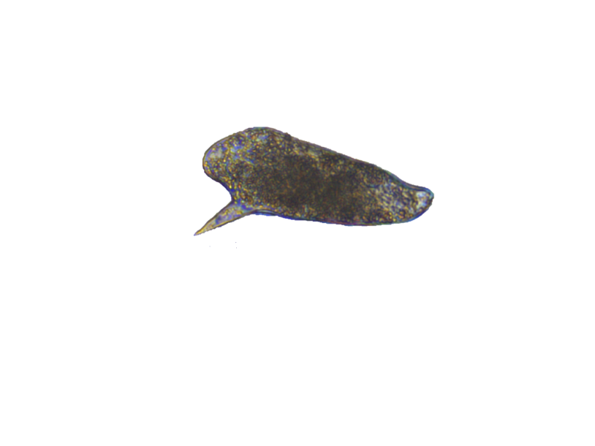
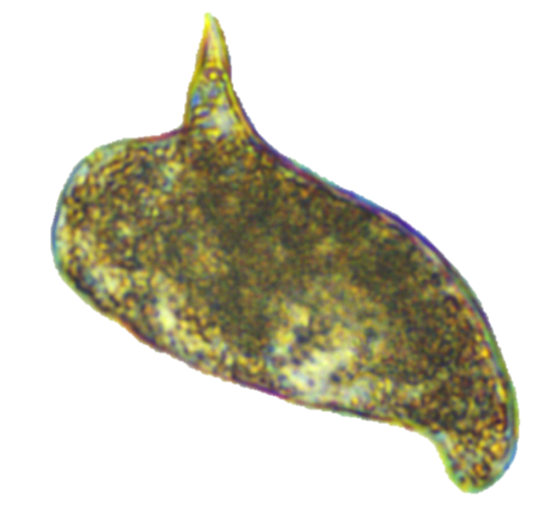
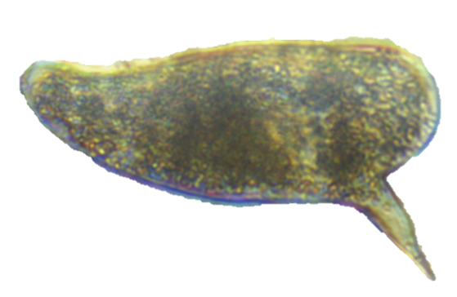
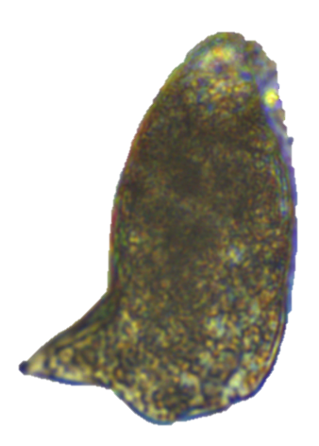
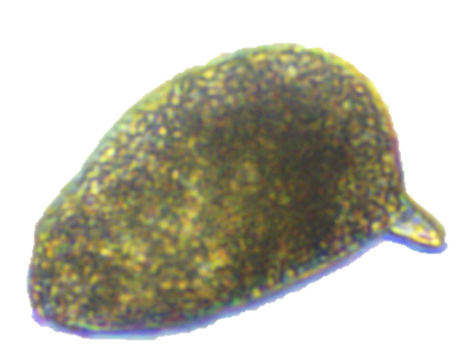
a Number of eggs released by females incubated with different concentrations of GSK-J4 and GSK-J5.
b Area measured (µm²) of S. mansoni eggs after treatment. Note that for 1mM, 5mM GSK-J4 and 30 mM GSK-J5 the oviposition was very low, compromising morphometric measurements.
c Images of eggs measured in b illustrating phenotypic alterations related to the effect of 0.2 mM and 0.8 mM GSK-J4, and 20 mM GSK-J5 (Scale-bar: 25 μm).
Control
0.2
0.8
0.2
0.8
1
5
20
GSK-J4 (μM)
GSK-J5 (μM)

