Slide 1

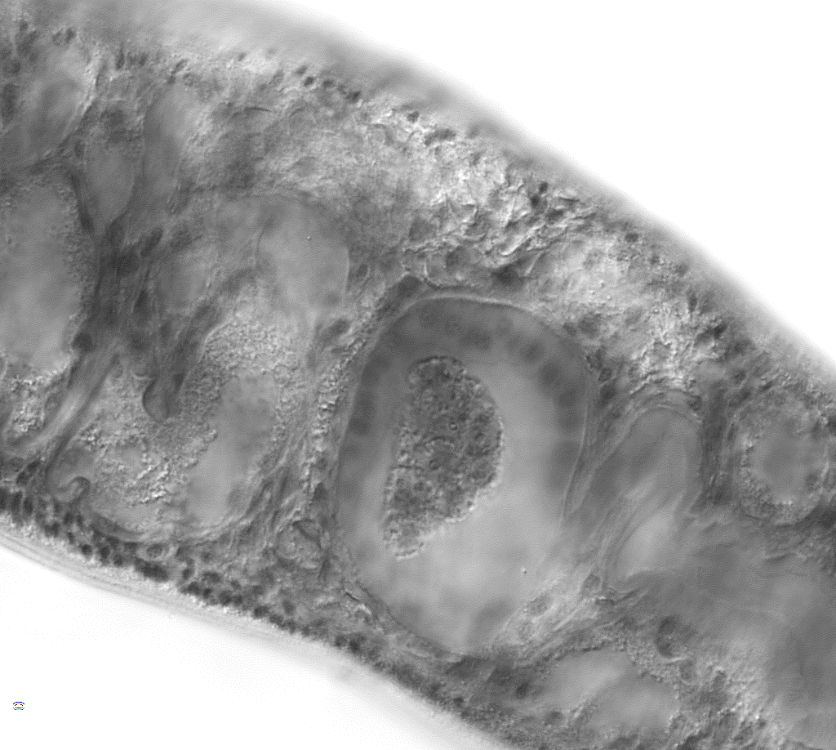
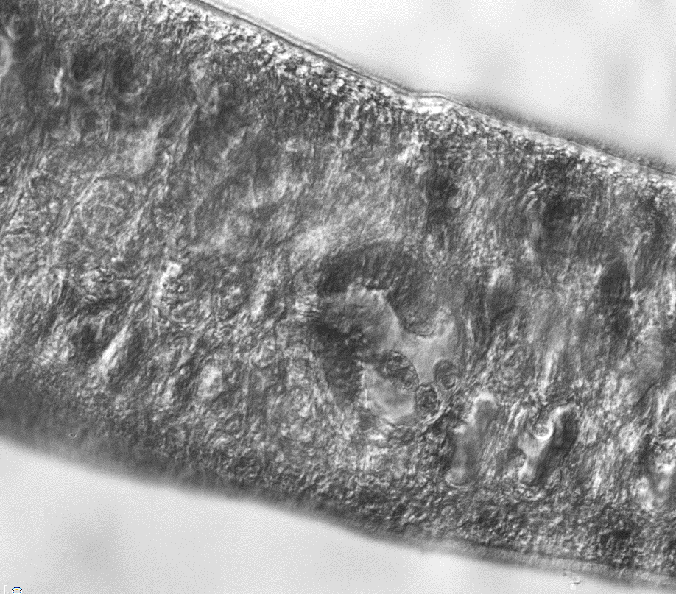
a Schematic drawing illustrating the position of female gonads highlighting the ovary (ov) and the ootype (ot) (red dashed boxes), also represented is the vitellaria (vt) and Mehlis’s gland (mg). b-g Ovary region showing normal numbers of immature (io) and mature (mo) oocytes. Treatment with GSK-J4 promotes cellular disorganization (cd) as revealed by the presence of spacing between cells. h-m Ootypes reveling the presence of normal eggs (ne), maturing eggs (me), dead eggs (de), vitelline cells (vc), zygote (z) and spine (s). n-s Differential interference contrast (DIC) of the correspondent images in (h-m). AFA-fixed whole mount adult worm stained with Langeron's carmine Scale-bars: 50 µm. Panel a of this figure is adapted from [51].
a
ov
ot
vt
mg
b
h
n
Control
io
s
ne
mo
ot
z
vc
c
i
o
io
me
GSK-J5 5 μM
ot
z
vc
mo
d
j
p
GSK-J5 20 μM
me
vc
mo
io
ot
z
e
k
q
GSK-J4 800 nM
vc
io
ot
mo
f
l
r
io
de
GSK-J4 7.5 μM
mo
cd
s
ot
g
cd
m
s
de
mo
GSK-J4 20 μM
s
ot
io

