Slide 1
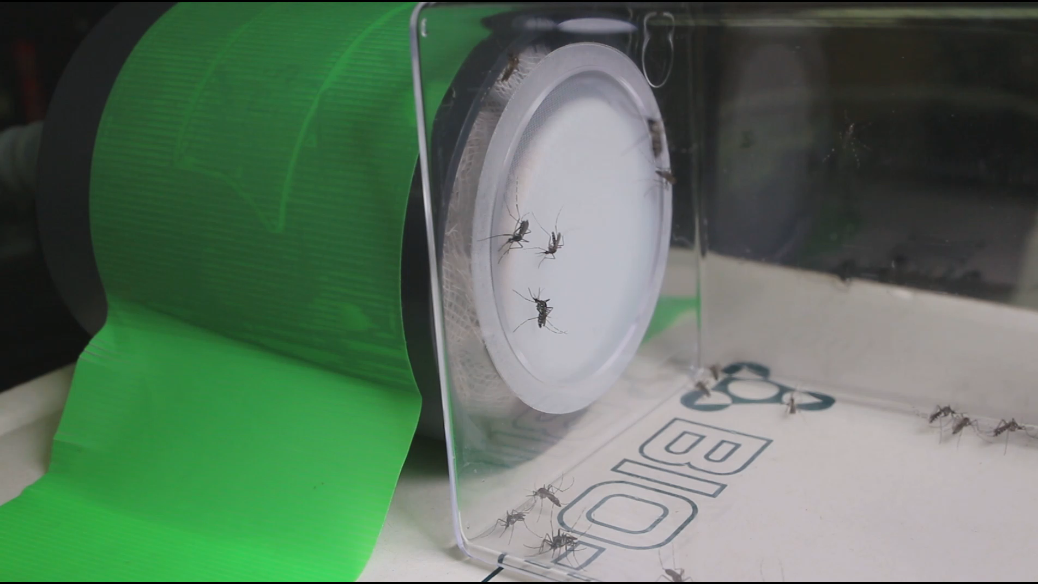
Aedes albopictus
Control

